Slide 1
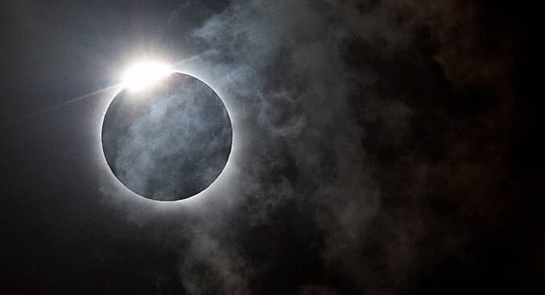





Eclipse Resources for Public Libraries

Slide 2


Date and Location
Today's Agenda
After Lunch Break
Facilitators
Names here
Agenda here
Agenda here

Slide 3

SEAL
Introductions
Please share your name, location, position

Slide 4

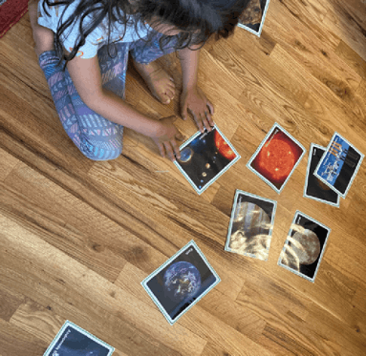
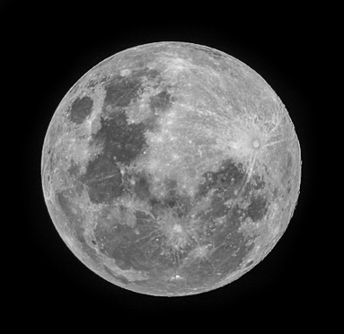


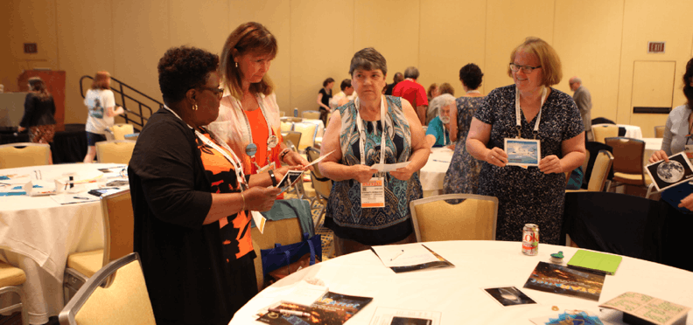


Sorting Games:
How Big? How Far? How Hot?
Work together to sort the cards in order of:
Green border = size (smallest to largest)
Blue border = distance (closest to farthest from Earth)
Red border = temperature (coldest to hottest)
ALA STEM Learning 2016
Notes:
While playing Sorting Games, participants will have the opportunity to share what they know about objects in our solar system and objects that are further in space. Most people, including very educated people, confuse the terms solar system, galaxy, and universe. Astronomers still have much to discover about objects in our solar system, our galaxy, and distant galaxies from the beginning of the universe. Engineers and technicians continue to create better and better tools to help explore these mysteries.
Telescopes, such as Hubble and James Webb, collect light from these objects – such as distant stars, planets, and galaxies. We can use them to take amazing and useful pictures and analyze the light to tell us more about these distant objects.

Slide 5

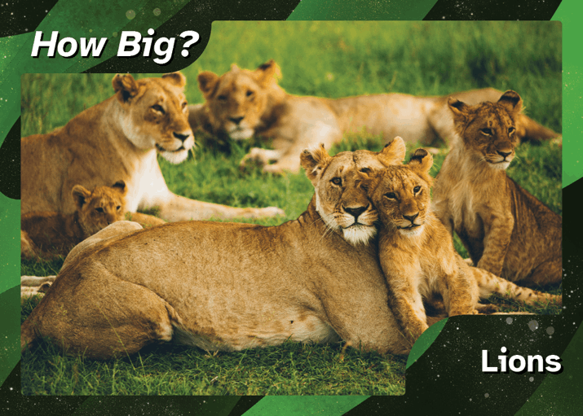
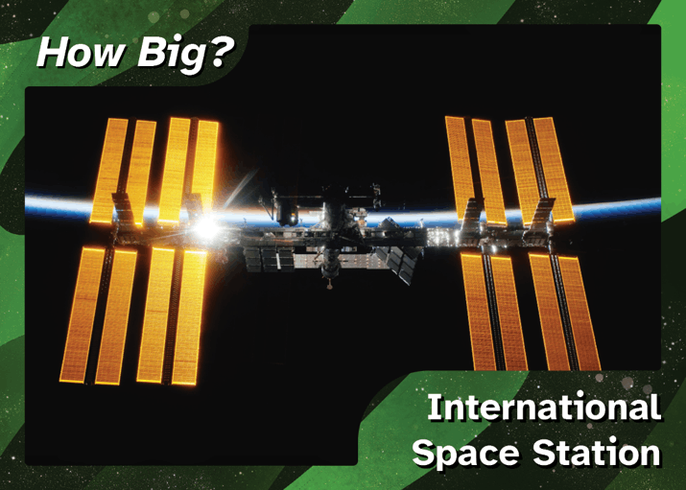
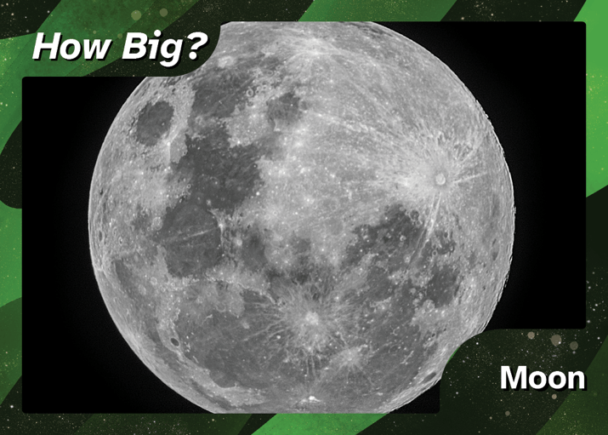
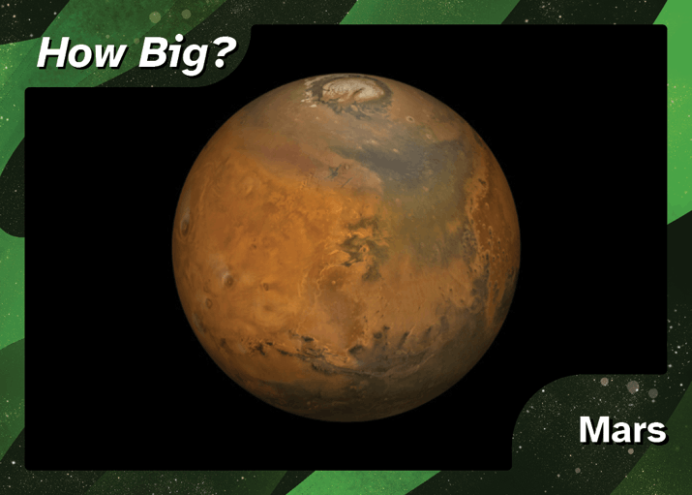
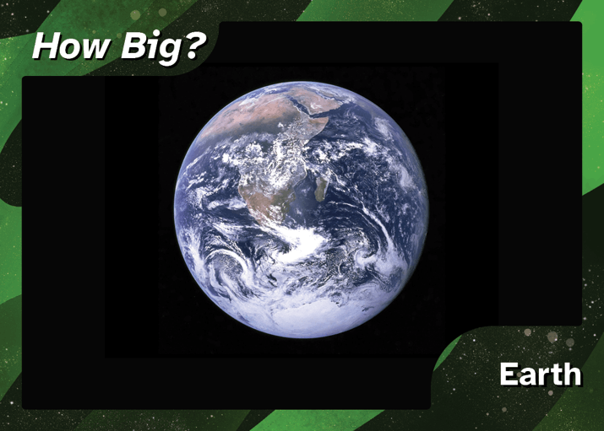
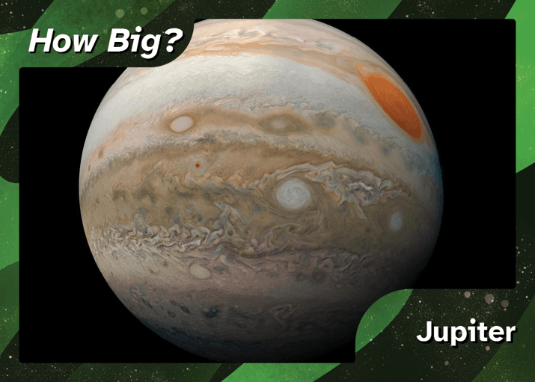
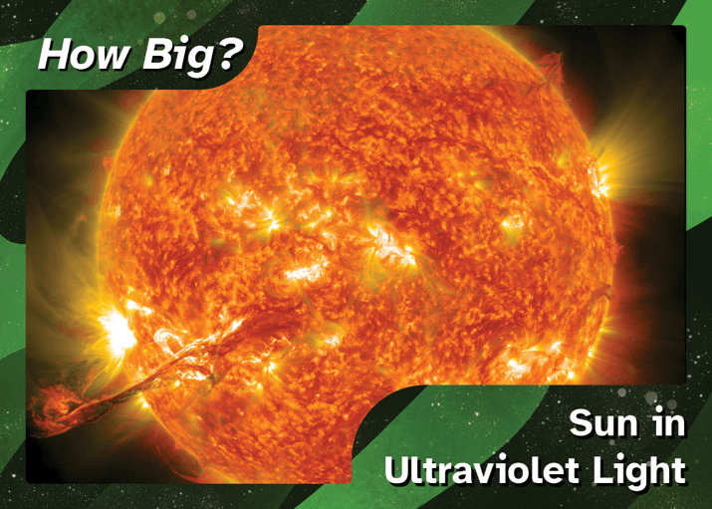
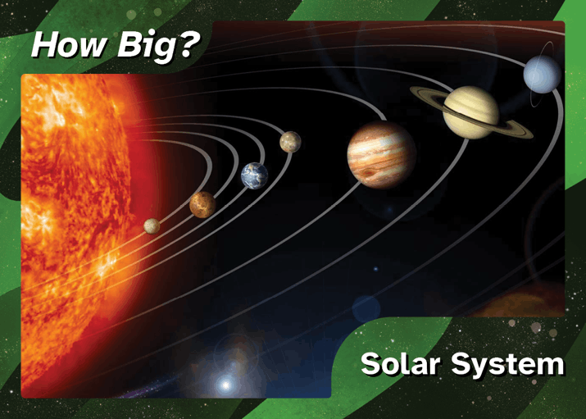
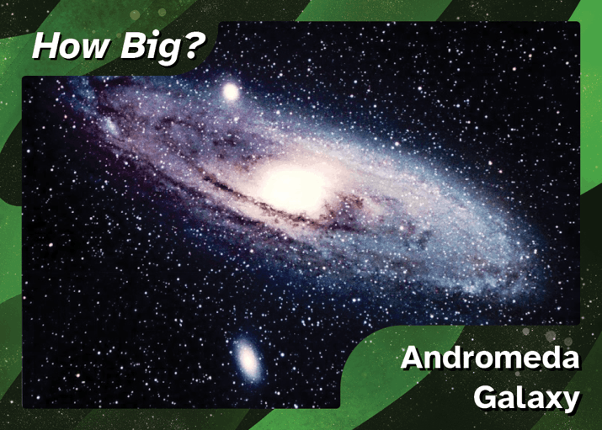
How Big?
Lions
International Space Station
Moon
Mars
Earth
Jupiter
Sun
Solar System
Andromeda Galaxy

Slide 6

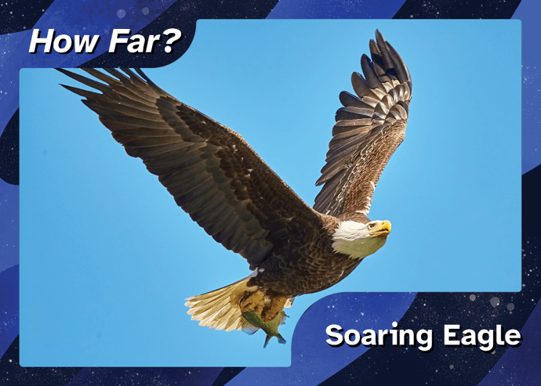
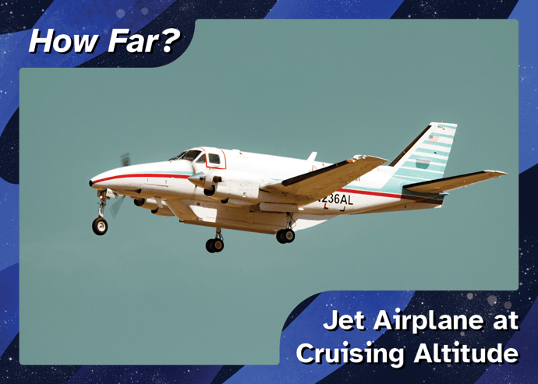
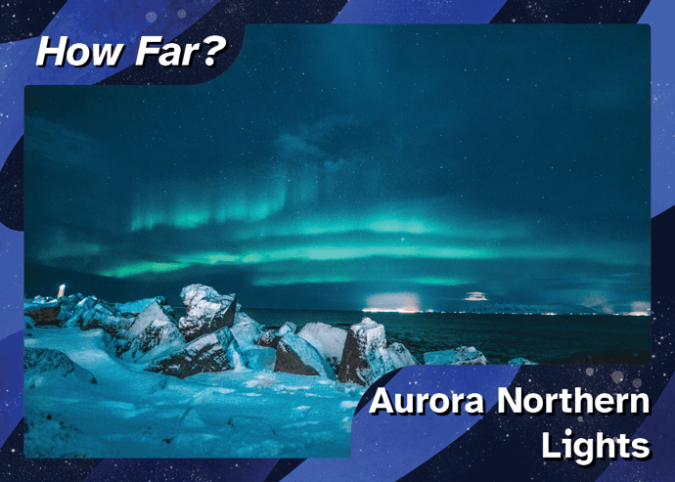
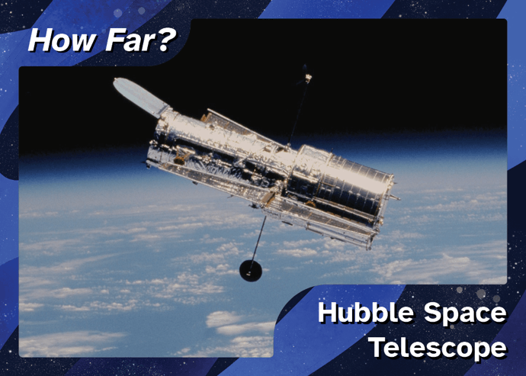
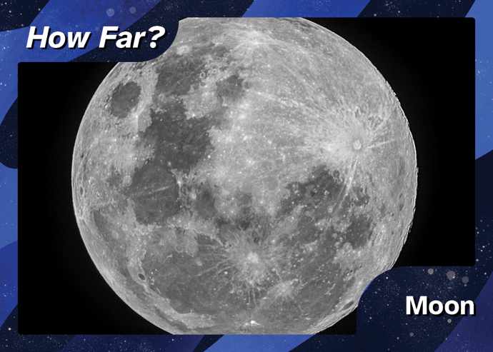
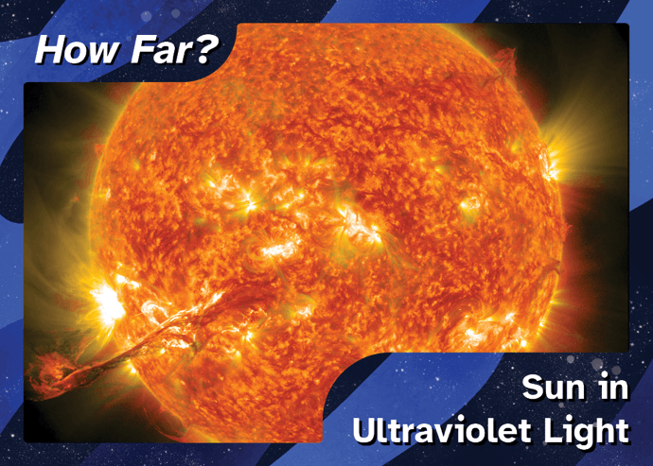
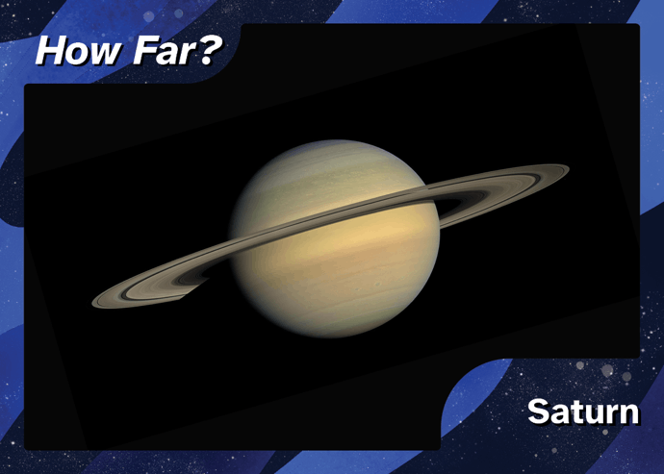
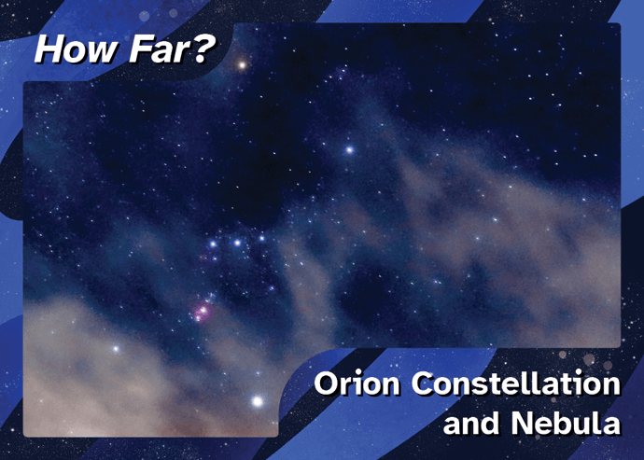
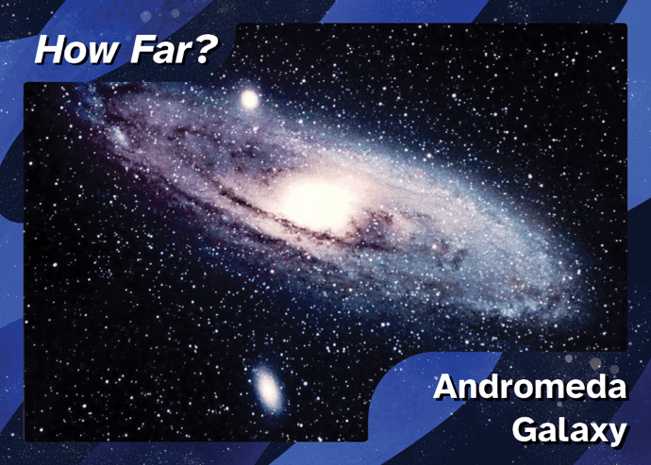
How Far?
Eagle
Jet
Aurora
Hubble Space Telescope
Moon
Sun
Saturn
Orion Nebula
Andromeda Galaxy
Notes:
Eagles can fly very high (about 10,000 feet) though jets can fly higher (about 35,000 feet). - Aurora’s happen in the highest levels of Earth’s atmosphere (about 100 miles up). - The Hubble Space Telescope is in space and orbits Earth about 350 miles about the surface. - The Moon is 240,000 miles, the Sun is 93 million miles, and Saturn is 1 billion miles from Earth. - Constellations are all made up of stars within our own Milky Way Galaxy. Distances at this scale are measured in light-years, the distance light travels in one year (about 6 trillion miles).
- The International Space Station orbits around Earth at a distance of 600 kilometers (373 miles). - How far from Earth is the Sun? The Sun is 1 Astronomical Unit = 150,000,000 kilometers (93 million miles) from Earth. - How far from Earth is Saturn? From 9 AU to 11 AU (about 1 billion miles away). It depends on which side of the Sun Saturn is, relative to Earth. - How far away are the stars we see at night? That depends on the star. The brightest stars of the Big Dipper, for example, are between 70 and 100 light-years from Earth. A light-year is about 10 trillion kilometers (6 trillion miles). 10 trillion = 10,000,000,000,000. But the stars we see at night are well within our own Milky Way galaxy. - How far away is the galaxy in the image from Earth? The Andromeda Galaxy, M31, is more than 2 million light-years from Earth.

Slide 7

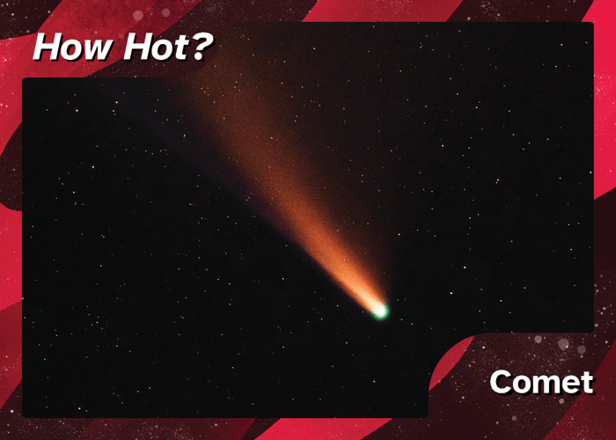
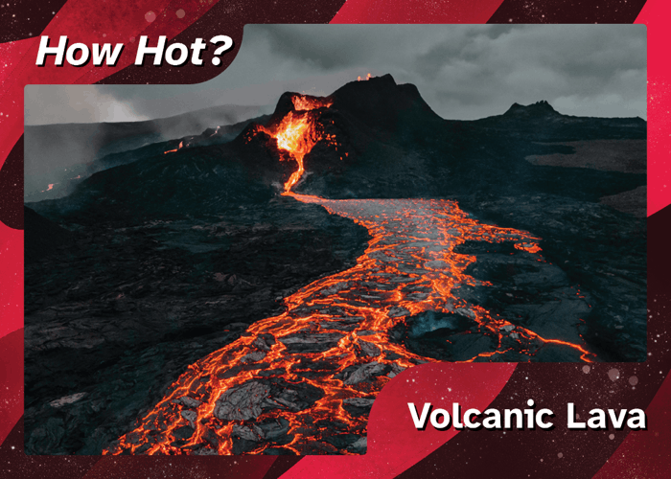
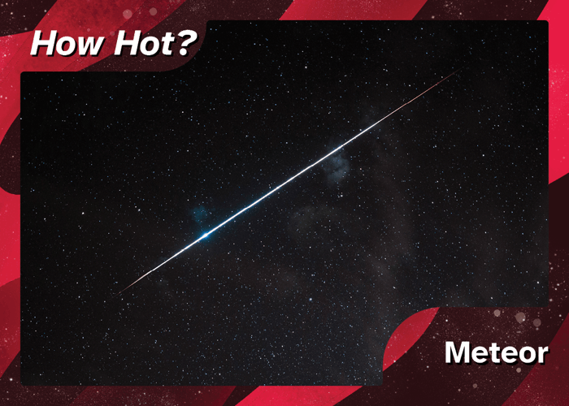
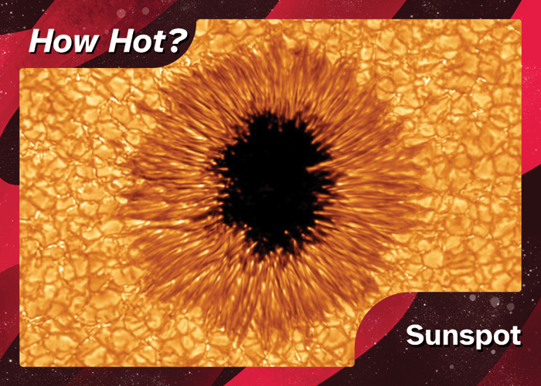
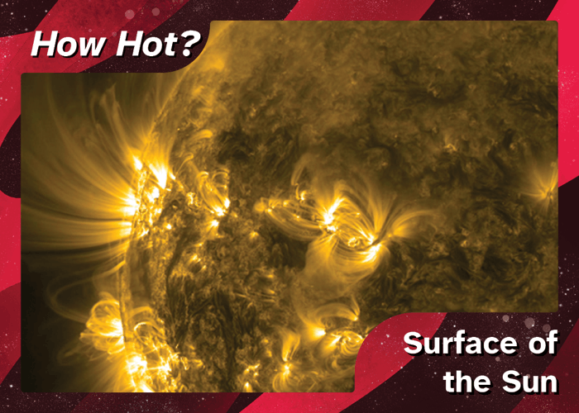
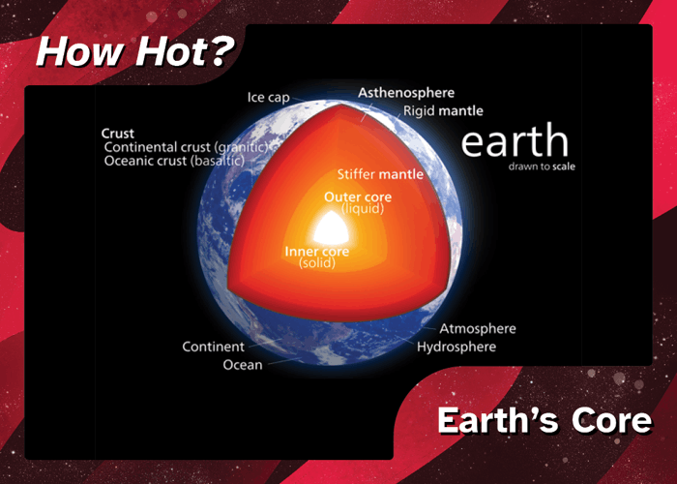
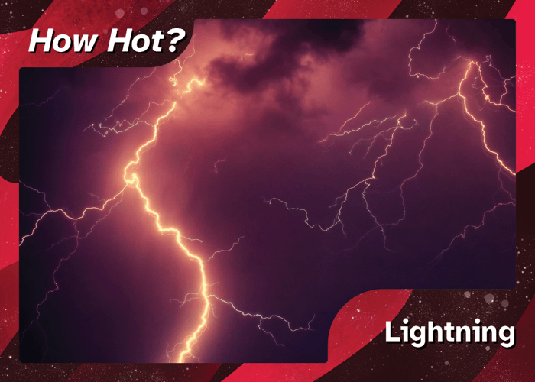
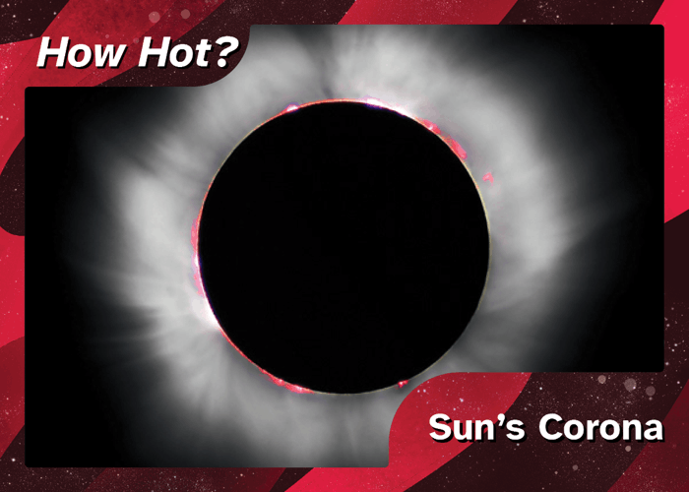
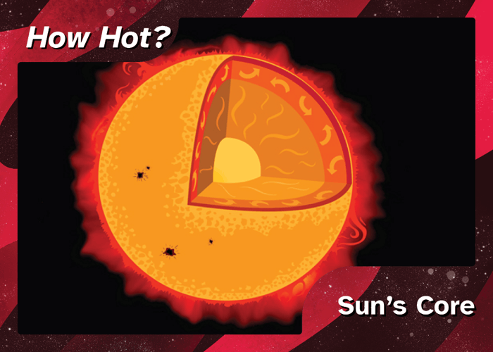
How Hot?
Comet’s Surface (171 °F; 77 °C)
Lava (1,832 °F; 1,000 °C)
Meteor (3,100 °F; 1,700 °C)
Sunspot (6,332 °F; 3,500 °C)
Sun’s Surface (9,932 °F; 5,500 °C)
Earth’s Core (10,832 °F; 6,000 °C)
Lightning Bolt (52,232 °F; 29,000 °C)
Sun’s Corona (3.6 million °F; 2 million °C)
Sun’s Core (27 million °F; 15 million °C)

Slide 8

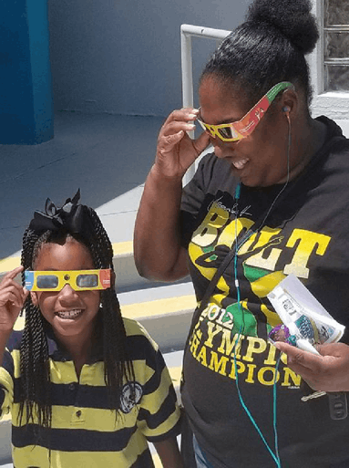
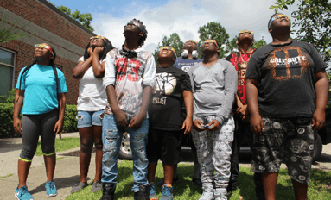
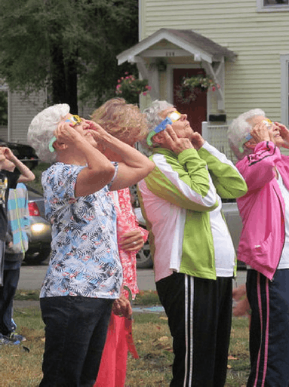
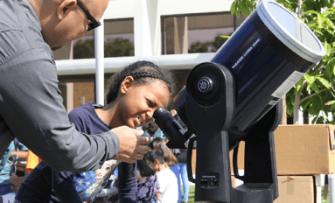
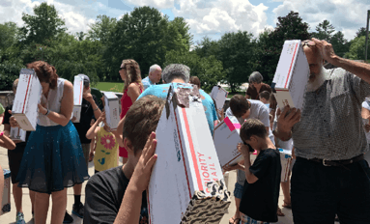
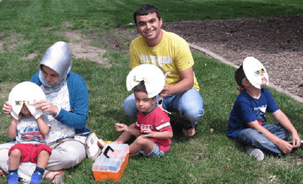

The 2017 Great American Eclipse
Notes:
Turn and talk with your neighbor: share a memory from the 2017 eclipse. If you weren't working at a library in 2017 and/or weren't able to see the eclipse, share what you are excited about for the upcoming eclipses.
On August 21, 2017 a spectacular solar eclipse was visible across the continental U.S. for the first time since 1918. STAR Net received funding in 2017 to provide professional development to library staff across the country and to distribute 2 million eclipse glasses

Slide 9
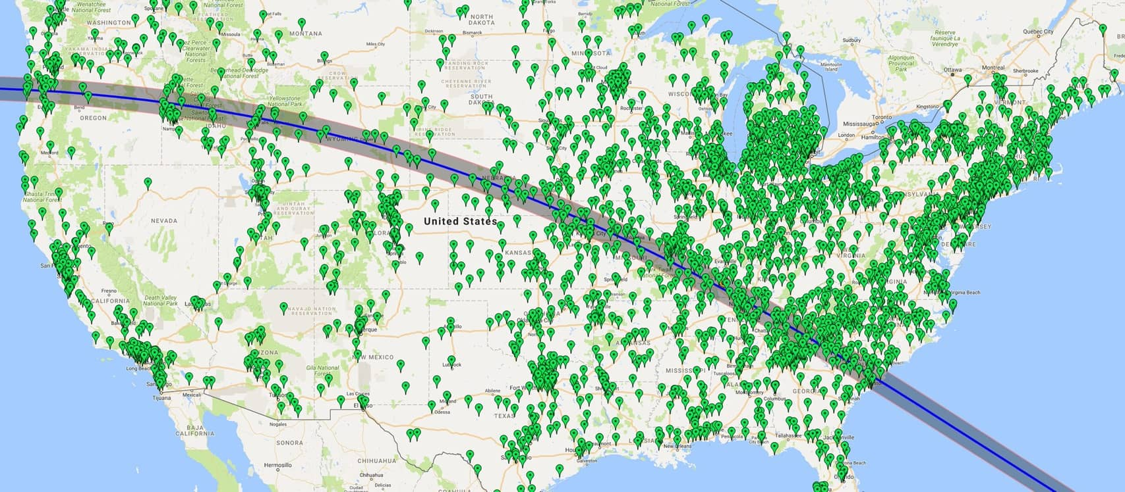
Libraries that Participated
Notes:
Every state had at least 65% of the Sun covered by the Moon, and lucky people on a narrow path from Oregon to South Carolina were in totality. The STAR Net Library Eclipse Project of 2017 allowed 6 million people to observe the event safely. Participating libraries were estimated to have conducted around 35,000 science programs before and after the eclipse, reaching approximately 1,750,000 people!

Slide 10
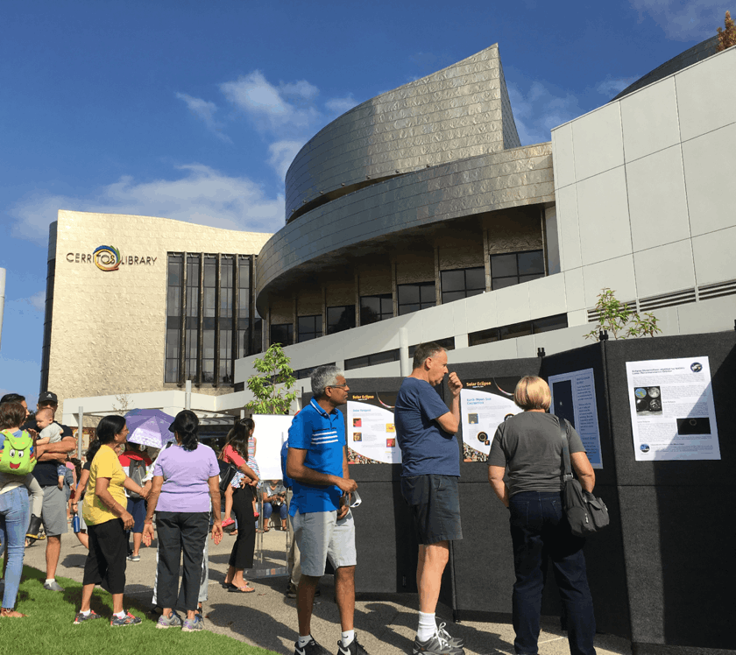
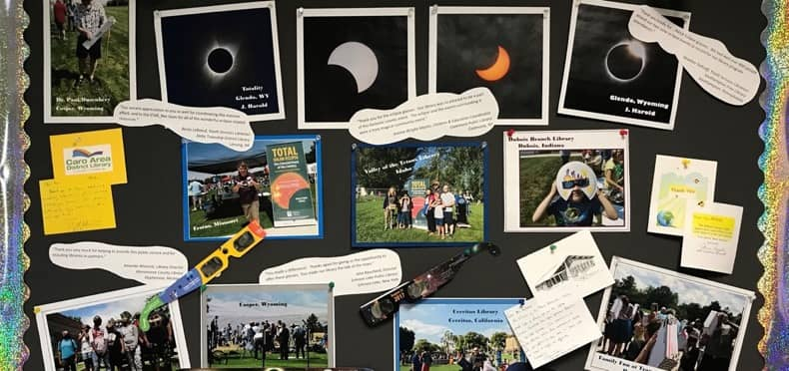
Photo Credit: Cerritos Library
2.1 million glasses distributed
More than 7,000 individual library locations participated through STAR Net
This included public library branches, book mobiles, tribal libraries, library consortia and state libraries
By the Numbers

Slide 11
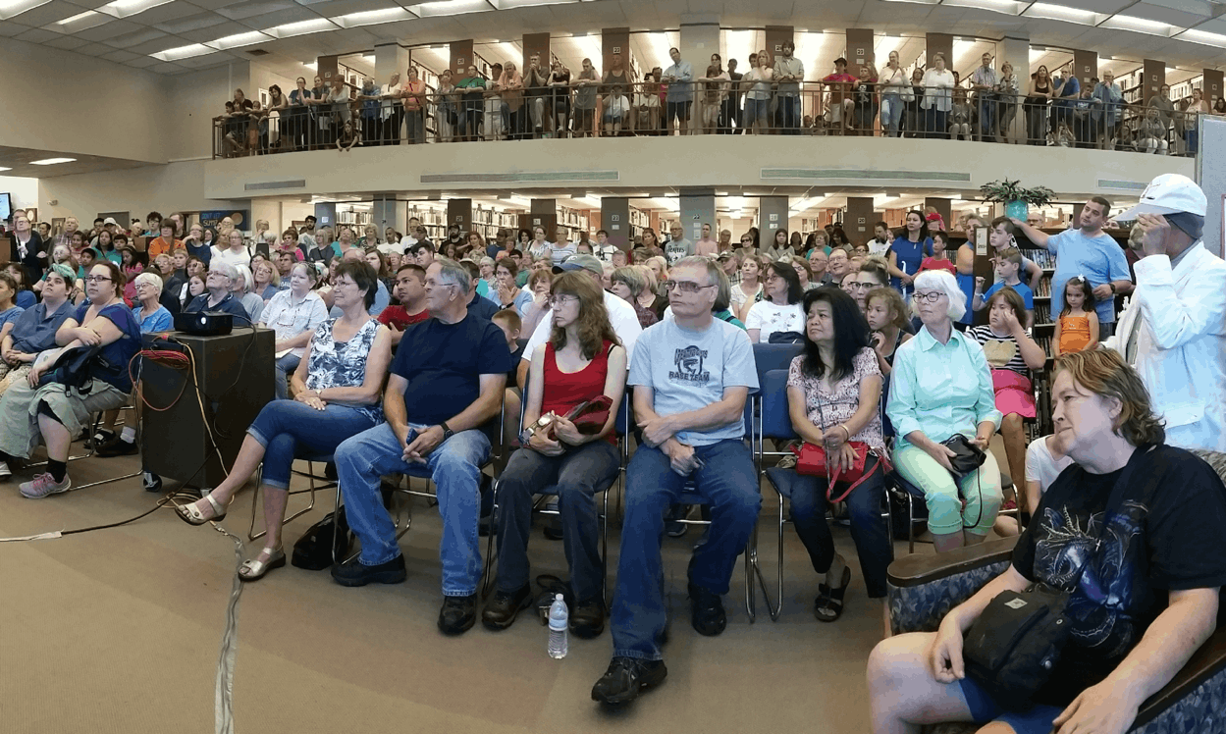
“We had one of the biggest events our Library has ever seen. So, in my language, we say Waewaenen (Thank You)!”
Menomin Hawpetoss,
Menominee County Library
What Libraries Said
Photo Credit: Longview Public Library
Notes:
Quote from Menominee County Library in Michigan; photo from Longview Public Library in Texas

Slide 12
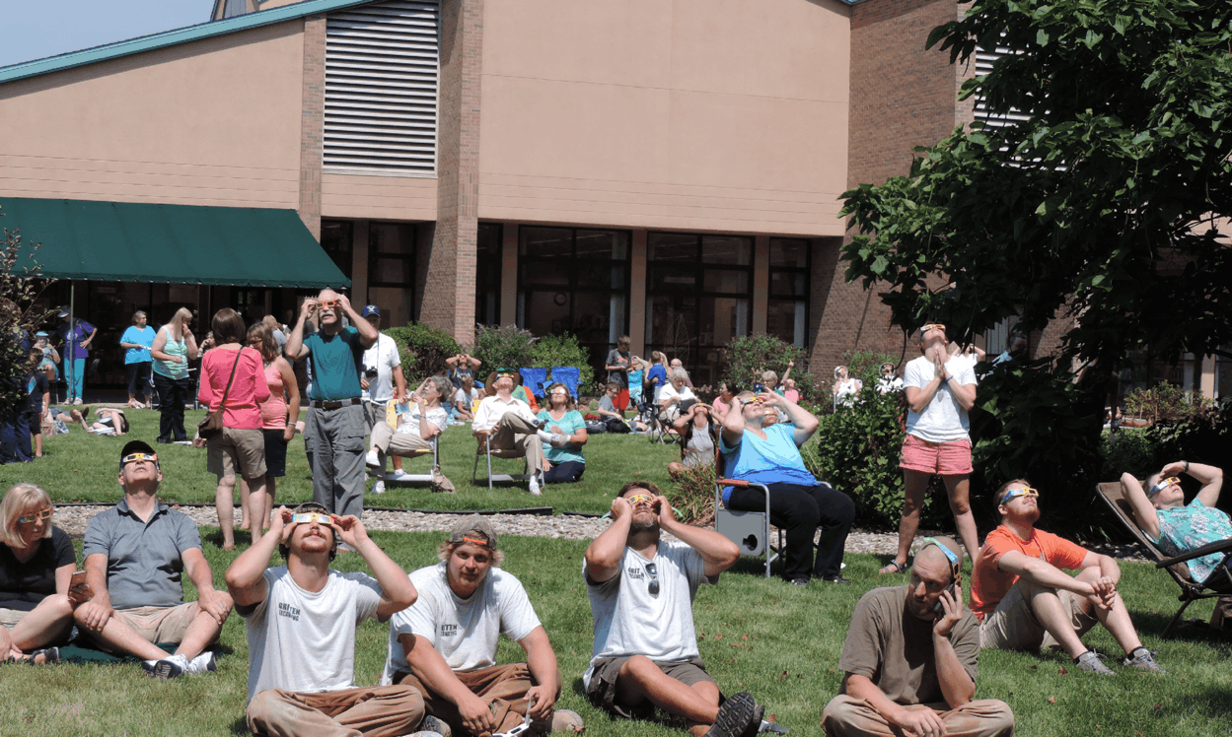
“Our eclipse programming has connected us with community collaborators for future programming and has created excitement from our patrons about future STEM programming.”
- Fort Fairfield Public Library
What Libraries Said
Photo Credit: Monticello-Union Township Public
Notes:
Quote from Fort Fairfield Public Library in Maine; photo from Monticello-Union Township Public Library in Indiana

Slide 13
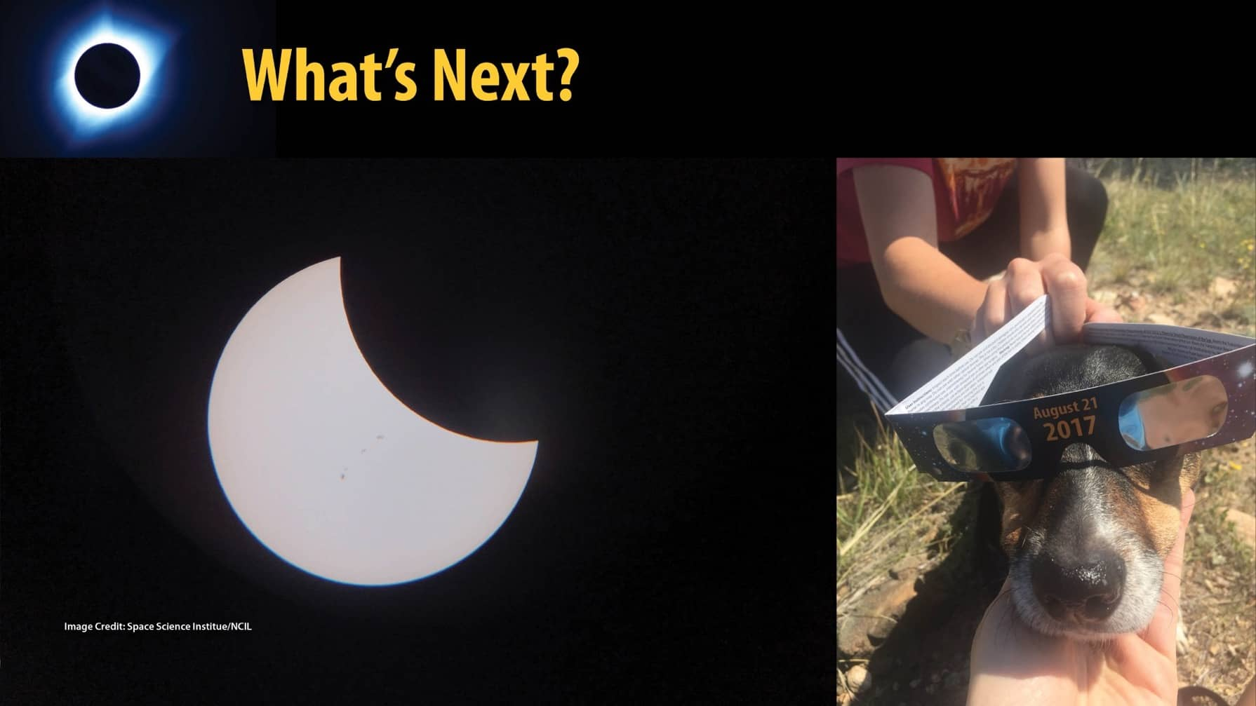
What’s Next?
Notes:
Two more eclipses are coming to the United States in the next two years! That's right, you (and your pets) will have two more opportunities to safely view the Sun!

Slide 14
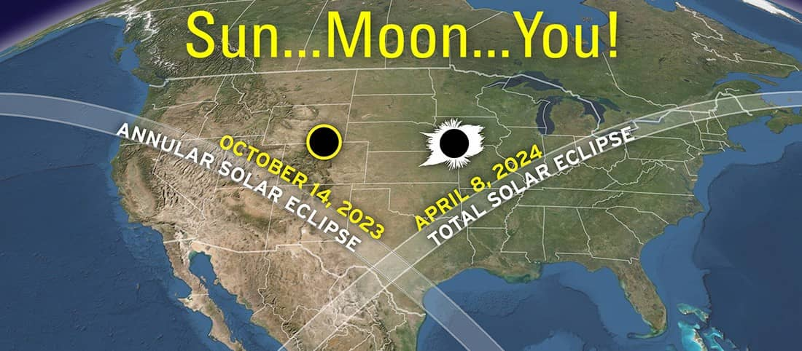
The 2023 and 2024 Eclipses
Photo Credit: American Astronomical Society
Notes:
On Saturday October 14th, 2023, an annular solar eclipse will be visible beginning in Oregon at 9:13 am Pacific Time and ends in Texas at 12:03 pm Central Time. All the rest of North America (except NW Alaska) will experience a nice partial eclipse in the morning on Oct. 14th.
On Monday, April 8, 2024 a total eclipse of the Sun will be visible in the U.S. Totality will be visible first in Mexico, coming to Texas just after noon local time. The eclipse then heads northeast through Oklahoma, Missouri, Ohio, New York, and Main, to name just a few of the states, and into Canada. In the northeast, totality will be around 3:00 to 3:30 pm, so in most of the U.S. students may be in school for the eclipse. In Mexico and South Texas the total eclipse will last over 4 minutes, which is really good for a total eclipse. All of the rest of North America will see a partial eclipse
The path of totality, where the Sun is completely blocked out by the Moon, will be over 100 miles wide and passes over more cities than the eclipse in 2017.
~32 million people live along the path of totality, and many millions will try to get there on April 7th and 8th, so it's good to plan ahead! Even if your library is not in the path of annularity or totality, you may have patrons who are planning to travel to those locations so you can provide resources and programs leading up to the eclipses.
By the way, the next total eclipse to cross the continental US will not be until August 12, 2045, so don't miss this one!

Slide 15
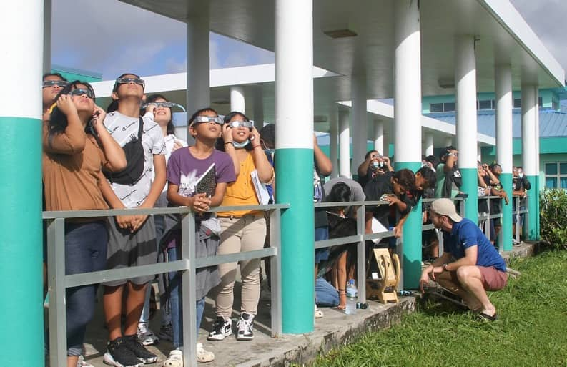
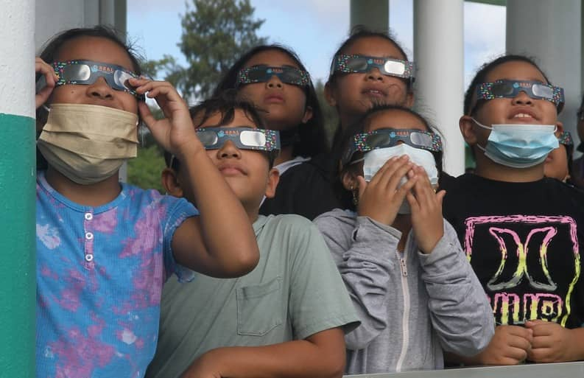
Distributing 5 million eclipse glasses to public libraries
Notes:
Just like in 2017, the STAR Library Network has received funding to distribute glasses to libraries across the country. However, instead of 2 million glasses, we have upped it to 5 million glasses!

Slide 16
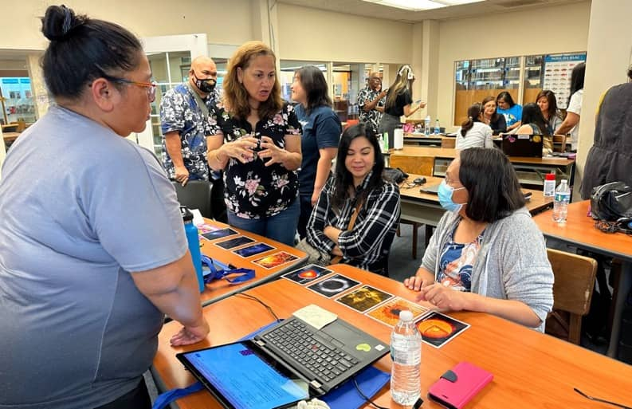
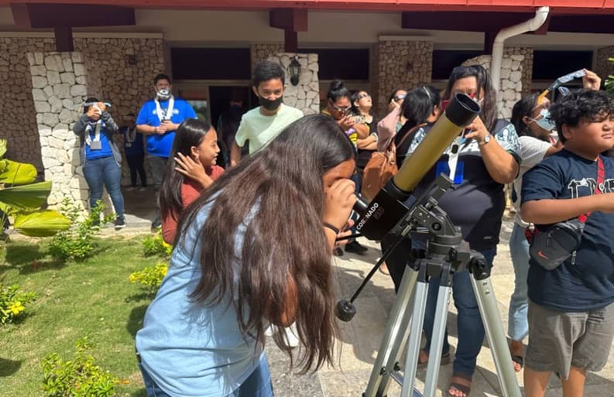
Workshops and trainings in all 50 states and 4 U.S. Territories
Notes:
In addition to delivering eclipse glasses, we are developing educational materials (such as a booklet with solar eclipse information that libraries receive with their eclipse glasses order), in-person workshops (such as this one) to all 50 states plus four territories, online training, and circulating solar science kits which you can check out from your state library. We have also put together an online community you can be a part of to get more info on the eclipses, connect with other libraries to share ideas, and connect with subject matter experts to help facilitate programs at your library, such as folks from the Night Sky Network and Solar System Ambassadors.

Slide 17
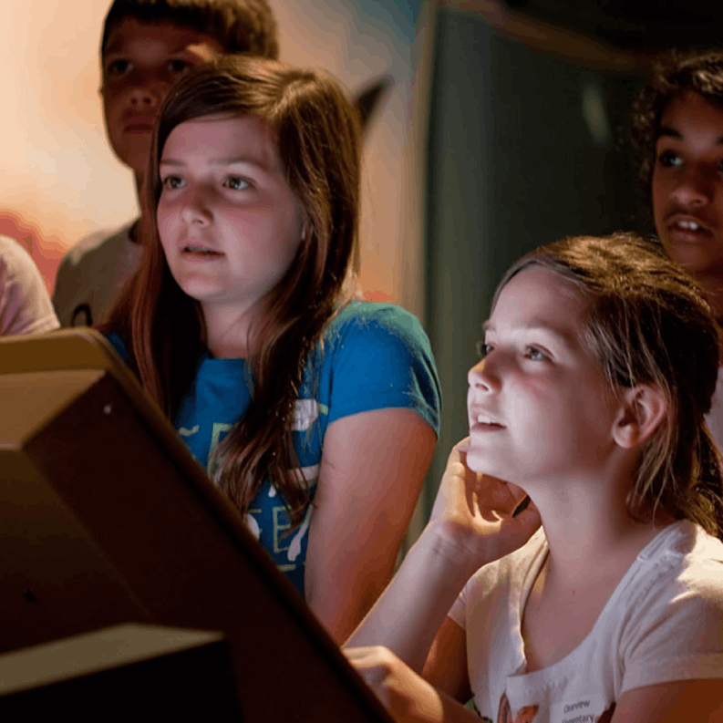



SSI's Mission
Discover, Educate, Inspire
Enable scientists to advance our understanding of Earth and the Universe
Increase science and tech literacy for all
Inspire youth to pursue STEM education and careers

Slide 18


STAR Library Education Network
Who we are and what we do!
Notes:
Now I'm going to take a step back from the eclipses to share a bit about who we are at the STAR Library Education Network, or STAR Net, and what we do for libraries. Who here has heard of STAR Net?

Slide 19

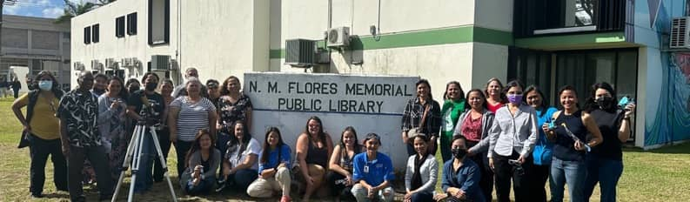




What does STAR Net do?
Exhibits
Kits
Professional Development
Community Dialogues
Partnership Guidance
SME Matchmaking
Events
Interactive Activities
Facilitation Strategies
Resource Dissemination
Eclipse Glasses and Training!
18

Slide 20


Why Libraries?
70% of the US population visits their local public library at least once a year
Demographics at library programs on average are a 1:1 match with demographics outside the door
Library staff are well educated and trained professionals who are comfortable trying new things and sharing results
Libraries are safe spaces in the community providing:
  Support in accessing government services
  Free safety resources (classes, books, etc.) for parents
  A place for homeless patrons to rest safely
  Translation services
  Gathering places for cultural groups
19

Slide 21


Slide 22


Slide 23


Slide 24

Eclipse 101
Slide deck created by Dr. James Harold, NCIL’s resident space plasma physicist
Notes:
Ok, so the Sorting Games you participated in at the beginning of the workshop gave some context about the scale and size of objects in space – essentially that things are much bigger and farther away than is easy to comprehend. Now it's time to go into the 'meat & potatoes' of the content – why and how Solar eclipses occur.

Slide 25

What do we know about the Sun?
Notes:
Big? About 100x as wide as Earth. Far away? 200 sun diameters. Takes about 8min for light to get here. Tied to almost all life on Earth. We’re all solar powered one way or another.

Slide 26

Very constant, very predictable.
Notes:
The Sun is very predictable: rises and sets on a schedule that varies over a year. Round. Featureless and perfect? Various civilizations have noticed occasional dots. Galileo suggested that the sun had spots on it (rather than clouds in front of it), implying it was flawed (!) One of several things that went poorly between him and the church.
The predictability is what makes eclipses rather dramatic.

Slide 27

And then every now and then, this happens…
Notes:
This is a Big Deal if you don't know what's going on, but partial eclipses are not super rare: you could see this a few times in your life. Who here has seen a partial solar eclipse that you didn't have to travel to?
Normally having a bite taken out of the Sun isn’t seen as a great thing. Occurs on cycles of a sort, so if you can keep track long enough you can at least roughly predict it. Gets easier when you have a good solar system model, but it isn’t necessary. Still: think of the power if you can predict it! Probably every culture has some set of ideas around eclipses. Sometimes a creature was eating the sun. Sometimes the sun and the moon were fighting. Or in love. Or both! There's a story of the Sun and the Moon being brother and sister and they got in a fight, and then they made up – so eclipses can be an opportunity for people to work on amending issues in their own personal relationships.

Slide 28

And very, very rarely this…
Notes:
A total solar eclipse, where the Moon completely covers the Sun. Who in the room has seen a total solar eclipse? Who in the room has seen a total solar eclipse you did not have to travel to?

Slide 29
Or maybe this.

Slide 30


So what’s going on?
The Moon gets in front of the Sun, casting a shadow on the Earth. The end.

Slide 31
Not so fast.
We have questions!
Why are solar eclipses rare?
Why are there different kinds of eclipses?
What’s the big deal with “totality”?
Is this entire exercise fraught with danger?!

Slide 32

Why so rare?
Why are solar eclipses rare?
Why are there different kinds of eclipses?
What’s the big deal with “totality”?
Is this entire exercise fraught with danger?!
Notes:
The scales of that upper right-hand diagram are completely wrong. This line we see here is now the Earth and Moon to scale (size and distance). So in reality, the Moon is about ¼ the diameter of Earth, and should be 30 Earth diameters away. the Sun is 400x further away, and 400x bigger than the diagram in the upper right-hand corner. That puts the sun 40 Earth-Moon distances away (multiply the line on the screen by 40), so you can say something based on room size about where the sun is.
At this scale, you can start to see that the shadow of the Moon on the Earth is very small. The Moon's shadow is only about 200km, 124mi wide. The width of the paths on the map are the size of the Moon’s shadow. Remember too that much of the Earth is water or otherwise uninhabited. The odds of you being under the line is next to nil. Being under a partial is much more likely.
On this map, the width of the lines across the continent equal the width of the Moon's shadow during a total solar eclipse.

Slide 33

Why not an eclipse every month?
Moon
(Sun is still waaaay off the screen)
Notes:
The Moon’s orbit is tilted just a bit (5 degrees) from the Earth-Sun orbit, so the shadow is likely to miss the Earth most of the time. So to get an eclipse the moon has to cross the Earth’s orbital plane (the ecliptic) at the point when it’s between the Earth and sun (new moon). The shadow has to hit the Earth and hit where you happen to be. On average a given spot on the Earth will only see a total eclipse once every 350 years.

Slide 34

The animated version
Notes:
This is a visual from Goddard's site. The Earth is in the middle; the Moon is orbiting the Earth, and the Sun is to the left. The line to the right is Earth's shadow – as the visual progresses you will see where the Moon's shadow goes.
When you first watch the visual, it would appear that we should have eclipses every month. But the animation will zoom in closer and you'll see that, because of the 5 degree tilt of the Moon's orbit, the Moon's shadow misses the Earth most of the time. It's only when it lines up just right that eclipses will occur.

Slide 35


And… “Annular Eclipses”?
(Sun is always going to be way off screen)
Notes:
The Moon’s orbit isn’t a circle, it’s an ellipse. It’s very close to a circle (you wouldn’t notice if we drew it accurately), but it’s enough that sometimes it’s a little closer, sometimes it’s a little farther. Which means sometimes it looks bigger and can cover the whole sun, and sometimes smaller and can’t. Close one eye and move your hand back and forth. Your hand stays the same size, but it can cover more of what’s behind it when it’s closer. Anybody know what we call a full moon when it’s at the point where it’s closest? (Supermoon)
The fact that the moon is just the right distance for eclipses is a crazy coincidence! The Sun is 400x further away, and 400x bigger: exactly what we need. But the moon is slowly getting farther away, so it’s only going to last for another 600 million years. Get a move on.
(supermoon micromoon image)

Slide 36


While we’re on the subject: what about “Lunar Eclipses”?
Shadow of the Moon on the Earth during an eclipse. (from the NASA/NOAA DSCOVR spacecraft)
Shadow of the Earth on the Moon during an eclipse. (Courtesy Andrew McCarthy, Cosmic Background).
Notes:
The terminology is a little messed up: a lunar eclipse is really a solar eclipse for the moon, but viewed from Earth. They’re more common for two reasons: (1) the Earth’s shadow is huge compared to the moon, so it’s much more likely to hit it, and (2) we’re viewing the lunar eclipse from space. If you were on the moon, every solar eclipse on Earth, wherever the shadow landed, would be visible and you’d say “Oh, it’s an earther eclipse”. :-)

Slide 37





Review: name this event
Solar Eclipse
Lunar Eclipse
Apocalypse

Slide 38

Let's demonstrate this concept with an activity!
Big Sun, Small Moon

Slide 39







What will we see on October 14th, 2023?
Partial (with sunspots?)
Totality, with a ring on it.
You will need your eclipse glasses on through the entire event!
Notes:
Everybody gets a partial eclipse!
Sunspots from 2014 partial, JH. Ring from 2017 total, JH. Beads NASA/Aubrey Gemignani, 2017. https://www.nasa.gov/image-feature/the-bailys-beads-effect-during-the-2017-total-solar-eclipse

Slide 40







What will we see on April 8th, 2024?
Partial (with sunspots?)
Diamond Ring
Bailey’s Beads
Totality… glasses off!
Notes:
Everybody gets a partial eclipse! Partials can last an hour or two on either side – you can plan eclipse programs/activities during this time
The diamond-ring effect occurs at the beginning and end of totality during a total solar eclipse. As the last bits of sunlight pass through the valleys on the moon's limb, and the faint corona around the Sun is just becoming visible, it looks like a ring with glittering diamonds on it.
Bailey's beads – what do you think causes this phenomena? As the Moon covers the Sun during a solar eclipse, the rugged topography of the lunar limb allows beads of sunlight to shine through in some places while not in others.
Sunspots from 2014 partial, JH. Ring from 2017 total, JH. Beads NASA/Aubrey Gemignani, 2017. https://www.nasa.gov/image-feature/the-bailys-beads-effect-during-the-2017-total-solar-eclipse

Slide 41


What’s so special about totality?
See the Sun’s atmosphere: the solar corona.
The Sun is 400,000 times brighter than the corona. (Even 99% of an eclipse is too bright to see the corona)
Totality is the only time you can (and should!) take off your eclipse glasses to look at the Sun.
Hot gases move along the Sun's magnetic field, tracing its complex structure.
Solar prominences arch above the Sun’s surface.
Notes:
Images by JH
Plasmas move along magnetic field lines – and the Sun has a huge magnetic field, so you can see the plasmas moving during totality.

Slide 42


The 2023 and 2024 North American Eclipses
To find information about the eclipse in your area go to:
GreatAmericanEclipse.com maps;
TimeandDate.com for specifics.
4 min is about the maximum for totality
Sci Games Eclilpse page
Notes:
4 minutes max for totality - which is actually really long! The 2017 totality was only a couple of minutes.

Slide 43



Things to observe any time you like: Sunspots!
Notes:
We thought it would be useful to talk about Sunspots because you can view those any time of the year, and the tools in the kits you can check out from the state library can be used to look at the Sun all year round. However, whether you’re likely to see sunspots depends on the year. The sun has its own seasons: the solar activity cycle runs 11 years. We’ll be nearing peak during the eclipses, so there’s a good chance you can see decent sunspots. First two images contrast solar min and max. The second is an image as you could expect to see it through the sunspotter or from a camera with a solar filter.

Slide 44

Eclipse science?
Yes! Space-based telescopes make their own eclipses and study “space weather.”
Other questions:
Citizen Science programs study eclipses’ effects on animals, insects, and the environment; and on the Earth’s outer atmosphere.
Notes:
This is called a “coronagraph”: a telescope with a disk that blocks out the sun. You have to do it in space: the atmosphere scatters so much light that it wont work well on the ground.
The shadow at the bottom left is the arm that holds the occulting disk. The white circle in the middle is the sun. Note the comet. The eruptions (“coronal mass ejections”) aren’t connected to the comet.. Just a coincidence. Also note the time… it’s about two days of images. LASCO instrument on SOHO (Solar and Heliospheric Observatory)

Slide 45

What other sun science is going on?
Notes:
We’ve come a long way from waiting for an eclipse to just happen. Some of these study the sun; some study the solar wind; some study Earth’s magnetic field, and how it gets pushed around by the solar wind. And check out Parker: it’s going to the source. It will get closer to the sun than any mission before it… less than 5 solar diameters away. If Earth and the Sun were at opposite ends of a football field, Parker will get to within 4 yards of the end zone. In 2025, at closest approach, it will be going 690,000 km/h (430,000 mph) relative to the sun, making it the fastest object ever built.

Slide 46





Lunch Break

Slide 47

Notes:
A short walkthrough the STEM Activity Clearinghouse resource.

Slide 48

Notes:
There are 38 collections featuring over 500 interactive STEM activities for pre K through adult library programs. On the Clearinghouse’s homepage, you will find eight featured collections.

Slide 49

Notes:
The 8 featured collections may rotate throughout the year to reflect seasonal events or to showcase activities for specific STAR Net projects, such as the Solar Eclipse Activities for Libraries (SEAL) collection

Slide 50
Notes:
To help navigate the site. Click on the “Browse and Filter All Activities” button on the home page

Slide 51

Notes:
and look for the Sort toolbar on the left-hand side

Slide 52
Notes:
to begin searching.

Slide 53


Tweens
Notes:
For example, I need an activity for Tweens

Slide 54

Tweens
One hour
Notes:
that takes one hour

Slide 55

Tweens
One hour
Easy
Notes:
has an easy difficulty level

Slide 56

Tweens
One hour
Easy
Instructions in Spanish
Notes:
with instructions in Spanish.

Slide 57

Notes:
14 activities match my requirements

Slide 58

Notes:
After you select an activity, notice you can scroll down to “Related Programming Resources.”

Slide 59

Notes:
It includes hints for uses in your library, related links, books, and other information to help you facilitate the activity.

Slide 60
Notes:
After you’ve done an activity, we invite you to write a review about how it went.

Slide 61

Notes:
This helps other library staff learn more about which activities work well in the library setting.

Slide 62


State Library Circulating Kits
Scan the QR Code for access to the PDF version of the kit list. Links to purchase the items are within the PDF too!
bit.ly/SEALkitlist

Slide 63











Multi-generational Kit
Tub
1 Coronado Personal Solar Telescope
1 Telescope Case
1 Telescope Mount
“When the Sun Goes Dark” book
2 Large Sunoculars
Big Sun, Little Moon (Handout Only)

Slide 64









Younger Audience Kit
Tub (WARNING Doesn’t travel well without reinforcement)
1 Sunspotter
Moon Bear’s Shadow Book
Moon Bear’s Shadow Activity Pieces
2 Sunocular minis
Sorting Game Printable Files

Slide 65

SEAL
Discussion
What are some ideas you have for facilitating a program using the kit materials?

Slide 66





Volunteers will take temperature, cloud, and land cover observations using simple tools (smart phone and thermometer) before and after the 2023 and 2024 eclipses.
Observations needed on and off the eclipse path
The GLOBE Observer team seeks U.S. library partners!

Slide 67







Opportunity for Libraries
Up to 100 U.S. public libraries will receive GLOBE Observer Eclipse kits and ongoing support. Resources are shown that will be included in the kit.
Bilingual GLOBE Observer Card
use center hole as a pinhole camera
100 per library
Bilingual GLOBE Sky Windows
100 per library
Digital talking air temperature thermometer
One per library
(limited supply of Spanish)
Elementary GLOBE Clouds Books
English and Spanish
Plus more resources and activities
will be online at:
observer.globe.gov/eclipse

Slide 68
Timeline for GLOBE Kits
May 4: Webinar on GLOBE Observer Eclipse Kits. ​
May 31: Applications due for library kits.​
Mid-June and July: Kits shipped to libraries.​
More details will be coming soon!

Slide 69





Safe Solar Viewing Stations
Solar Telescope
Sun Spotter
Sunoculars
Indirect Solar Viewing

Slide 70



Indirect/Low-Cost Solar Viewing

Slide 71

Cereal Box Viewer

Slide 72


Slide 73

STEAM Activity
Eclipse Chalk Art

Slide 74

15 Minute Break!

Slide 75

Facilitation Styles
Credit: Pioneer Library System
Notes:
We are going to explore three common facilitation styles and how they may or may not promote STEAM learning in the library setting.

Slide 76



Turn and talk with a neighbor
What is an impactful learning experience you have had? This could be from any point in your life.
Notes:
Before we begin, I want you to think back on a learning experience you have had that was particularly impactful or memorable to you. This could be in a classroom setting, summer camp, college, or even a professional development session. Turn and talk with a neighbor about what made that experience so great.

Slide 77

Fact or Fiction?
“Science is a collection of facts”
Notes:
Thing about this statement: "Science is a collection of facts." Give me a thumbs up if you agree with this statement, or a thumbs down if you disagree.
This has given STEM a bad reputation that falls short of the real work done by science and technology professionals. While it is certainly important to understand factual data within the science fields you are studying, we believe that STEM within the library setting is less about memorizing a bunch of facts

Slide 78

Exploration
Notes:
We can create STEAM learning experiences that are not just memorizing facts. Like in the real-life professions, we can focus on exploration…

Slide 79

Inquiry
Credit: Muhlenberg Community Library
Notes:
…inquiry…

Slide 80

Creativity
Credit: Prince George’s County Memorial Library System
Notes:
…and creativity

Slide 81


Fact or Fiction?
"Facilitating STEM requires subject matter expertise"
Notes:
Thing about this statement: "Science is a collection of facts." Give me a thumbs up if you agree with this statement, or a thumbs down if you disagree.
This has given STEM a bad reputation that falls short of the real work done by science and technology professionals. While it is certainly important to understand factual data within the science fields you are studying, we believe that STEM within the library setting is less about memorizing a bunch of facts
(insert facilitating picture)(astronaut giving a talk photo)

Slide 82

What do you notice about this image?
Sage on the Stage
Have you ever had an experience like this?
Illustration by Kevan Mills. Credit: Space Science Institute
Notes:
Take a look at this image. What do you notice? Who gets to participate?

Slide 83

What do you notice about this image?
Trivia Master
(or Initiation-Response-Evaluation )
Illustration by Kevan Mills. Credit: Space Science Institute
Notes:
We call this style "Trivia Master," or Initiation-Response-Evaluation.
Facilitator asks closed questions, controls discussion, and does majority of talking. In this style, the facilitator is still expected to know the answers and be the “keeper of the knowledge”
Patrons recall, list, recite, label
“Correct” answers are rewarded
Doesn’t encourage patron construction of knowledge and is still “facilitator-focused”

Slide 84
Trivia Master
(or Initiation-Response-Evaluation )
Facilitators
Ask closed questions
Control discussion
Do majority of talking
Patrons
Recall, list, recite, label
Rewarded for “correct” answers
Illustration by Kevan Mills. Credit: Space Science Institute
Notes:
We call this style "Trivia Master," or Initiation-Response-Evaluation.
Facilitator asks closed questions, controls discussion, and does majority of talking. In this style, the facilitator is still expected to know the answers and be the “keeper of the knowledge”
Patrons recall, list, recite, label
“Correct” answers are rewarded
Doesn’t encourage patron construction of knowledge and is still “facilitator-focused”

Slide 85

What do you notice about this image?
Guide on the Side
Illustration by Kevan Mills. Credit: Space Science Institute
Notes:
Now take a look at this image. What do you notice? / Who gets to participate? What is the facilitator’s role?
We call this style of facilitation "Guide on the Side." Being a “guide on the side” puts STEAM into the hands of the learners

Slide 86

“Guide on the Side’’
Strategies for Your STEAM Programs
Credit: Space Science Institute
Notes:
Now we are going to dig into just how to be a “Guide on the Side” with strategies to help you guide library patrons in their own learning journeys.

Slide 87

Strategy 1
Create a safe learning environment
Credit: Space Science Institute
Notes:
Strategy 1: Create an atmosphere that is safe for exploring – and where it’s okay to fail. Let patrons know that being wrong is the first step in learning!
Encourage patrons to use their own knowledge and experiences to help answer each other’s questions.
Show that you are not a “keeper of knowledge,” but rather that you are there to learn with your patrons.

Slide 88
I don’t know…let’s find out together!
Notes:
Try responding to challenging questions with phrases like: “I don’t know…let’s find out together!”

Slide 89
That is an interesting thought! How did you come up with it?
Notes:
When responding to patron’s answers, comment on the process of how they came to that answer, rather than on whether it is “right” or “wrong.”
Try phrases like: “That is an interesting thought! How did you come up with it?”

Slide 90

Strategy 2
Open-ended questions
Credit: Space Science Institute/High Plains Library District
Notes:
Strategy 2 Use open-ended questions to access patron’s prior knowledge and experiences. Open-ended questions are prompt learners to reflect and lead to more than one right answer.

Slide 91

What do you notice?
Can you tell me more?
What does this remind you of?
Credit: Rolling Hills Consolidated Library
Notes:
For example, encourage patrons to try new things with questions like: What do you notice? Can you tell me more?

Slide 92

Strategy 3
Notes:
The third strategy will be demonstrated to you in a series of images over the course of 5 seconds. Please pay close attention and then share out what you observe.

Slide 93

Illustration by Kevan Mills. Credit: Space Science Institute

Slide 94

Illustration by Kevan Mills. Credit: Space Science Institute

Slide 95

Illustration by Kevan Mills. Credit: Space Science Institute

Slide 96

Illustration by Kevan Mills. Credit: Space Science Institute

Slide 97
Let's take another look

Slide 98
Illustration by Kevan Mills. Credit: Space Science Institute

Slide 99
Illustration by Kevan Mills. Credit: Space Science Institute

Slide 100
Illustration by Kevan Mills. Credit: Space Science Institute

Slide 101
Illustration by Kevan Mills. Credit: Space Science Institute

Slide 102

What did you observe?
Illustration by Kevan Mills. Credit: Space Science Institute
Notes:
What did you notice over the course of those images?

Slide 103

Strategy 3: Wait Time
Wait approximately 5 seconds after asking a question.
Respond to someone who took longer to form his or her thoughts.
Gives time for learners to think about and articulate their ideas.
Notes:
The third strategy is to provide a “wait time” of approximately 5 seconds after asking a question. Try responding first to someone who took a little longer to form his or her thoughts – after all, we need deep thinkers to help us tackle the challenges of the future! A wait time of 5 seconds gives time for learners to think about and articulate their ideas.

Slide 104

Strategy 4
Turn and talk
Notes:
Strategy 4: Turn and Talk
While using a wait time can give more learners a chance to participate, this next strategy ensures participation from everyone in your program. You can make sure everyone is being heard - and manage any individuals who might be dominating the whole conversation – by setting up smaller groups for discussion.

Slide 105
Please turn and tell your family member or friend your ideas.
Credit: Rolling Hills Consolidated Library
Notes:
Pose your question, then invite participants to “ please turn and tell your family member or friend your ideas.”

Slide 106

“Help each other figure this out. Take your time. I will come back in a few minutes to see how you’re doing.”
Credit: Pioneer Library System
Notes:
Give patrons space and time to try things for themselves with prompts like: "help each other figure this out. Take your time. I will come back in a few minutes to see how you're doing.

Slide 107

Strategy 5
Hands-on activities
Notes:
Strategy 5: Hands-on activities! Design programs that are centered around fun, interactive STEM learning experiences. Choose activities that allow patrons to interact and engage with unfamiliar concepts, ideas, and physical objects or tools.

Slide 108

Have you tried any of these facilitation strategies in your organization?
Turn and discuss with your neighbor
Create a Safe Learning Environment
Open-Ended Questions
5-Second Wait Time
Turn and Talk
Hands-on Activities

Slide 109
Which facilitation style matches the impactful learning experience you shared earlier?
1. Sage on the Stage
2. Trivia Master
3. Guide on the Side

Slide 110

Hands-On Activity

Slide 111

Partnerships and Your Community
How would you promote solar science programs in your community?
What community partners could help with facilitation?
Think about reaching those historically excluded in STEAM

Slide 112

Community Dialogues
A Community Dialogue is a loosely facilitated discussion that provides the opportunity for library staff and community leaders or members to discuss common, community-based challenges or aspirations.
Community Dialogues can help your library:
  Expand your understanding of patrons’ feelings about their local library and its programs, including programming related to STEM
  Obtain meaningful feedback from the community on who visits the library and why
  Have a conversation about how the library can better serve ethnically, economically, and geographically underserved and underrepresented audiences
  Better connect with local organizations and potential future partners that have shared interests with the library and community

Slide 113
Make Dialogues work for you
Community Dialogues are about more than leaving the room with a list of to-dos and answers to all the questions. Rather, they are about discussing topics and issues in an inclusive and uninhibited environment, with community representatives and stakeholders.
STAR Net Community Dialogues
https://www.starnetlibraries.org/deia/community-dialogues/

Slide 114


SEAL Group on the STAR Net Online Community

Slide 115

What is the Community?
Online network specially curated for you
Opportunity to interact with fellow libraries
Place where all relevant documents are accessible
Place to upload your program pictures, activity documents, and chat

Slide 116

What is the Community?
Similar to other social media platforms, you can post discussions, “like” other’s comments, upload documents for activities and share pictures

Slide 117

Maintaining Your Eclipse Glasses
If you're getting a box of glasses from us, keep them boxed up until you're ready to distribute!
If you have old glasses, make sure they don't have any scratches or holes. (Hold them up to the Sun and make sure no points of light shine through)
Keep open glasses in an envelope or folder to prevent scratches and folding
Make sure any old glasses you get donated to you are tested and have the appropriate safety numbers on them.

Slide 118

Two Schools of Thought on Photographing an Eclipse
Don’t. Enjoy this rare experience without distractions.
Ignore the people who suggest #1. We like taking pictures and showing them to people later.
Notes:
If you're going to take pictures, it's just a matter of having realistic expectations of what's going to happen.

Slide 119




Things to remember when taking pictures
Treat your camera like your eyes.
The sun is small in the sky, and camera phones are wide angle. Zoom if you can.
Exposure matters. Unless it’s totality, you’ll have to have a filter.
  You can take pictures of people too! The partial phase can last 2+ hours: there’s plenty of time to take all the pictures you want. But totality is only 1-4 minutes.
  Even if there are clouds you can get cool photos.
Notes:
You’ve accidentally taken pictures of the sun before, and it didn’t destroy your camera, any more than glancing at the sun destroys your eyes. But don’t stay pointed at it, especially with a zoom. A zoom with no filter could definitely damage a camera.
The difference between the first and second images are just exposure: the sun is much smaller than you think… the glare gives you a false impression. Both images are a typical full frame cameraphone image.
People do entertaining stupid things during eclipses. Capture them!
Last shot is a fancy camera with a zoom and a “black glass” filter. Check out the sunspots though. :-o

Slide 120


What kind of camera will you have?
If you have a camera phone:
  You can take pictures through your eclipse glasses (but zoom!)
  You can take pictures through a solar telescope.
  At totality you can take pictures with no filter.
  Practice manual settings (exposure, focus). Camera phone logic wasn’t really made for this.
  There’s at least one app to help.
If you have a fancy camera
  Get the best zoom lens you can.
  There are “black glass” filters.
  One word: “stacking”.
Everything except totality can be practiced any time!
Notes:
“stacking” is a strategy that involves taking many exposures, then combining them using software to enhance details and decrease noise. It’s very common in astrophotography, and it’s how the eclipse photos that show a lot of detail in the corona are made. You can google and get detailed information on how to do it.

Slide 121
Free Additional Resources
(Take a Picture of This Slide!!)
Register for FREE Eclipse Glasses
  https://www.surveymonkey.com/r/BT58RYV
500+ STEAM Activities for Public Libraries
  http://clearinghouse.starnetlibraries.org
STAR Net Online Community
  https://community.starnetlibraries.org/
Eclipses in Fiction (books, music, art, videos)
  https://www.fraknoi.com/wp-content/uploads/2022/11/Resources-Connecting-Eclipses-and-Other-Fields.pdf
#STEMInLib Videos
  https://youtube.com/starnetlibraries
NASA’s Night Sky Network
  https://nightsky.jpl.nasa.gov/
NASA’s Solar System Ambassadors
  https://solarsystem.nasa.gov/solar-system-ambassadors/events/
Getting Started with SEAL
  https://community.starnetlibraries.org/get-started-with-seal/
Notes:
Free eclipse glasses – application must be completed in one sitting; must upload (on library letterhead) a brief letter from your director or other similar responsible party attesting that you intend to utlize these glasses for educational programs, will not sell the glasses you receive, agree to complete a post event survey, and commitment to participate in relevant trainings; you have the option to receive 2,000, 1000, or 500 pairs of evlipse glasses.

Slide 122



