Slide 1
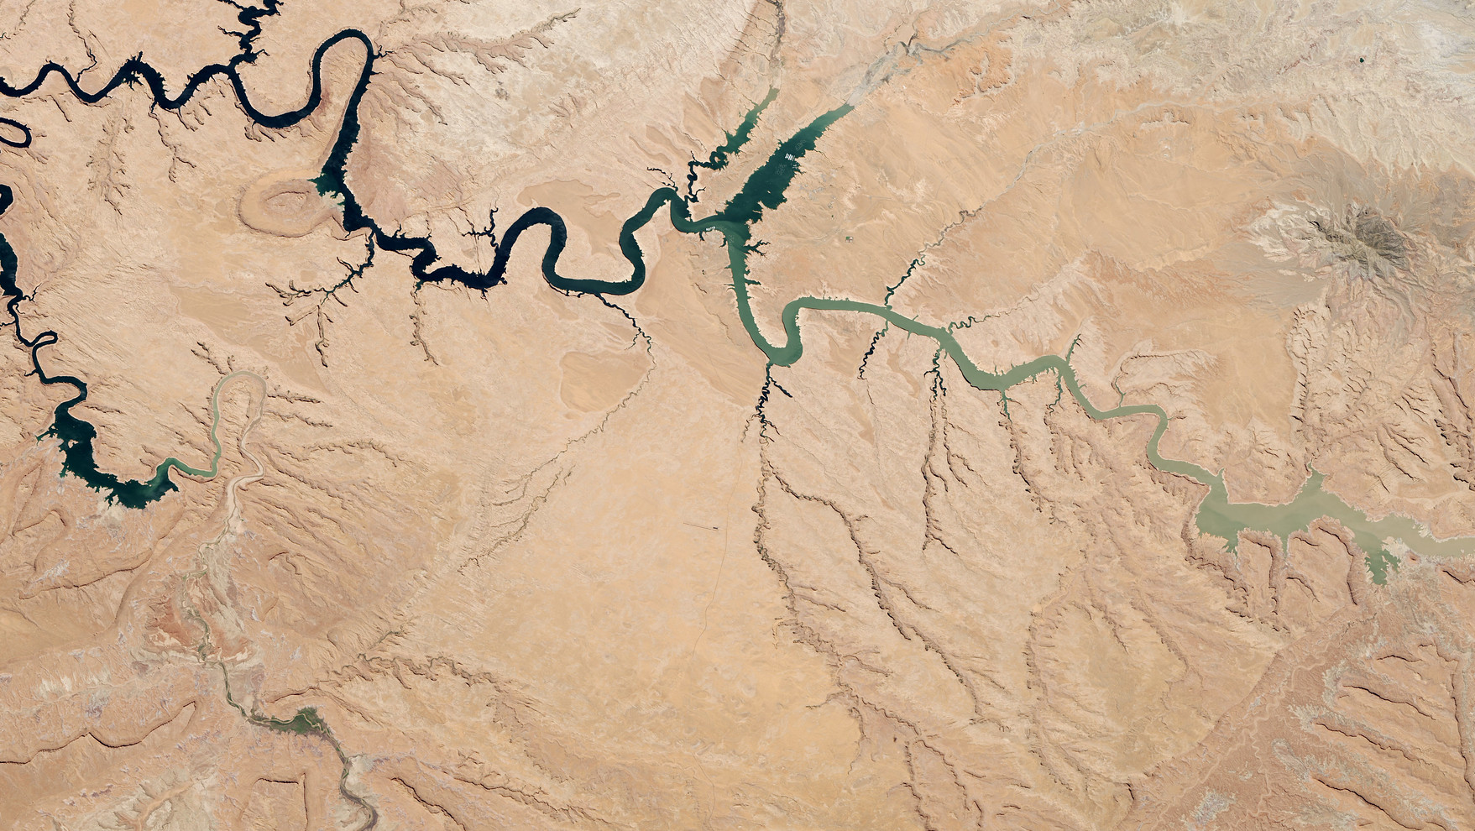
Celebrate Water During Earth Science Week
Tuesday, May 24 at 1:00 pm M.T.
This webinar will be recorded

Slide 2
Facilitator Introductions
Claire Ratcliffe Adams, Space Science Institute
Dillon Connelly, Space Science Institute

Slide 3
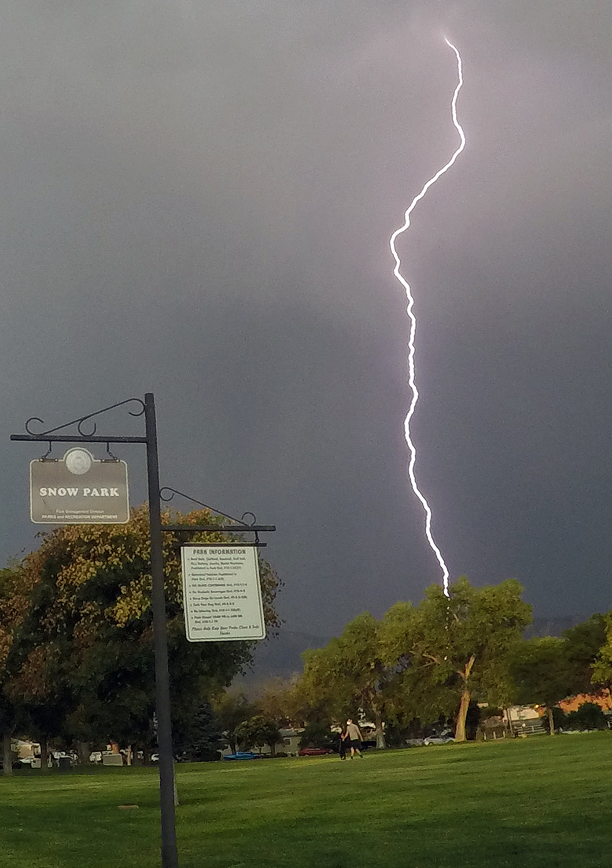
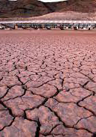
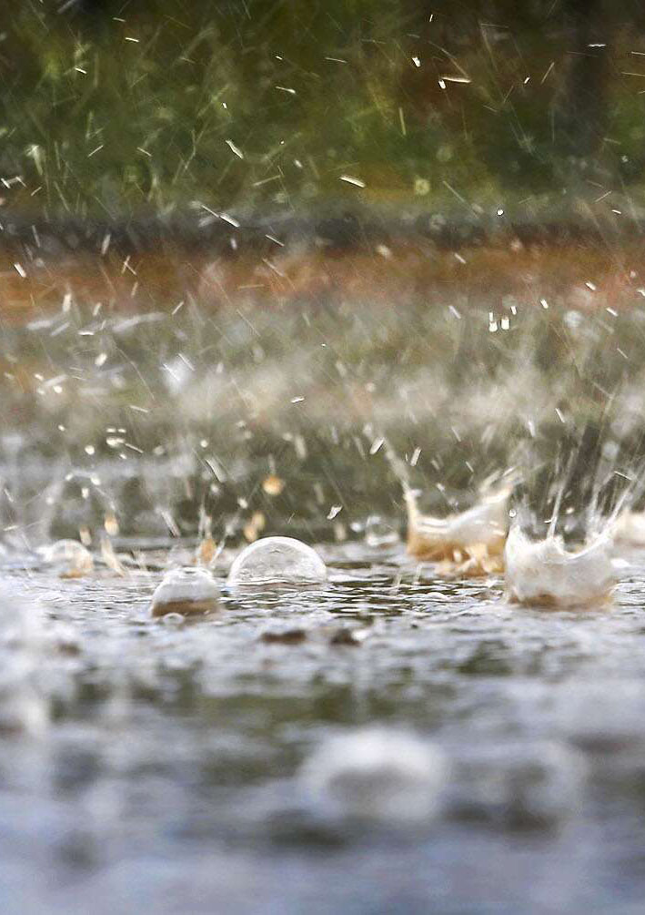

Icebreaker: What Four Corners weather are you today?
Dry Thunderstorm
Full of energy
Flashy
Drought
Waiting for relief
In need of some Jergens
Flash Flood
Fast acting
Enriching to your environment
Winter Storm
Cool
Preparing for the future

Slide 4

Share in the chat
Describe a time when you realized water was a “resource” or had multiple different values/access for different groups.

Slide 5

Notes:
Claire

Slide 6

Funded by the National Science Foundation
Notes:
Claire

Slide 7
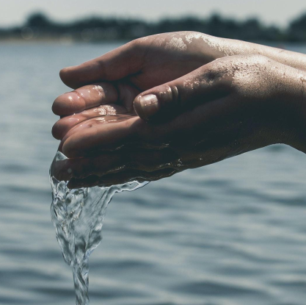
We are Water
Sharing stories and inspiring conversations about what water means to communities across the Four Corners Region of the Southwestern U.S.
Notes:
Claire

Slide 8
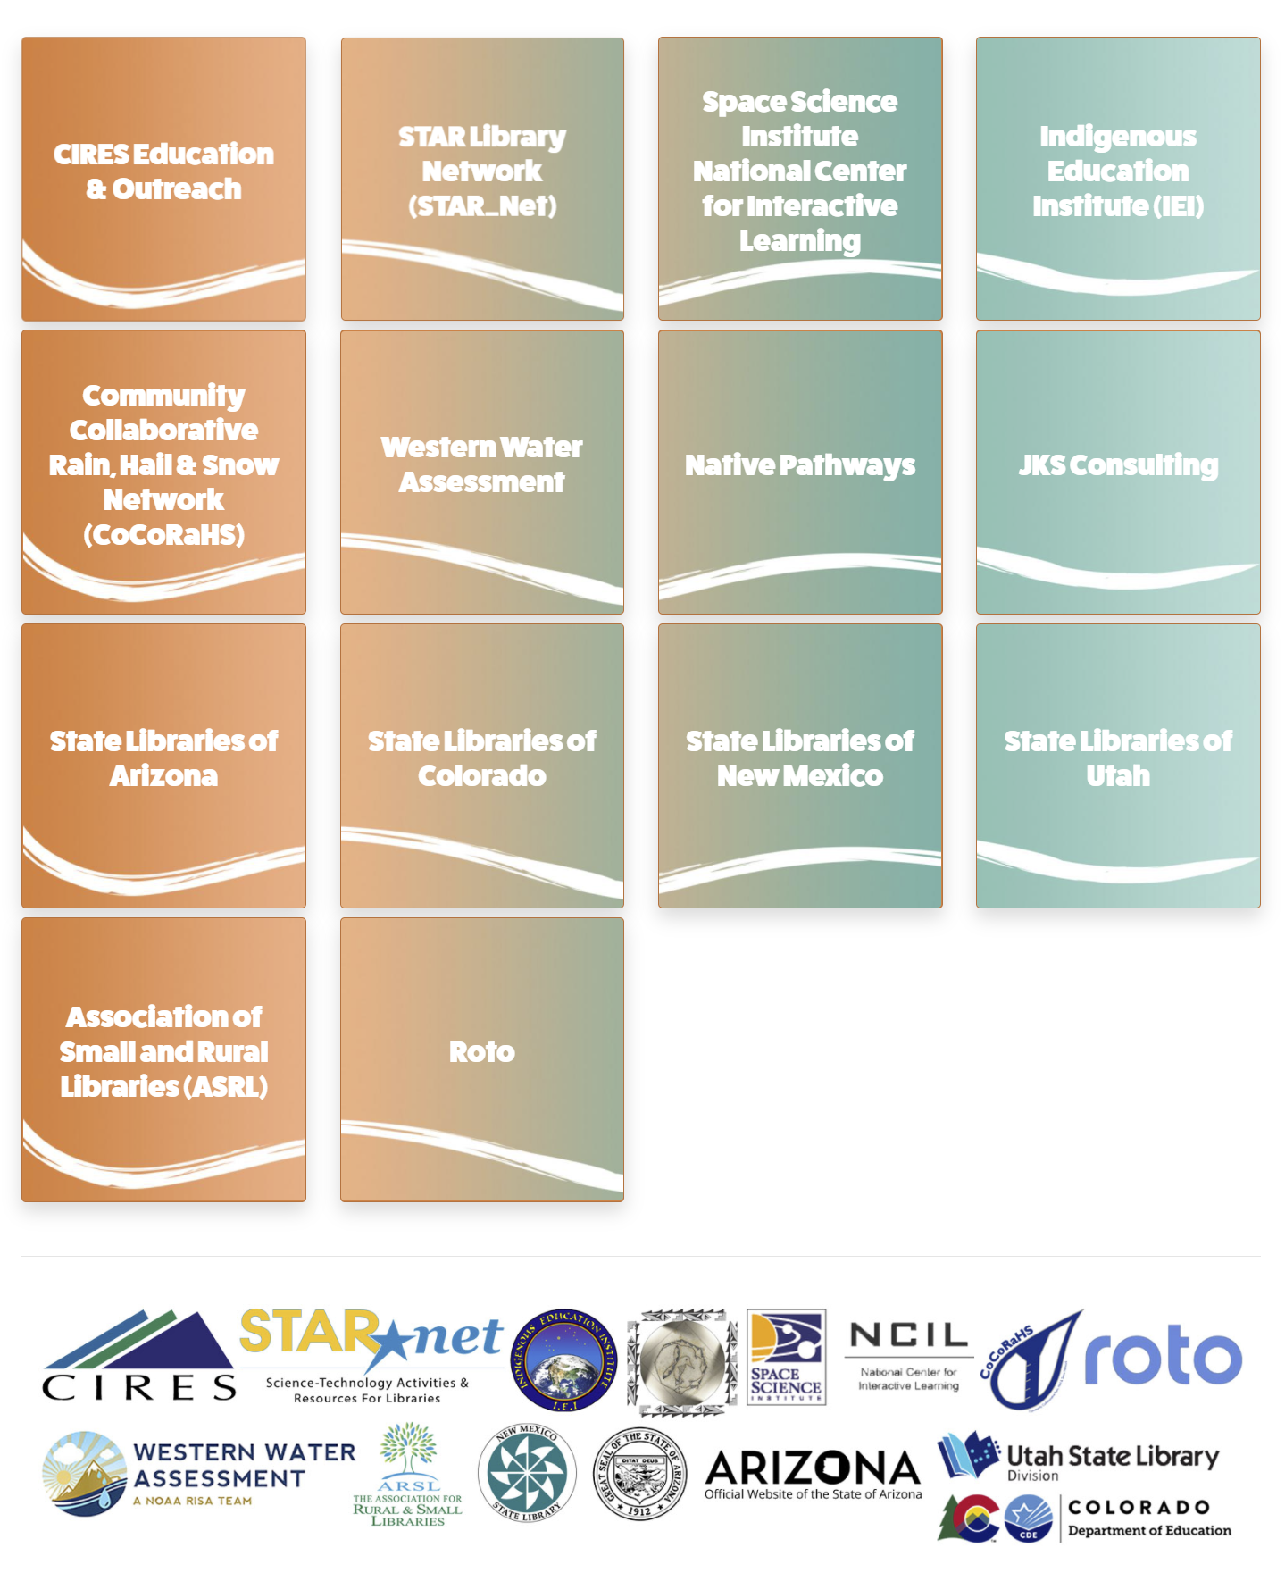
Collaboration between scientists, Indigenous science educators, learning researchers, informal educators, and library staff.
Notes:
Claire

Slide 9

Goals for Patron Experiences
Patrons will:
Enjoy participating in STEAM learning experiences.
See water topics in new ways.
Increase their awareness that water is critical and scarce across the region.
See themselves, their community, or culture reflected in STEAM learning experiences.
Expand their cultural and/or scientific perspectives about water and are able to appreciate multiple ways of knowing about water.
Engage in local water topics through sharing art, water stories, water concerns, and conversations.

Slide 10
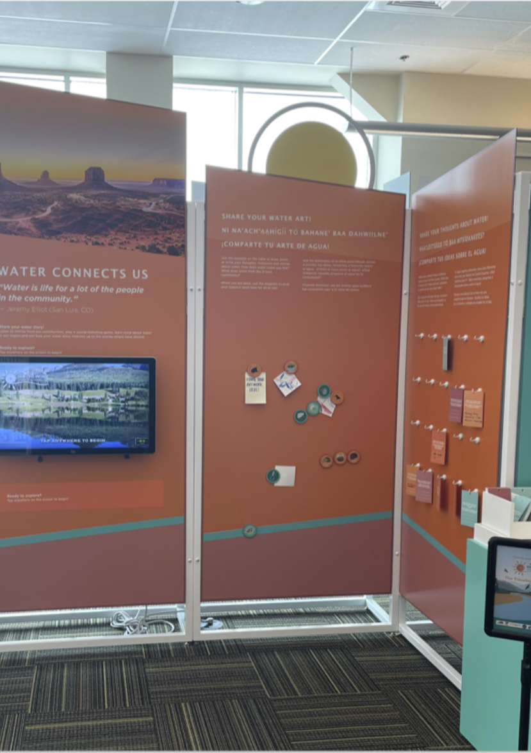
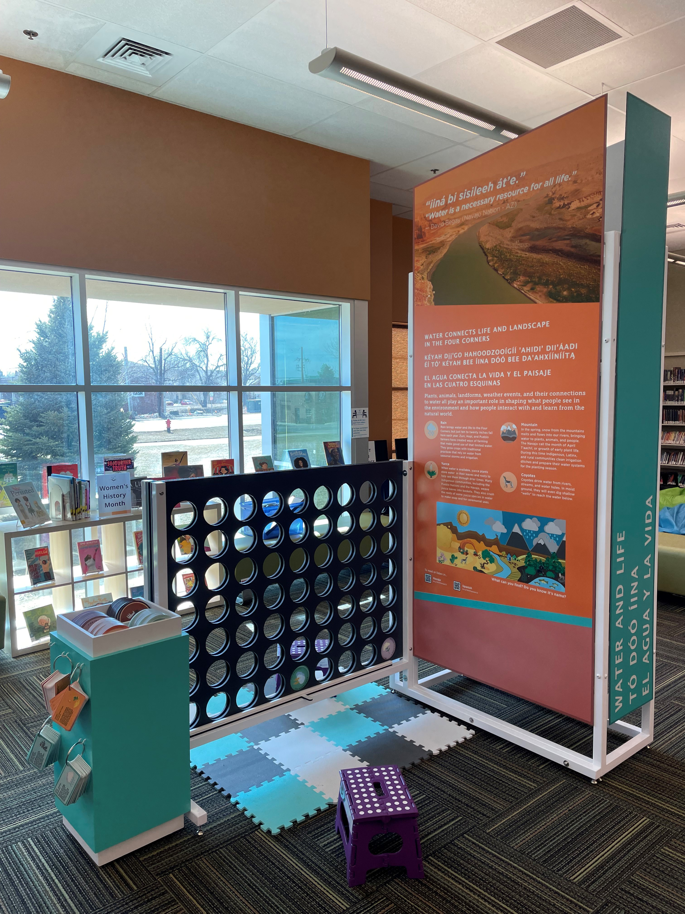
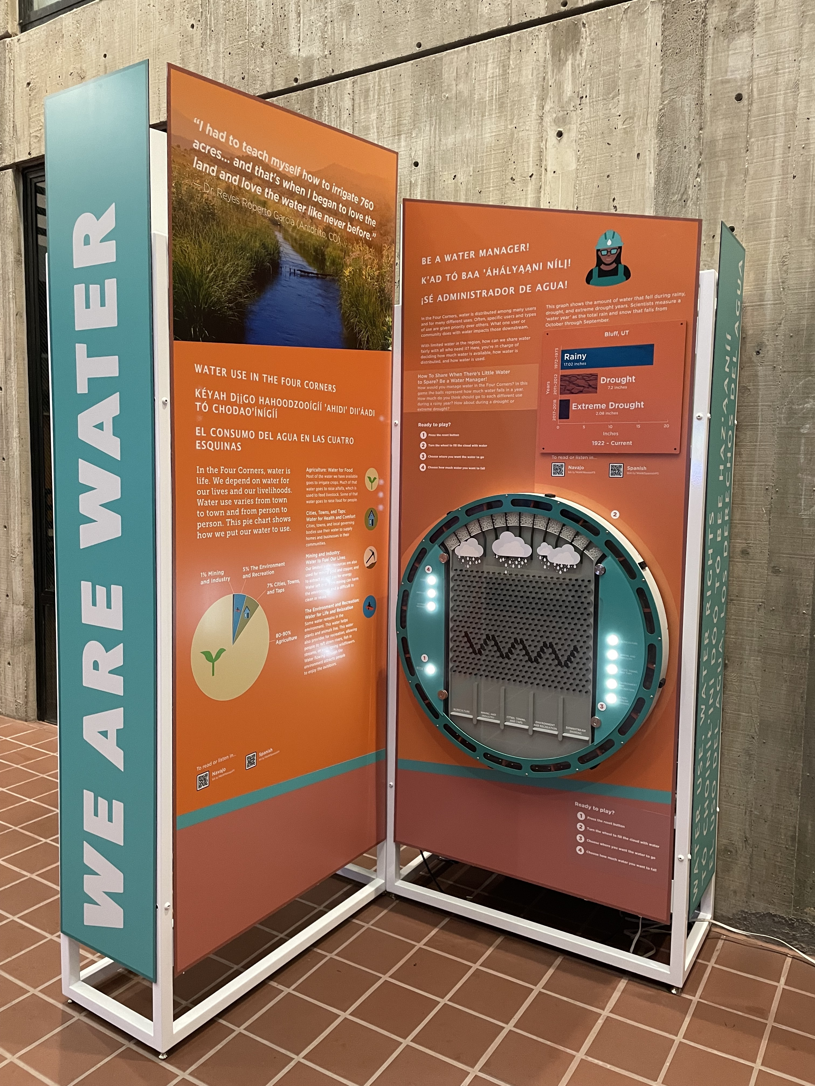
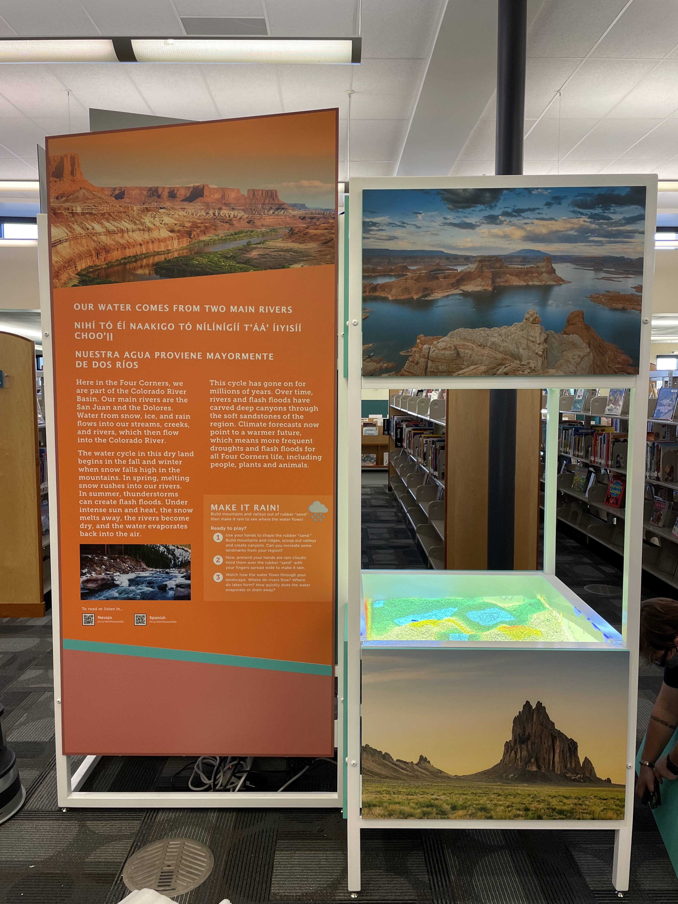
Four Exhibition Pieces
Notes:
Claire

Slide 11
Learning Resources
Take & Make Kits
Programming Resources
Curated Activity List on STAR Net's STEM Activity Clearinghouse
Library Facilitation Guides

Slide 12
Activity Demonstrations

Slide 13
Adaptations: A Way of Life
A set of six activities designed by the Arizona-Sonora Desert Museum.
Adapted by STAR Net to reflect four corners plant and animal species.
Great on their own or part of a larger program.
New How-To video on the STEM Activity Clearinghouse!
Notes:
Claire/Brooks

Slide 14
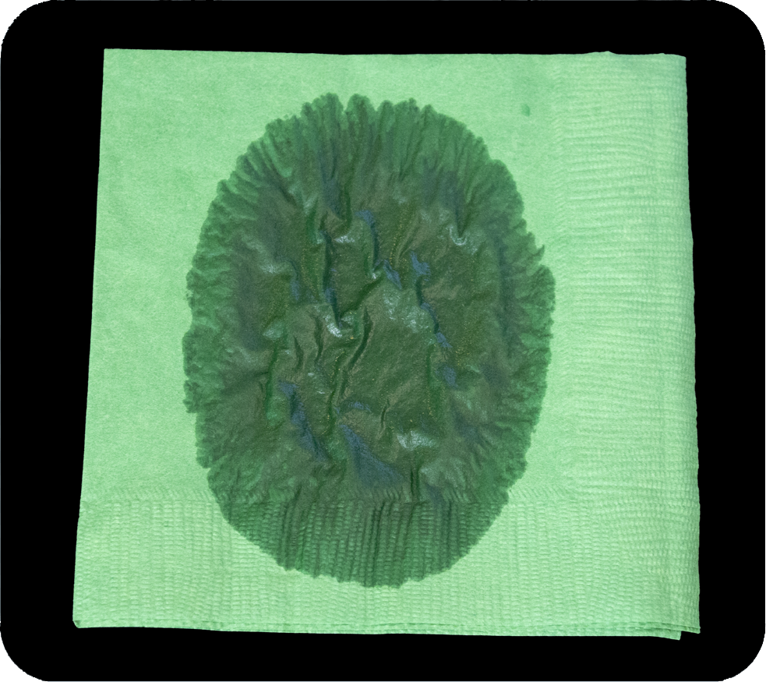
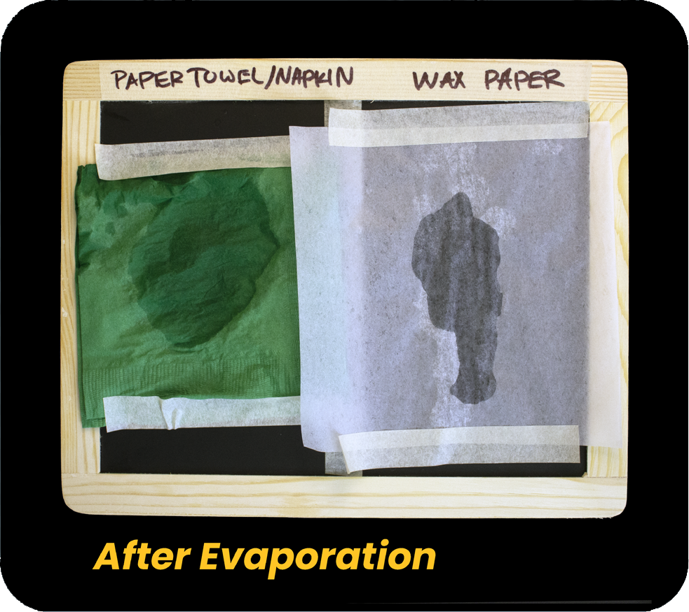
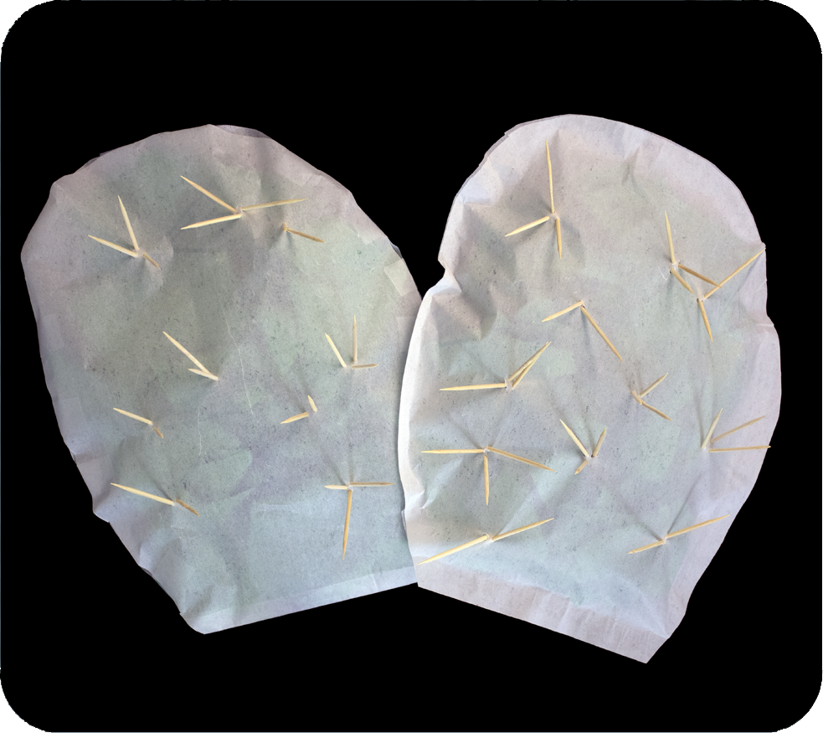
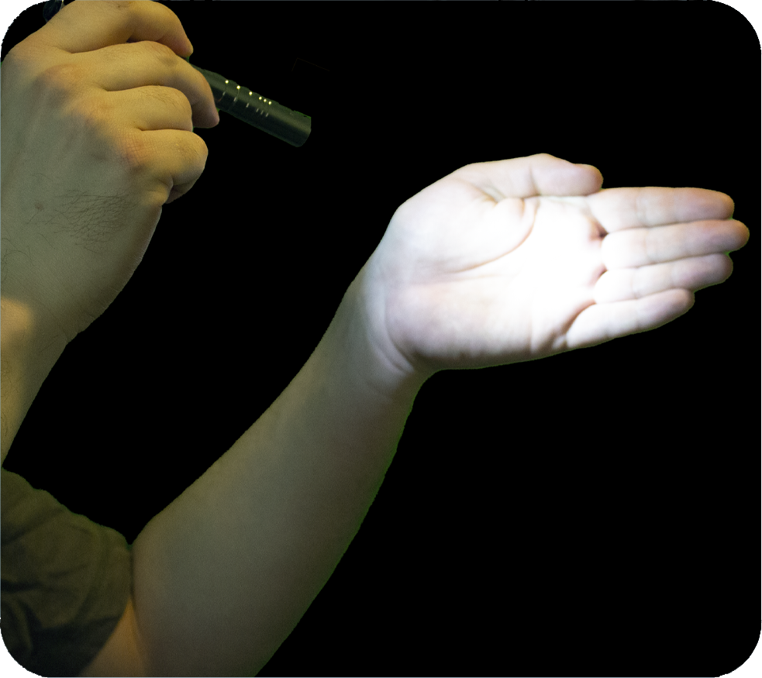
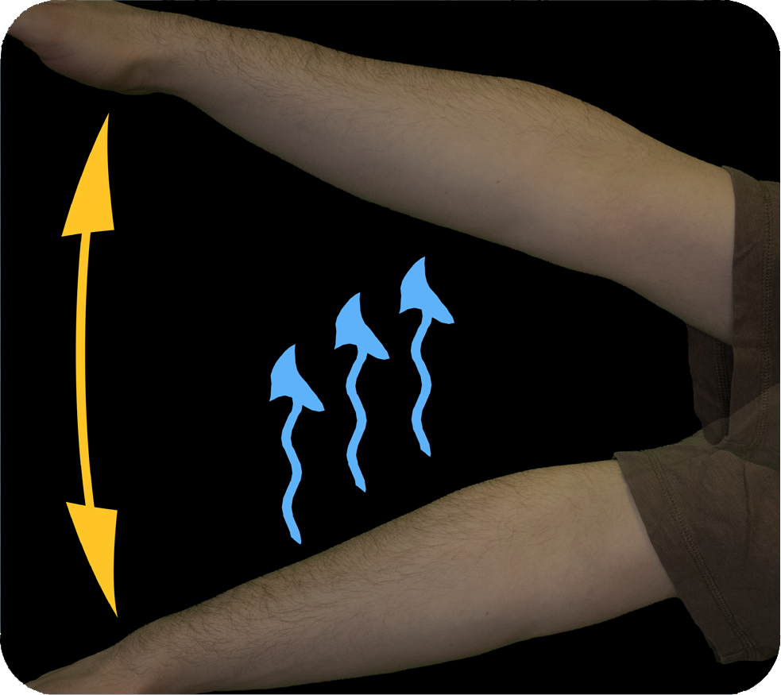
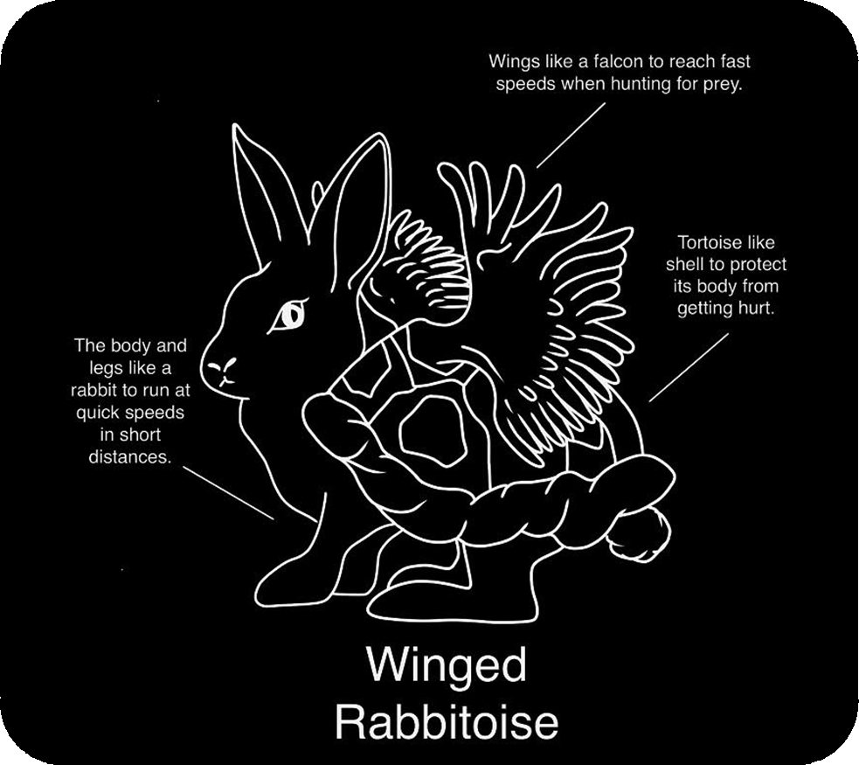
Adaptations: A Way of Life
Activities and demonstrations explore the different adaptations of desert plants and animals
  Succulence
  Keeping cool in the hot desert
  Shade and light in the desert
All demos and activities can be run on their own or paired with one or more of the others
Succulence Demo
Succulence Activity
Prickly Pear Model
Shade and Leaf Angle
Panting and Sweating
Create a Desert Creature
Notes:
Claire/Brooks

Slide 15
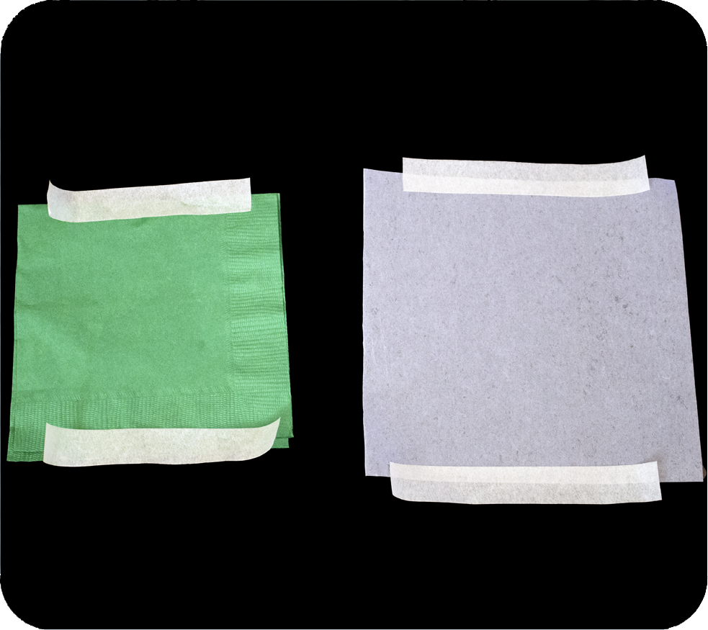
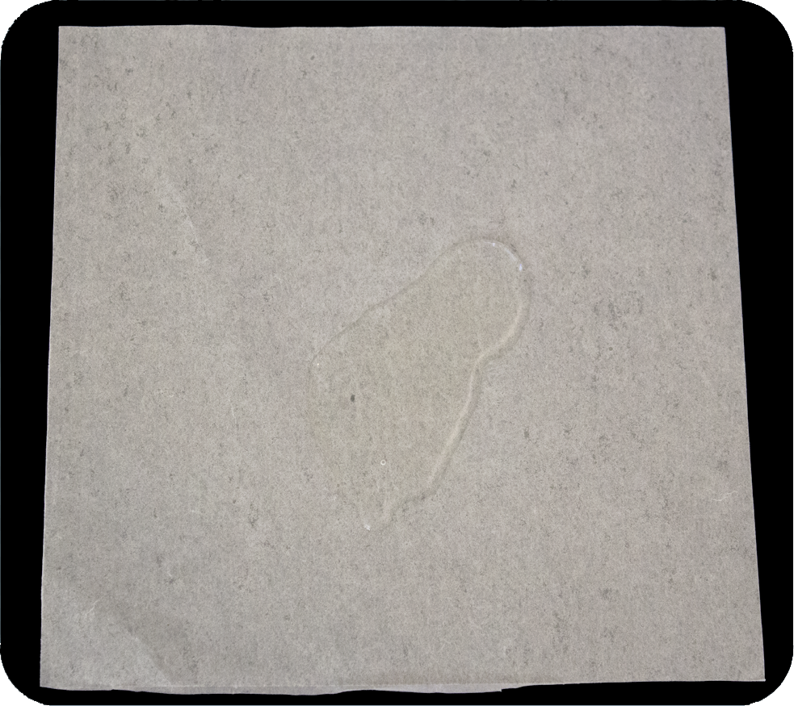
Adaptations: A Way of Life
Succulence Demo
Supplies
  Paper Towels/Napkins
  Wax Paper
Models how the different parts of a succulent leaf absorbs or repels water
  Absorbent paper towel models the fleshy interior of succulent leaves
  Wax paper models the waxy exterior of a succulent leaf
Notes:
Claire/Brooks

Slide 16
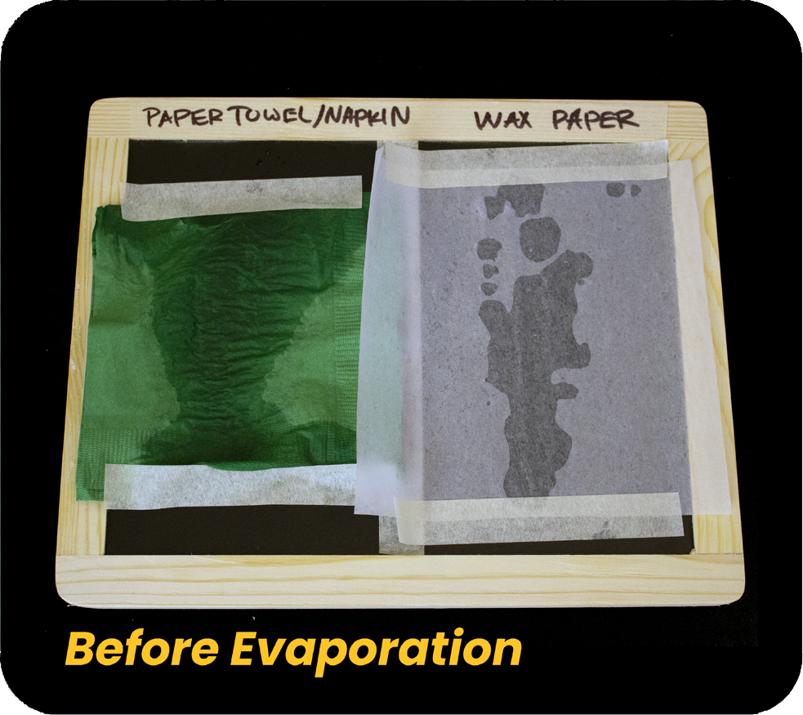
Adaptations: A Way of Life
Succulence Activity
Supplies
  Paper Towels/Napkins
  Wax Paper
  Blackboard
Allows patrons to observe adaptations discussed in the demo
Great to set up before another activity (Build a Desert Creature, Prickly Pear Model, storytime, etc.)
Notes:
Claire/Brooks

Slide 17
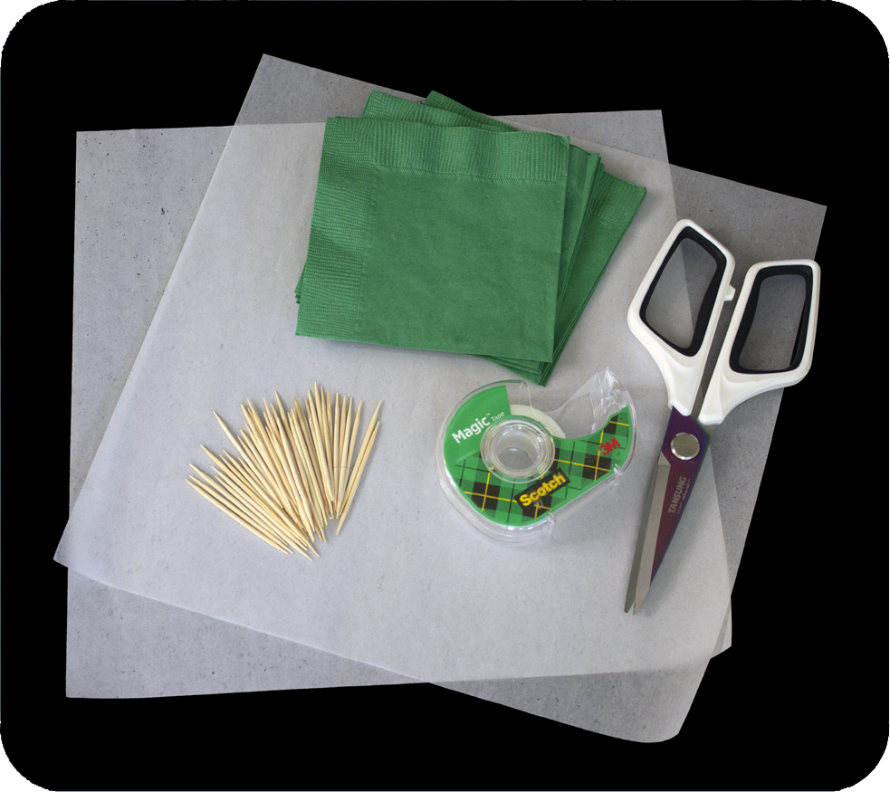
Adaptations: A Way of Life
Prickly Pear Model
Supplies
  Paper Towels/Napkins
  Wax Paper
  Tape/Glue
  Toothpicks
Patrons create a model succulent
Set up as a station, facilitated activity, or take and make
Notes:
Claire/Brooks

Slide 18
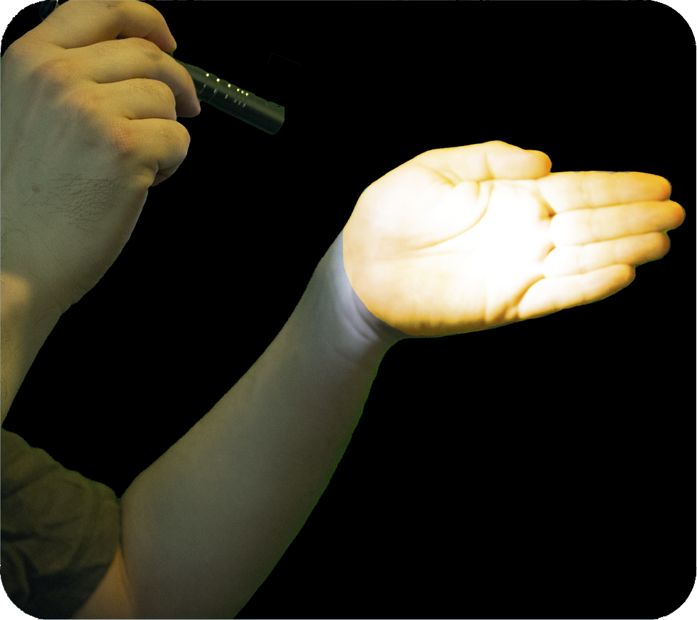
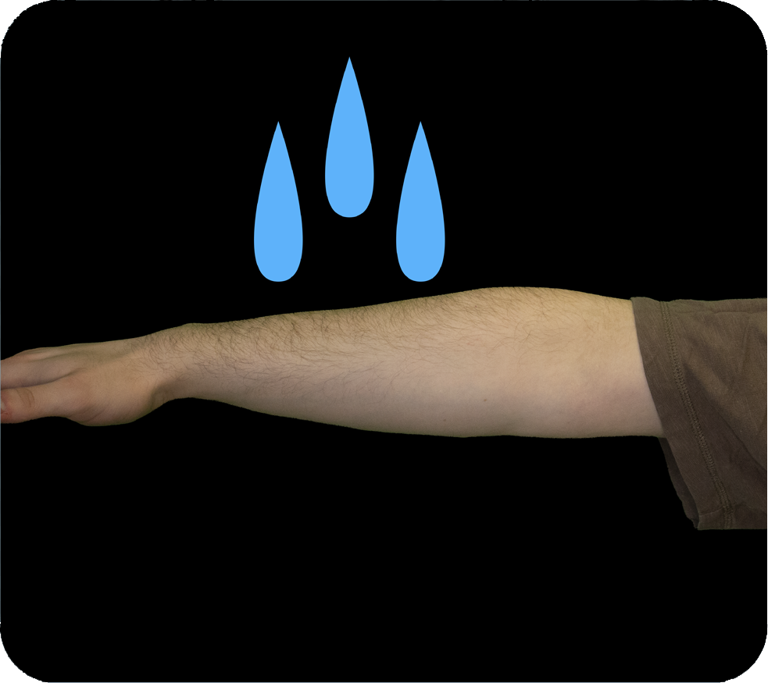
Adaptations: A Way of Life
Keeping Cool Demos
Kinesthetic activities that allow patrons to participate
Shade and Leaf Angle demo explores how plants adjust leaf angle to control how much light/heat they absorb
Panting and Sweating allows patrons to feel the effects of evaporative cooling
Notes:
Claire/Brooks

Slide 19
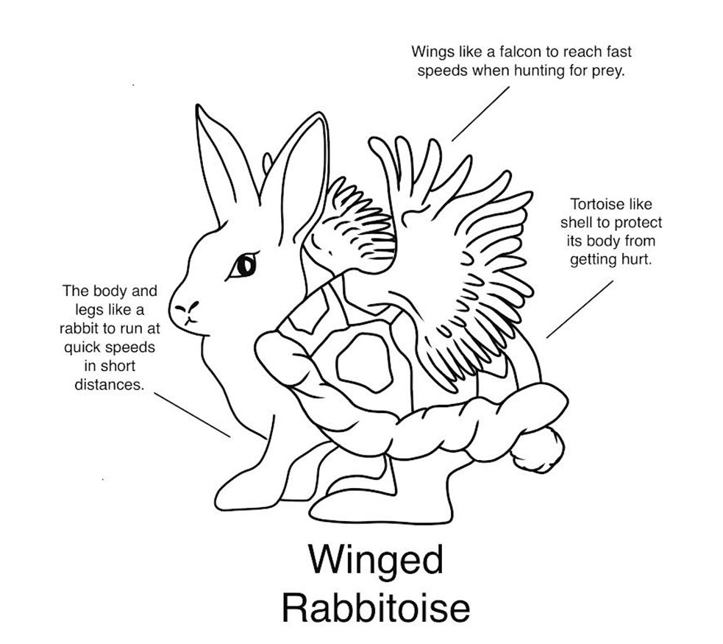
Adaptations: A Way of Life
Create Your Own Desert Creature
Create your own desert creature with any art supplies
Great found materials activity
Have patrons create their desert creature
Notes:
Claire/Brooks

Slide 20
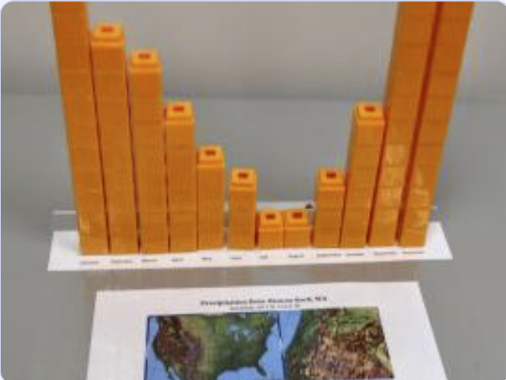
Precipitation Towers
Participants create 3D graphs using stackable cubes (Legos) using NASA data.
Observe and compare precipitation levels from several different locations.
Make it "place-based" by creating a data set unique to your location!
Tweens

Slide 21
Precipitation Towers
Activity includes precipitation data across the U.S. and around the globe
Optional: 3D Printer file to create bases for the precipitation towers
Includes videos about drought in the U.S.
Tweens

Slide 22
Precipitation Towers
Library facilitation guide and how-to video coming soon!
Tweens

Slide 23
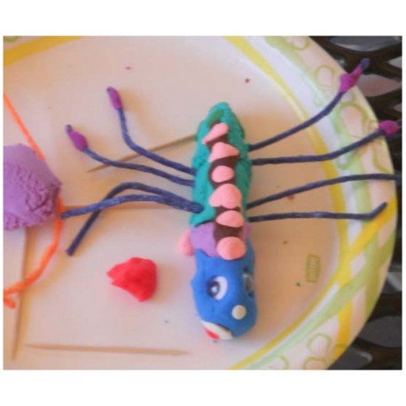
Build-A-Bug
Patrons learn about adaptations while creating their own aquatic insect.
Make this a "Take & Make" activity by providing
  a printed copy of the Table Sign
  Craft materials
Ages k-6

Slide 24
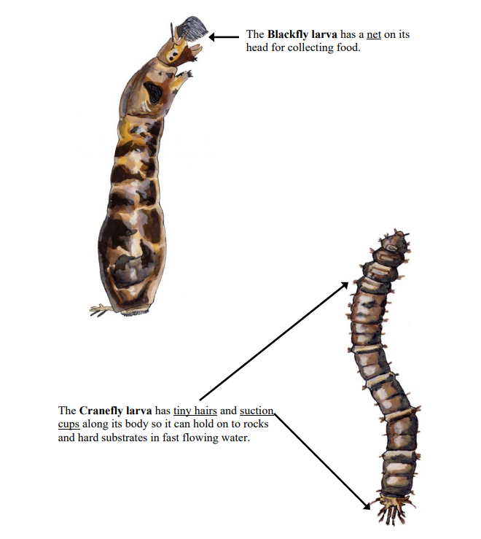
Build-A-Bug
What is an adaptation?

Slide 25
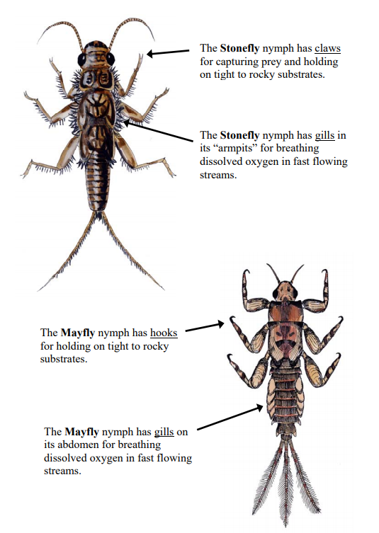
Build-A-Bug
What are some adaptations an insect might need to live in the water?
Facilitation tip: ask probing questions
Why would it need that?
How does the adaptation help it survive?

Slide 26
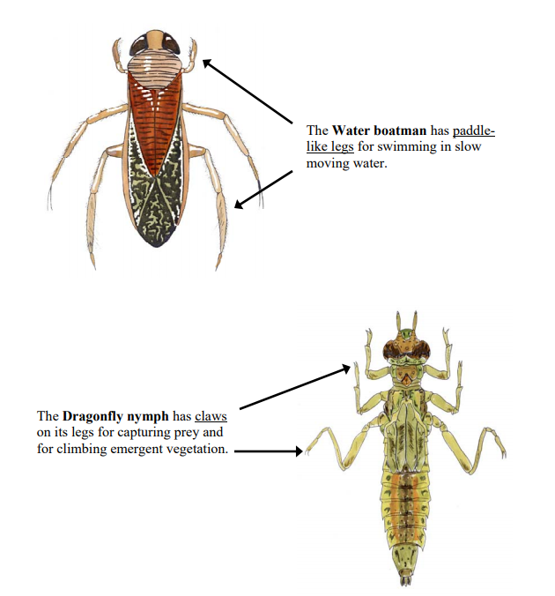
Build-A-Bug
Insects that live in the water are called “Aquatic Macroinvertebrates”

Slide 27
Build-A-Bug
Macro: big enough to see without a microscope.
Invertebrate: doesn’t have a backbone.

Slide 28
Many macroinvertebrates can’t live in polluted water.
If we see many kinds of macroinvertebrates in a pond or stream, what does that tell us about the water quality?
Build-A-Bug

Slide 29
Build-A-Bug
You will be creating your own special aquatic macroinvertebrate!

Slide 30
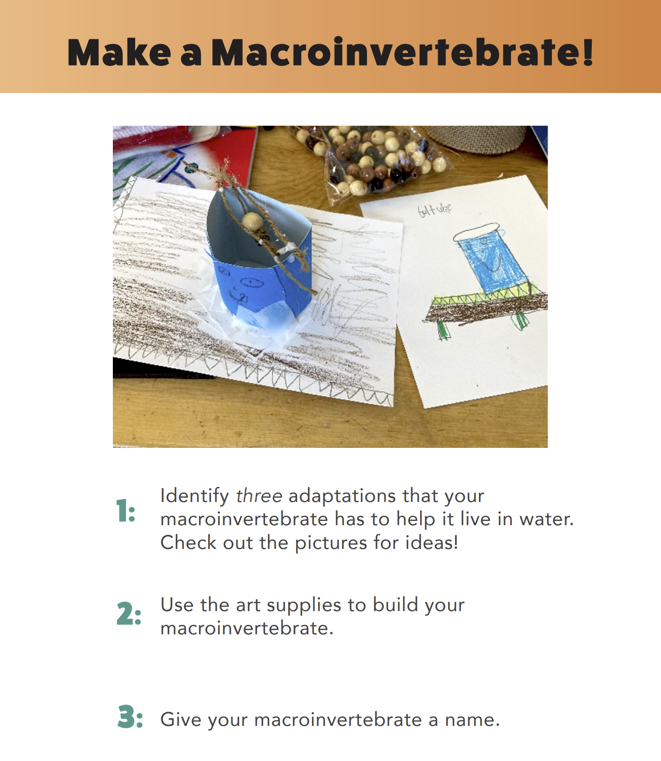

Slide 31
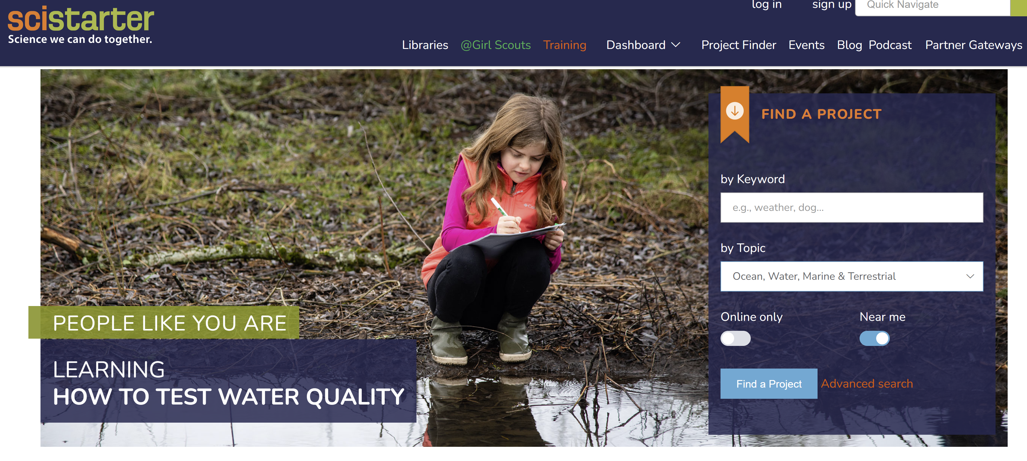
Citizen Science Projects

Slide 32
Citizen Science Projects

Slide 33
Citizen Science Projects

Slide 34
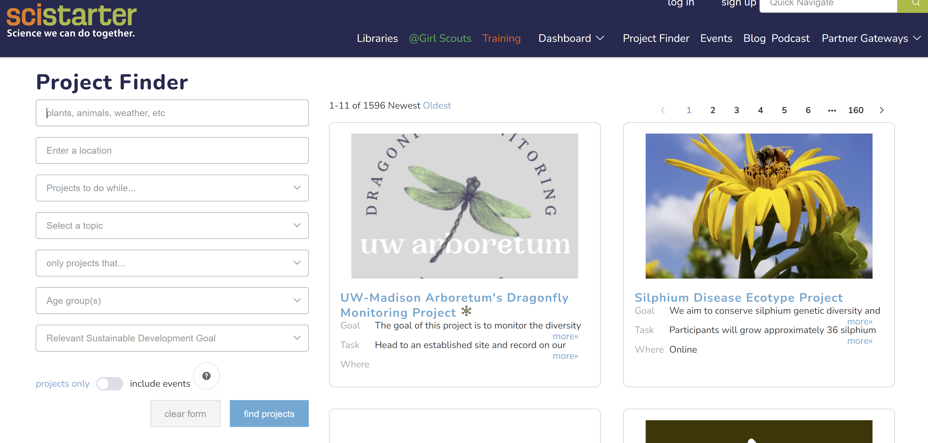

Slide 35
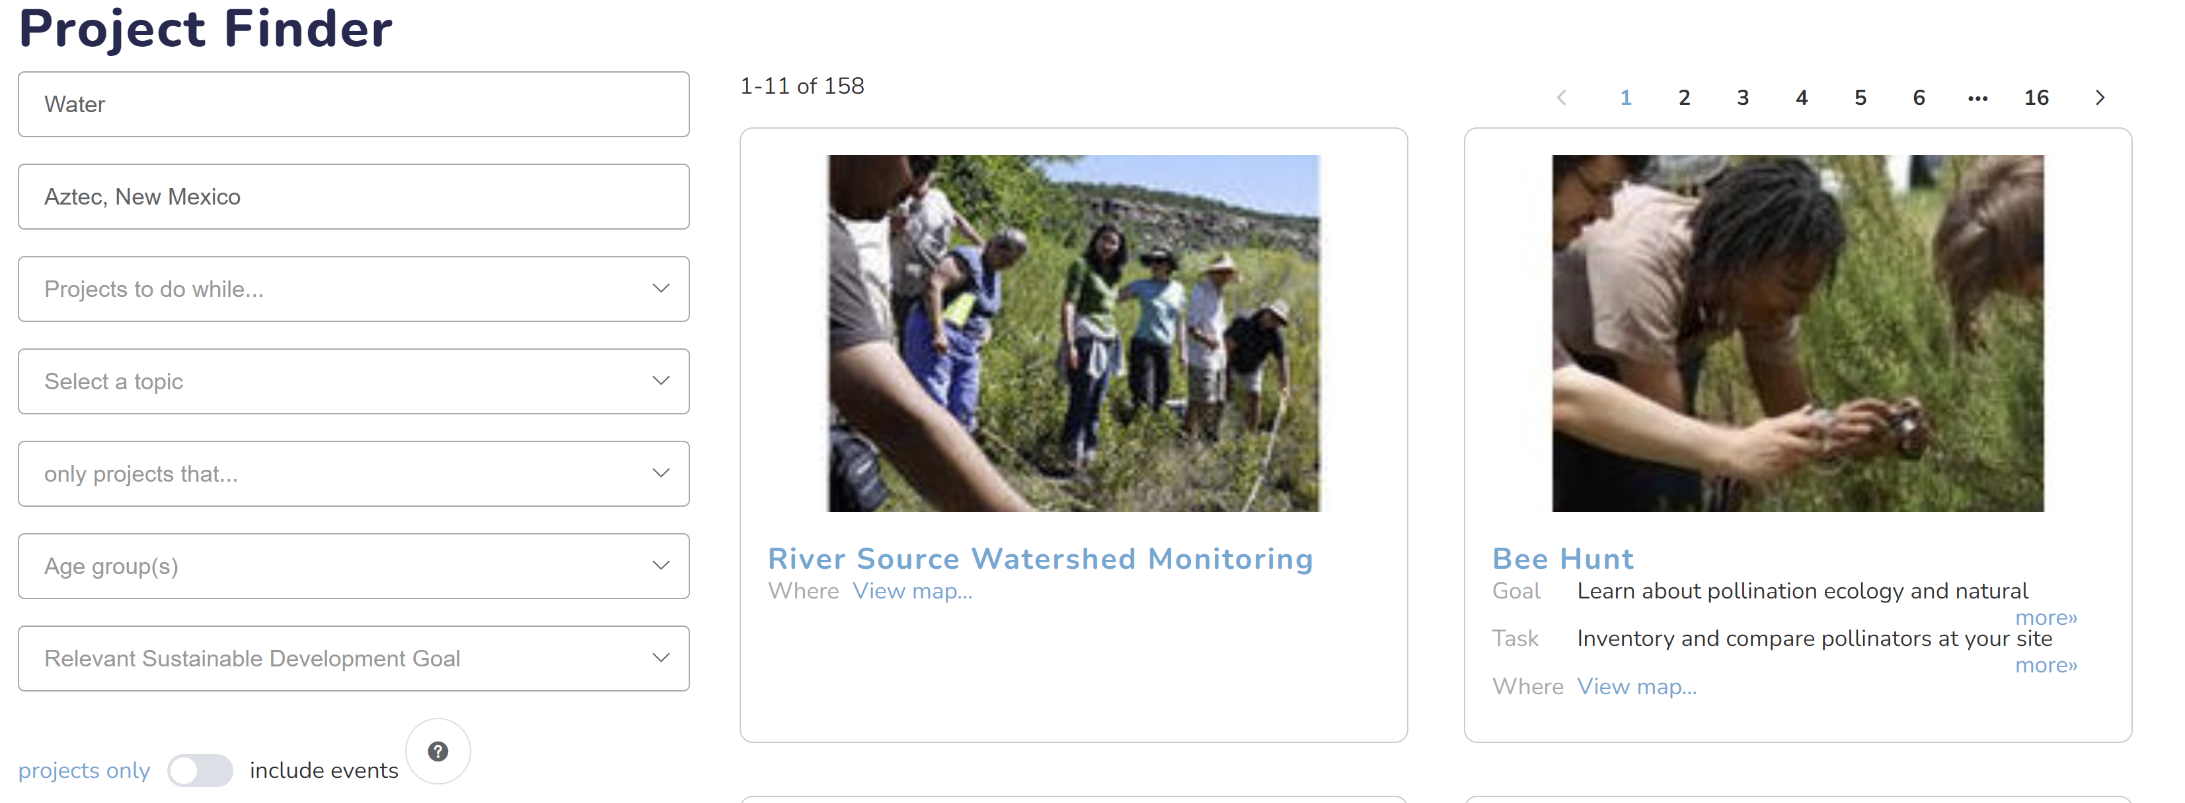

Slide 36
Citizen Science Projects

Slide 37
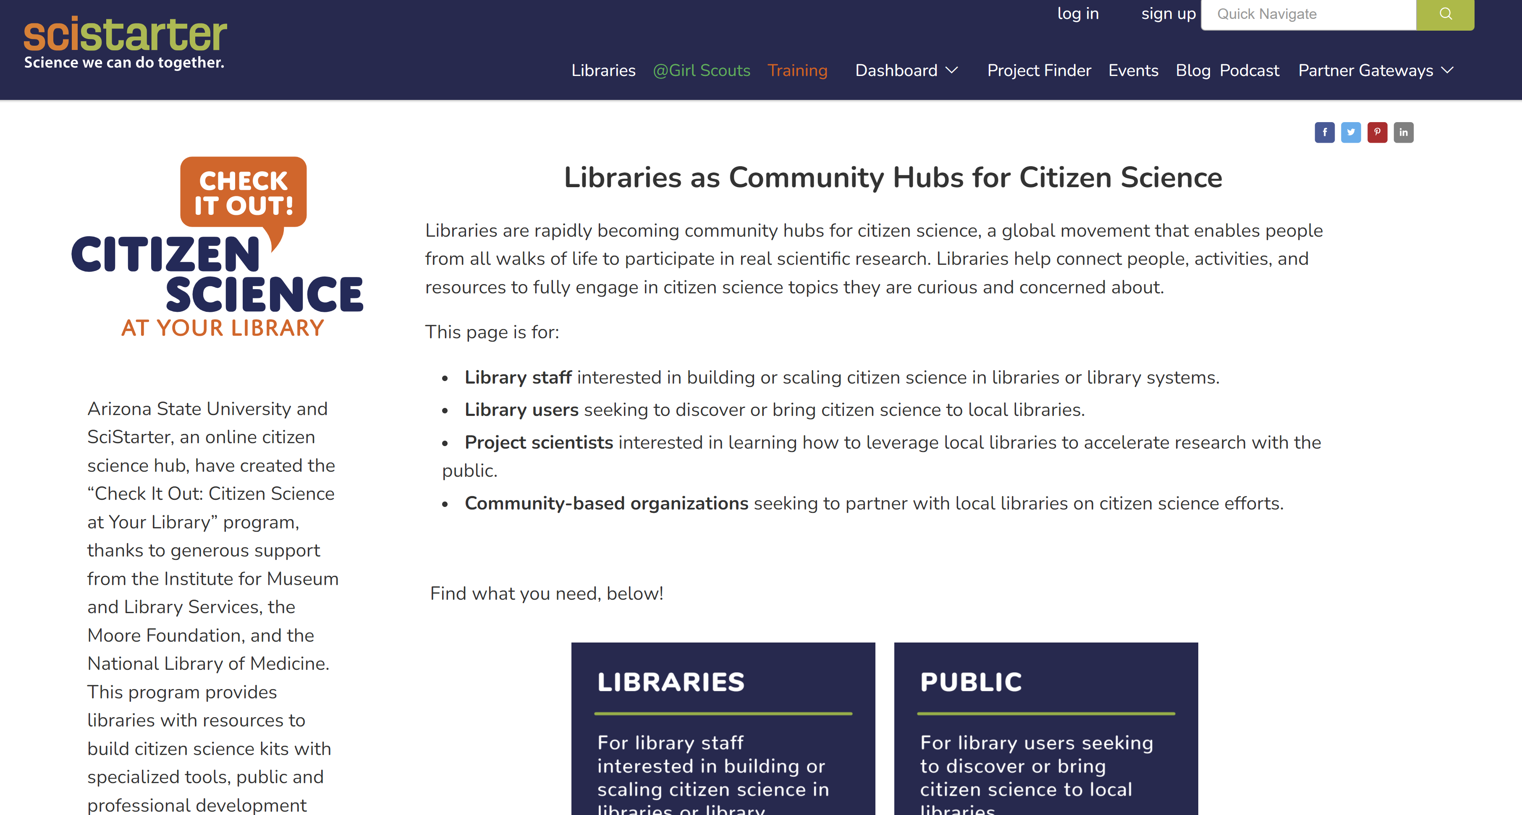

Slide 38
Additional 'We are Water' Resources

Slide 39

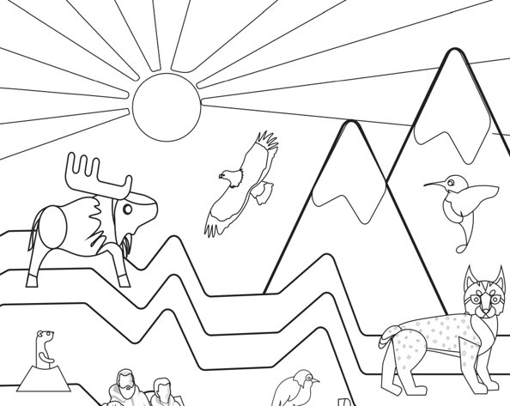
Take & Make Kits:
Be a Water Historian
Coloring and Activity Book

Slide 40
Poll Question
Which of these activities/resources are you most excited about?
- Adaptations: A Way of Life
- Precipitation Towers
- Build-A-Bug
- SciStarter Citizen Science Resources
- Take & Make Activities

Slide 41
Thank you!

