Slide 1
Citizen Science in the Library: Turn Your Curiosity into Impact
February 24, 2022
The webinar will begin at 1:00 p.m. (MT) and will be recorded.
While you’re waiting
Find the toolbar – it will either be on the bottom or top of your Zoom window
Introduce yourself in the chat box (please select “Share with Panelists and Attendees” not “Share with Panelists”)
Click audio “Join by Computer” – you won’t have microphone access
Tip for viewing: You can resize and move the location of the video and slide screens by clicking and dragging them

Slide 2
Facilitator Introduction
Claire Ratcliffe Adams (STAR Net)
Dillon Connelly (STAR Net)
Caroline Nickerson (SciStarter)

Slide 3
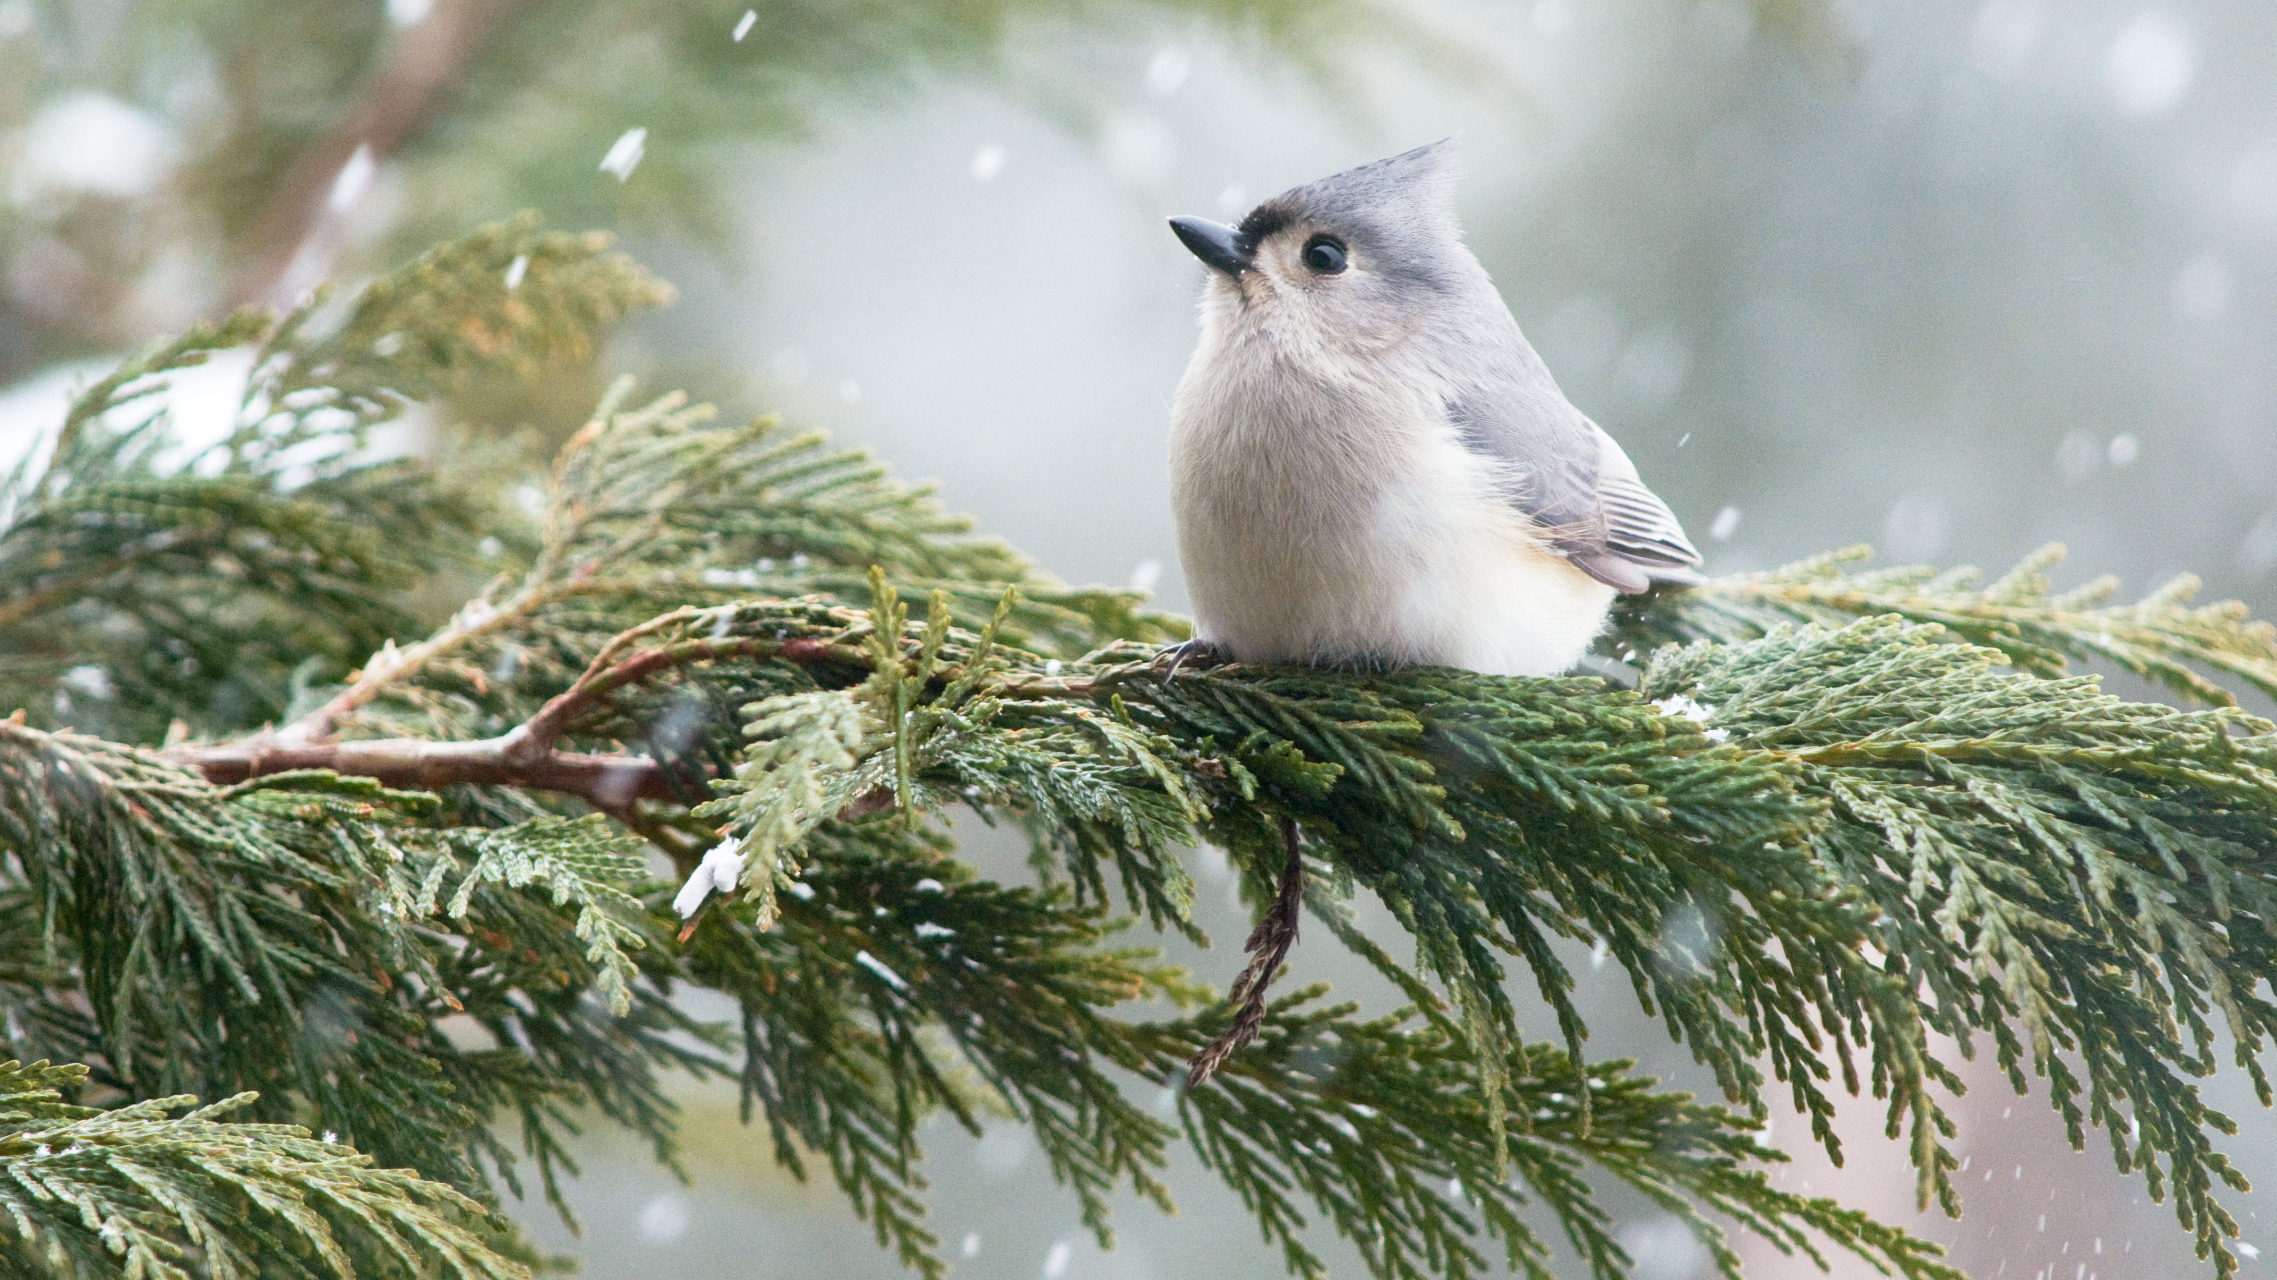
Ice Breaker
How long has the longest-running citizen science project been going?
3 months
2 decades
122 years
200 years

Slide 4
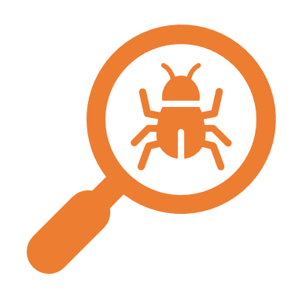
Libraries as Community Hubs for Citizen Science
Planning for 2022 Citizen Science Month in April!

Slide 5
Today’s Agenda
Library Network Overview
What is Citizen Science Month?
Today’s Agenda
Planning for Citizen Science Month
Promoting Your Citizen Science Month Event
Questions

Slide 6
Welcome to the National Citizen and Community Science Library Network!
SciStarter.org/library-network
Notes:
https://scistarter.org/library-network

Slide 7
What is
citizen science?
A global movement that enables people from all walks of life (anytime, anywhere) to participate in real scientific research by making and sharing observations with scientists. It’s how people can make an impact on issues they care about!

Slide 8
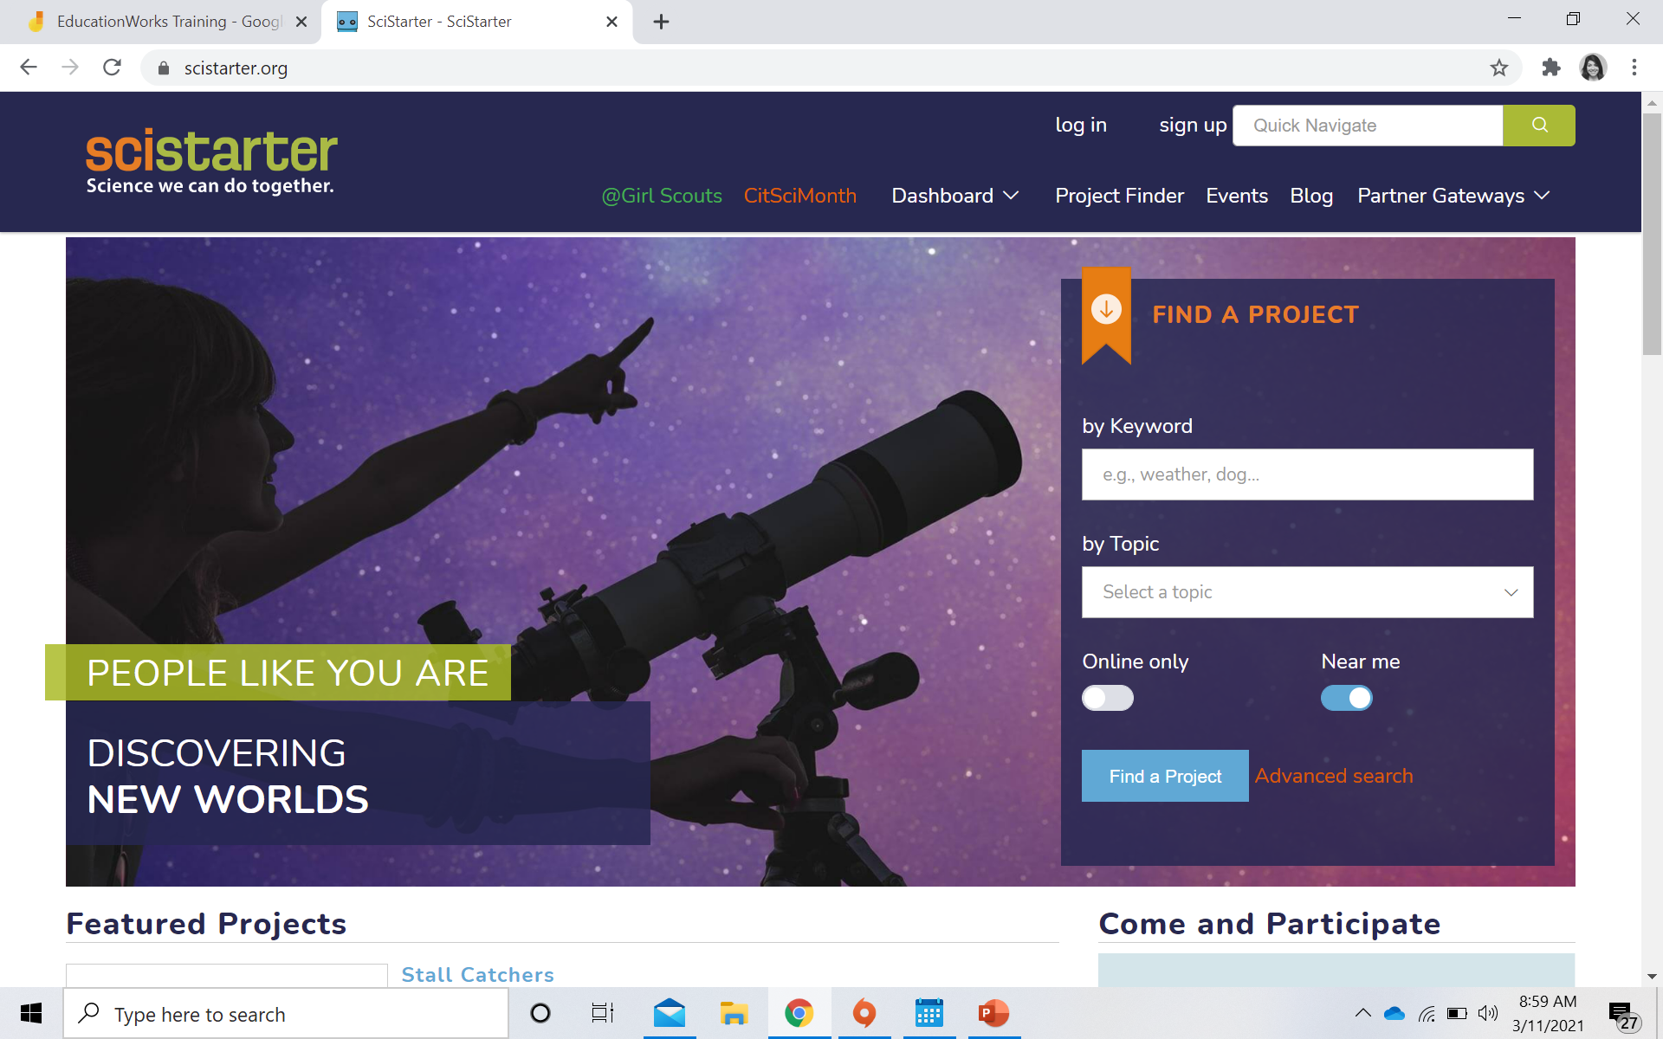
What is SciStarter.org?
A globally acclaimed web and mobile site that connects millions of people to thousands of projects, events, and tools.
Find replicable resources designed for libraries at: SciStarter.org/Library
Notes:
Why? Because libraries are important partners and facilitators to scale public engagement in science!

Slide 9
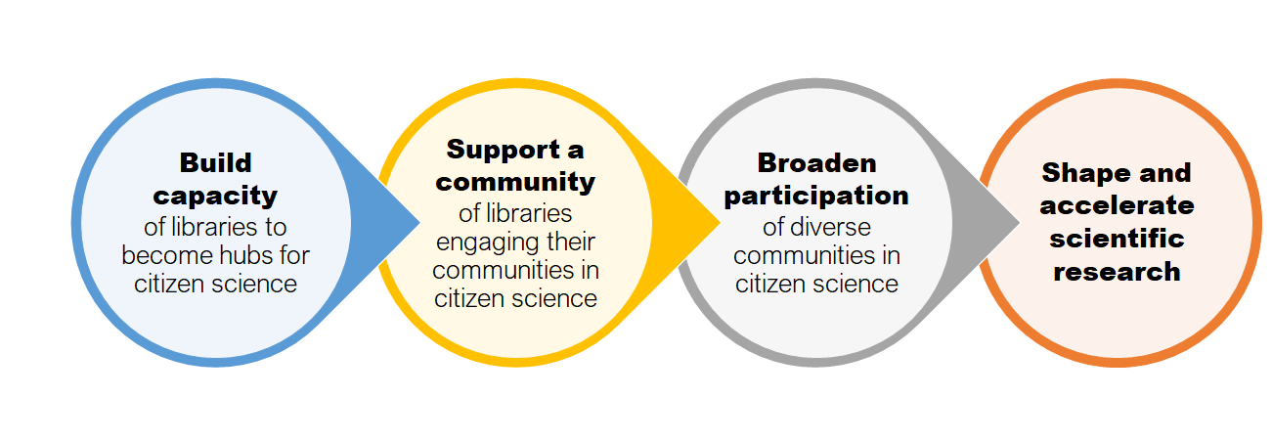
Citizen and Community Science LIbrary Network Goals

Slide 10
Benefits
Expectations
Ongoing professional development.
Kit building guides and marketing resources.
Access to future grant & funding opportunities.
Community of practice with other libraries invested in citizen science.
Access to a national network of community-based organizations committed to broadening participation in STEM through citizen science.
Evaluation reports with data and findings.
Sign-up for network at SciStarter.org/library-network.
Engage your community in citizen science.
Build and circulate citizen science kits.
Promote awareness of library network citizen science events.
Attend webinars and community of practice calls.
Participate in evaluate activities such as surveys and feedback calls.

Slide 11
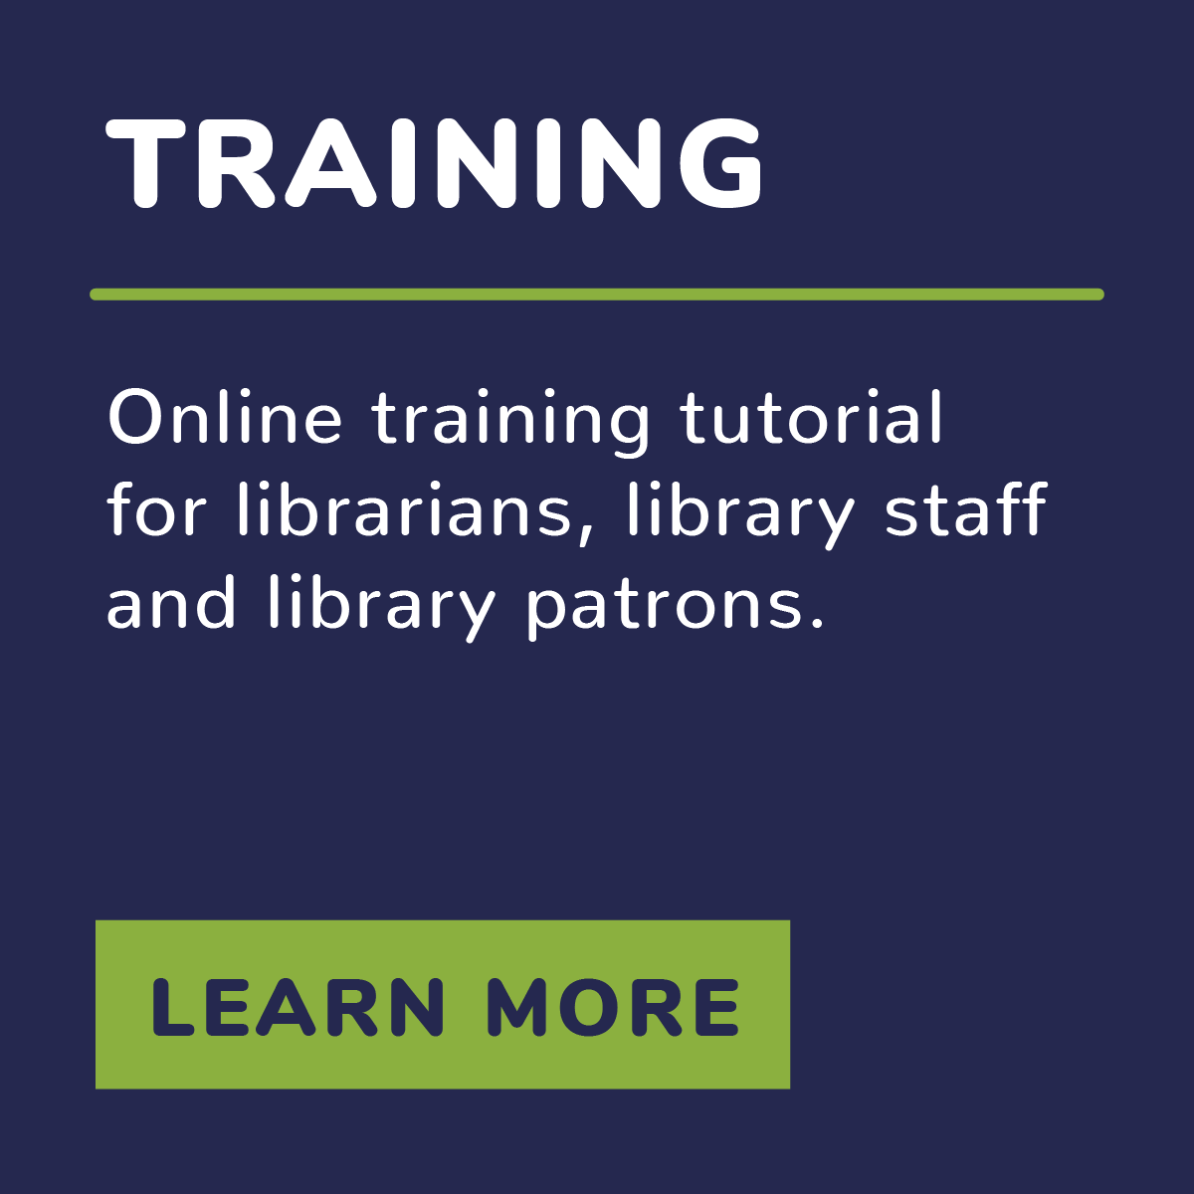
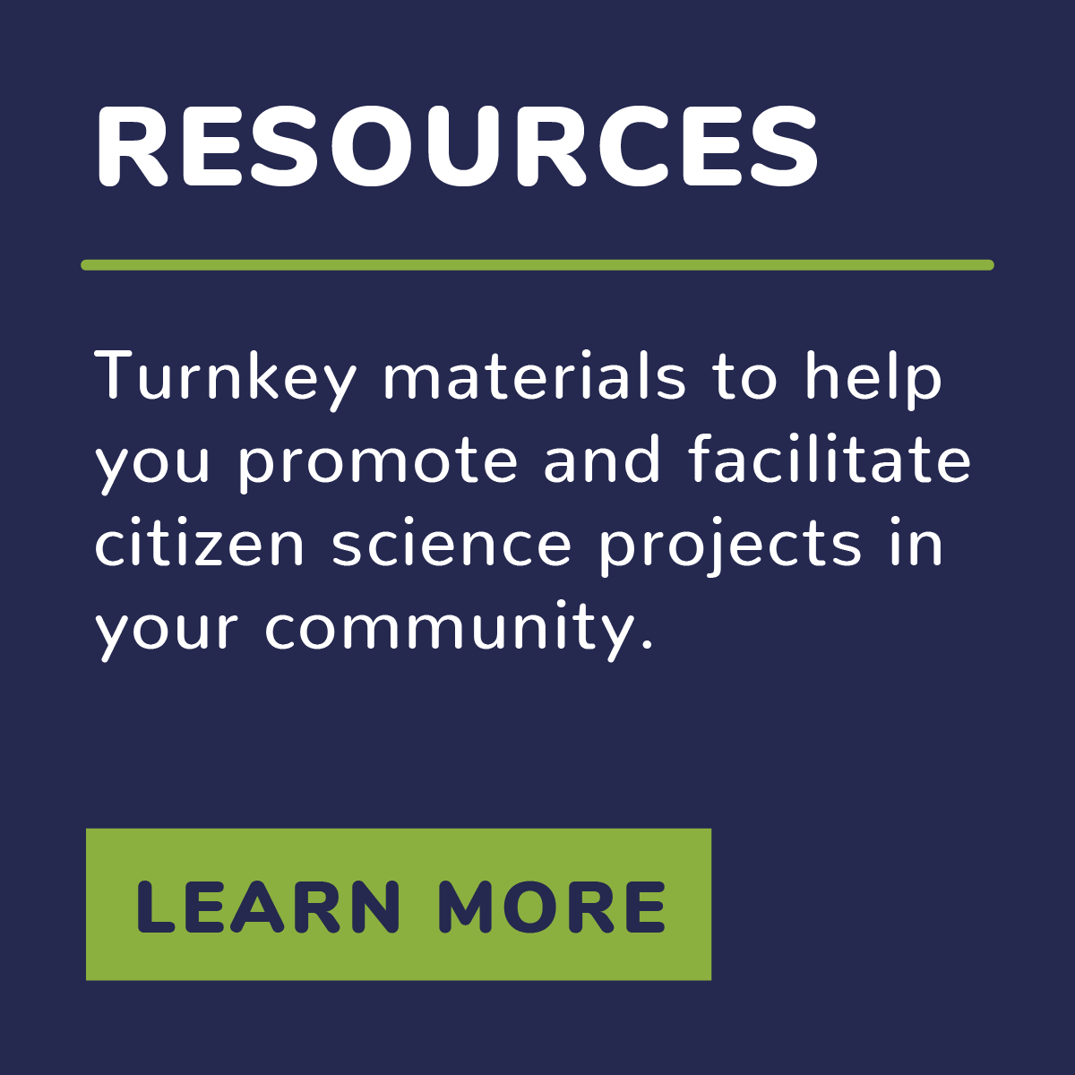
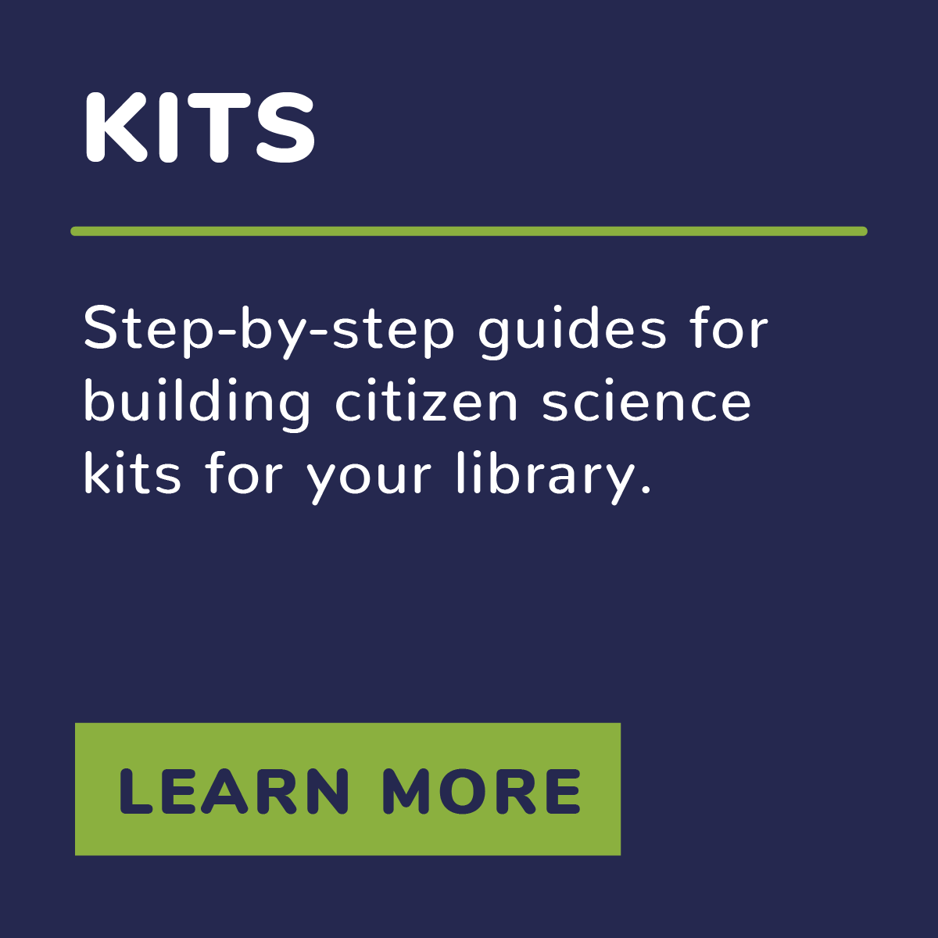
Ongoing Support for Library Staff
SciStarter.org/library-network
Notes:
Promotion and facilitation resources! Free and brandable
Marketing kits: Community partners (EVAC), video with brief kit training, one-on-one engagement, program commercials
Binder provided to each library for training and support
Staff training: opportunity for staff to look and use kits, how to find kits in library catalog, checkout/checkin process

Slide 12
Network Webinars
Watch previous webinars on YouTube, including:
Introduction to Citizen Science
How to Host a Citizen Science Event
Deeper Dive into Citizen Science Kits
www.youtube.com/scistarter

Slide 13
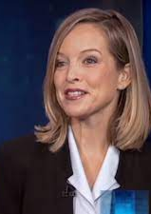
What is Citizen Science Month?
Citizen Science Month is a month-long celebration in April that features hundreds of events hosted by libraries to help build awareness of and engagement in citizen science!
Darlene Cavalier Founder of SciStarter
Notes:
https://scistarter.org/library-network

Slide 14
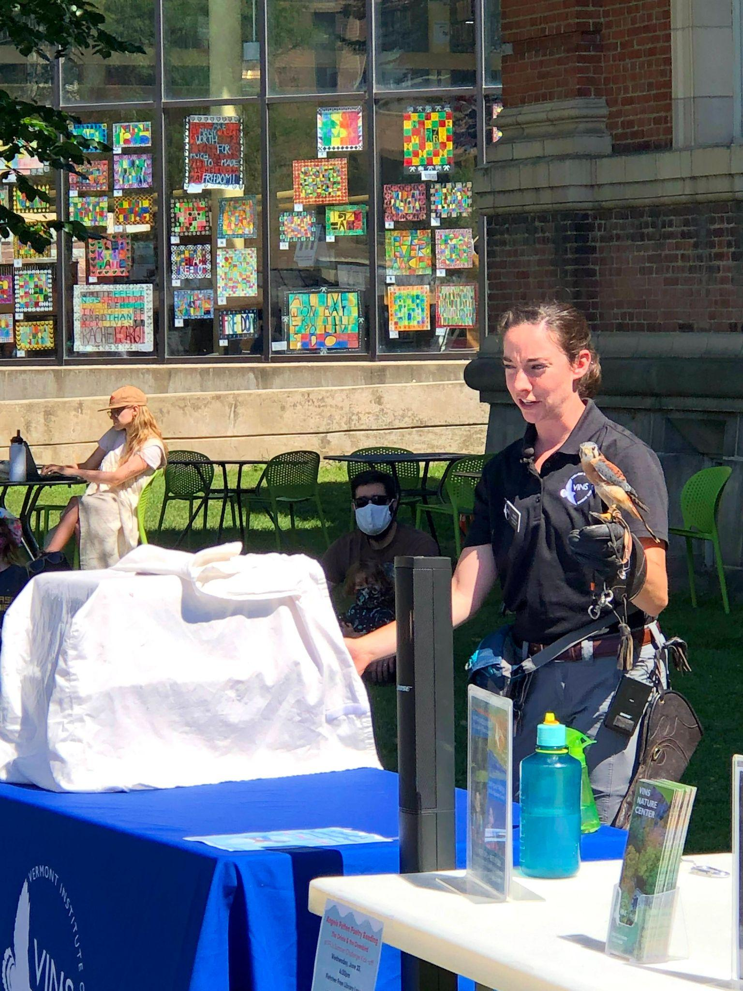
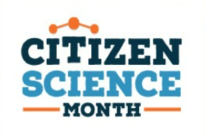
Goals of Citizen Science Month
Increase awareness of citizen science
Support librarians to host citizen science programs and events
Broaden participation in citizen science

Slide 15
Citizen Science Month 2021
250 events resulting in more than 350,000 data contributions to projects
two-thirds of survey respondents said Citizen Science Month helped change the way they think about libraries and the services libraries provide
100% of event organizers reported CitSciMonth matched or exceeded expectations
More than one million people reached through social media!

Slide 16
Planning for Citizen Science Month!

Slide 17
@SciStarter
Caroline Nickerson
Citizen Science Enthusiast
Notes:
17

Slide 18
Why host a citizen science event at your library?
Understand your community’s interests
Introduce projects advancing science that your community cares about
Support efforts to increase science learning
Enhance existing programs

Slide 19
Poll:
Have you hosted a Citizen Science Month event before?

Slide 20
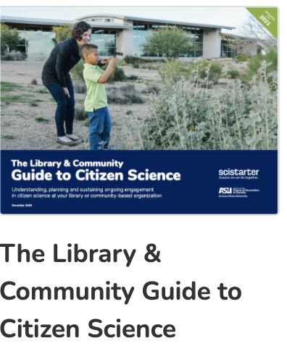
Use these resources to prepare:
CitizenScienceMonth.org
Find: best practices, case studies, evaluation/survey templates, program guides, grant opportunities, project recommendations, promotional materials and much more.

Slide 21
Essential Elements of Programming
Story
Experience
Action
Why should the viewer care?
Demo, active component.
Call for the viewer to participate in the citizen science project.

Slide 22
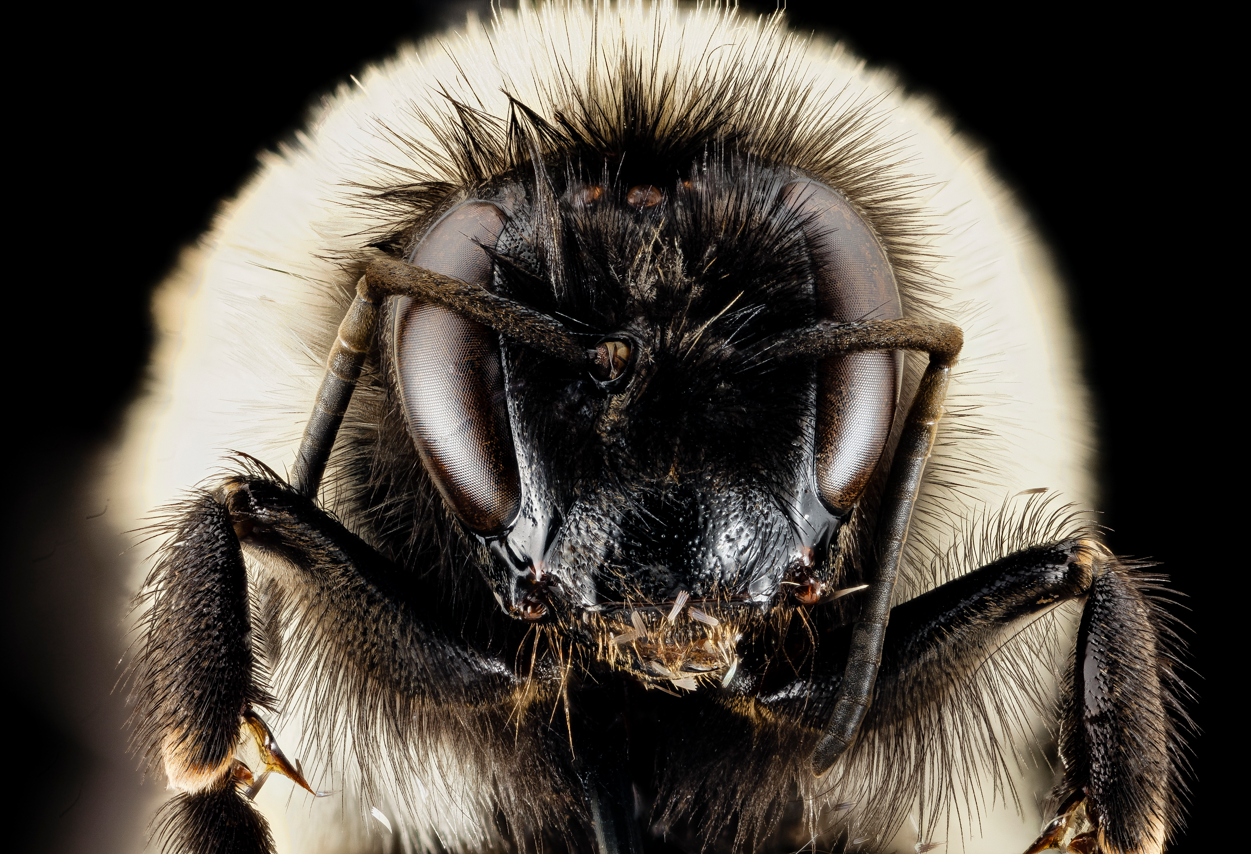
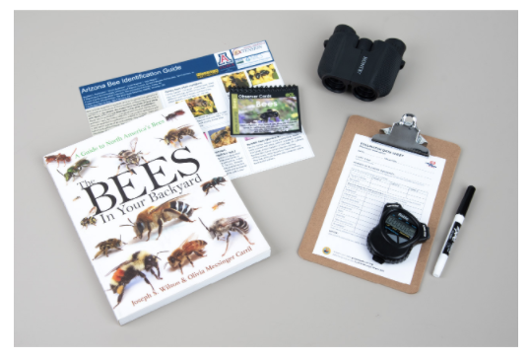
Story
Experience
Action
Read a story
Share a video
Interview a subject matter expert
Do an activity or experiment
Take a nature walk
Build an Observing Pollinators kit
Collect data together

Slide 23
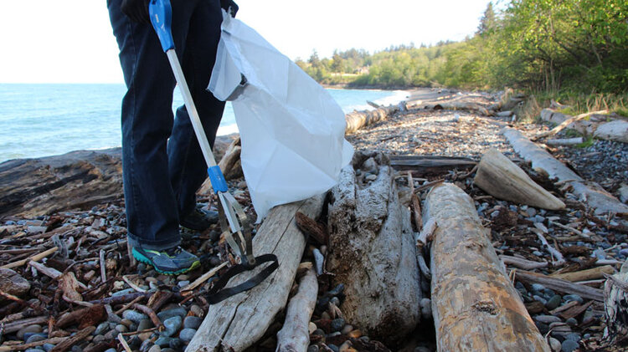
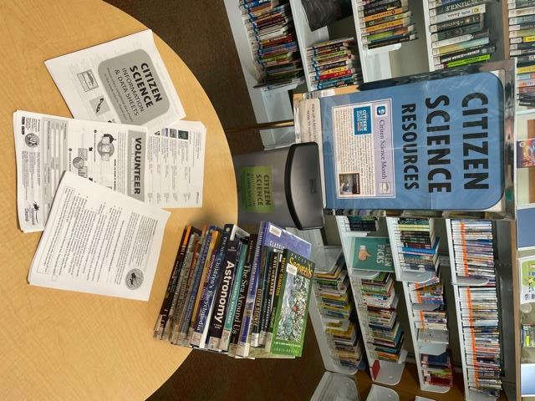
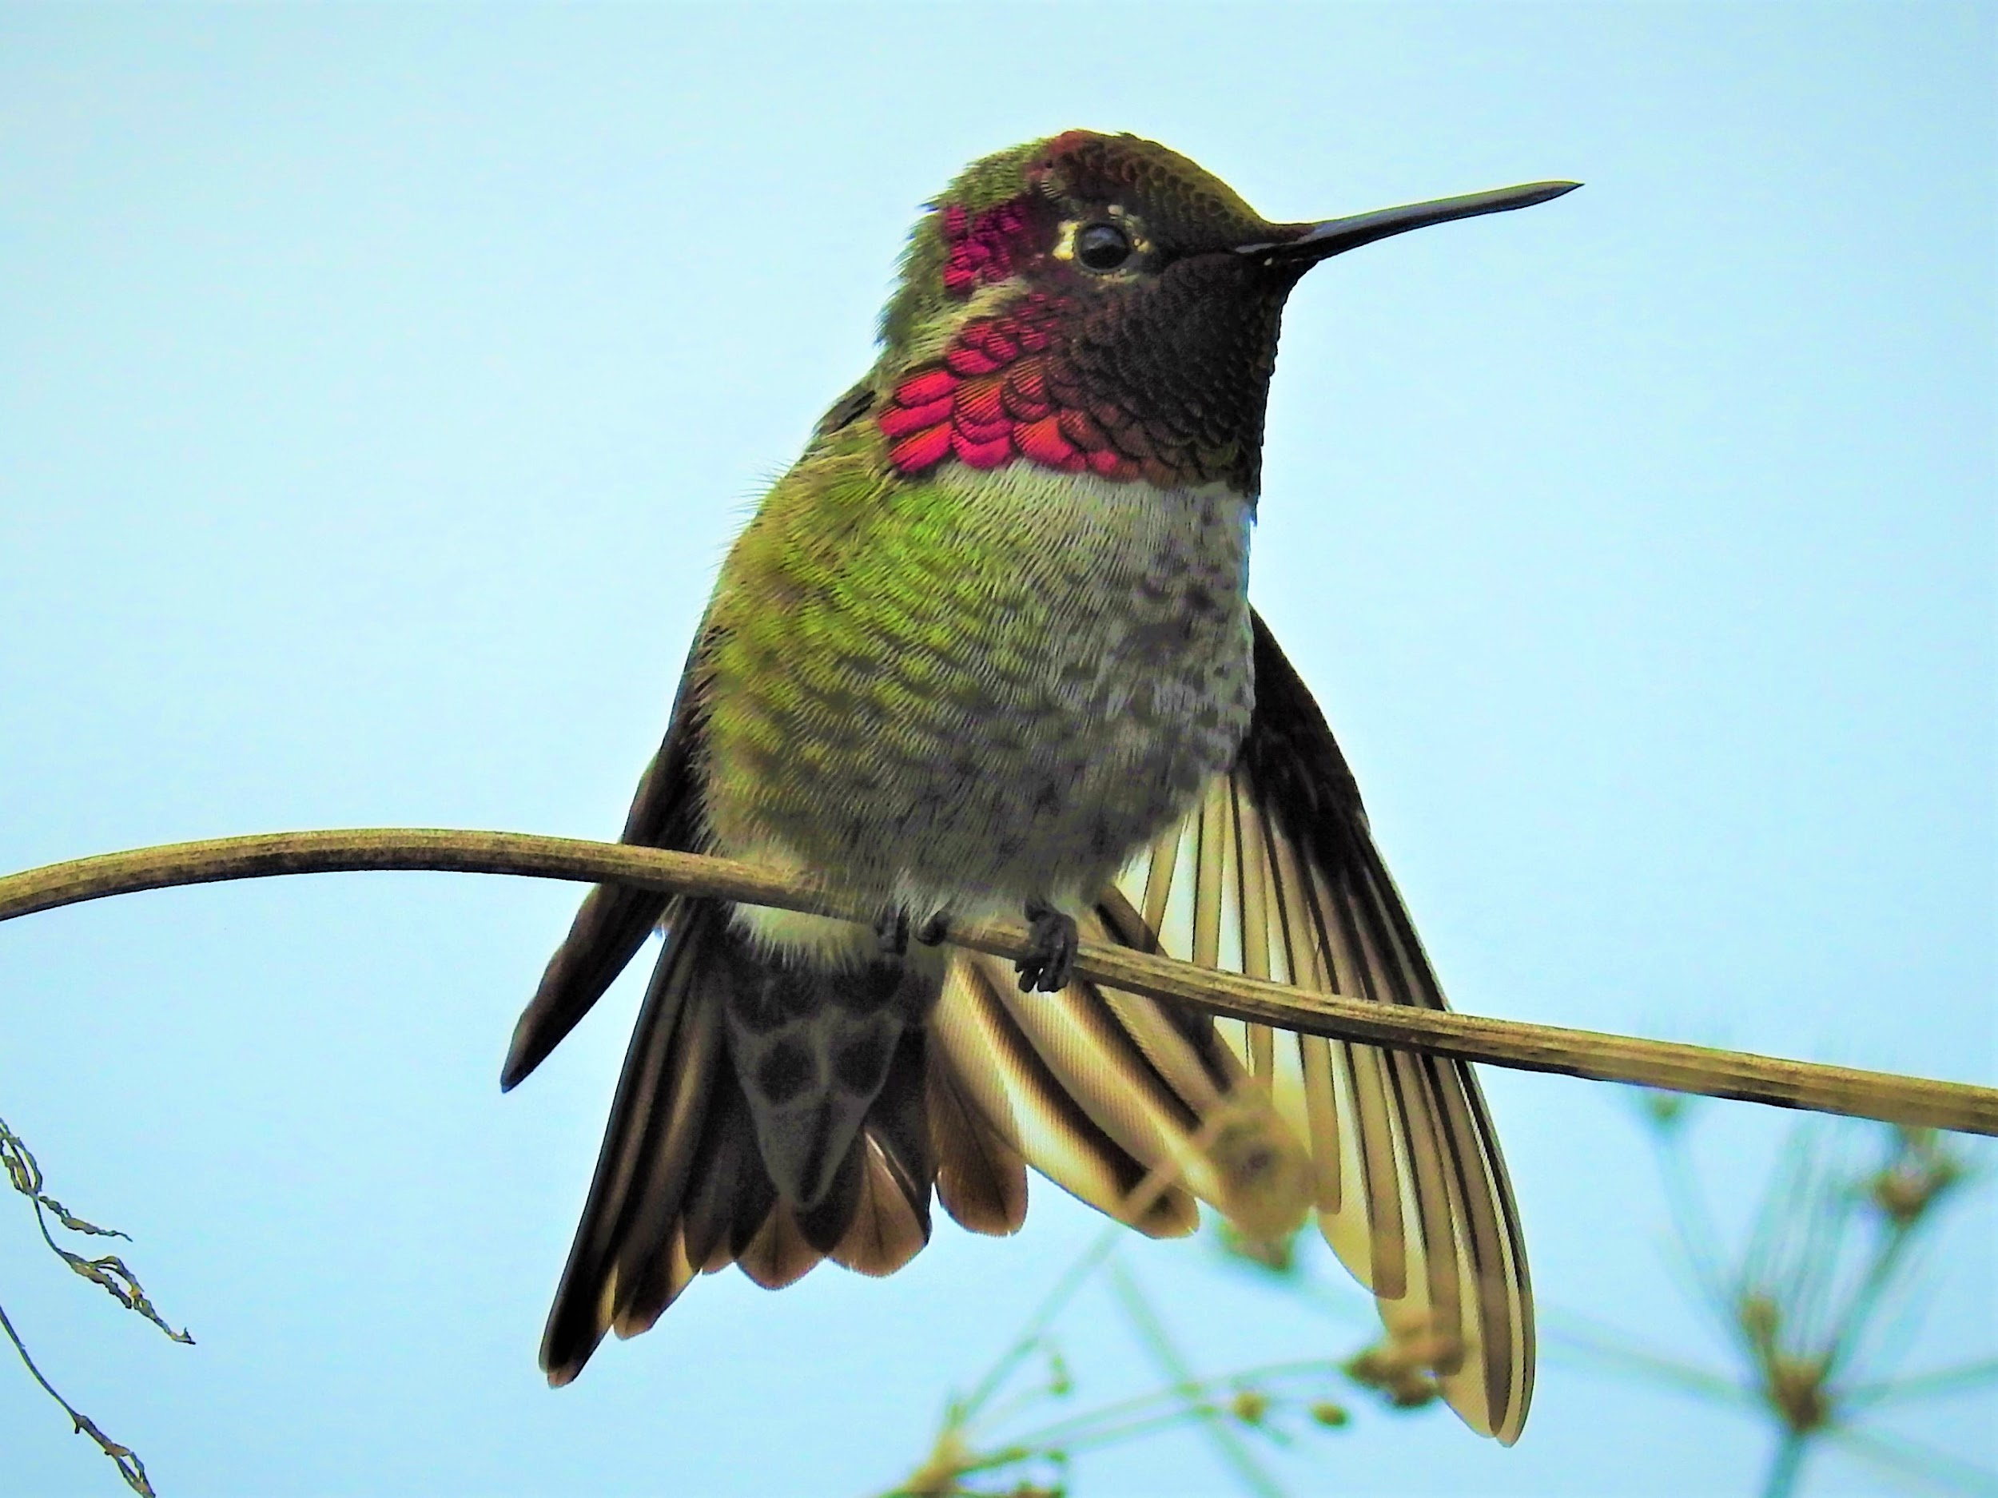
Citizen Science Month on Lummi Island, Washington
Hosted event to educate library users about marine debris and plastics.
Used SciStarter.org/NLM to find a related project then organized beach clean up and used Debris Tracker citizen science to report plastics to scientists.
Hosted webinar with SciStarter to talk about conservation and marine debris prevention.
Whatcom County Library System was the resource headquarters providing books, activities, data sheets & more!

Slide 24
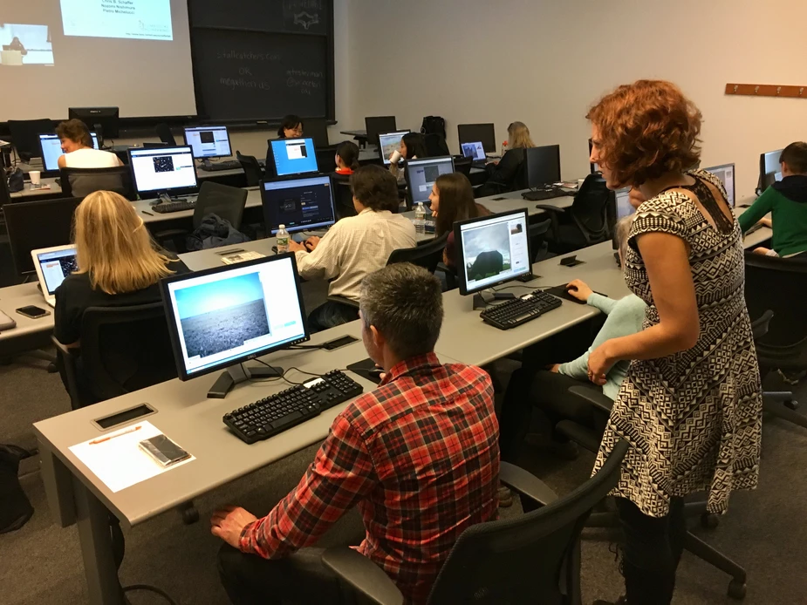
Stall Catchers Citizen Science at Princeton University Library
Citizen science games at your computer lab!
Stall Catchers
Eterna
Foldit
Find them all on SciStarter.org/NLM!
Image credit: https://www.mtesterman.com/post/citizen-science-princeton

Slide 25
Other programming ideas…
BioBlitz
Use free apps, tablets/phones, and materials (kits!) to document trees and biodiversity.
Walking Clean Up Tours
Use free apps, gear, and clean-up materials to record and pick up litter while helping scientists understand plastic pollution.
Game Day to Support Alzheimer’s Research
Play an online game (compete against other libraries!) and help speed up research on Alzheimer’s.
Location: Outdoor
Prep time: 30 mins
Event time:1-2 hours+
Age level: All ages
Location: Outdoor
Prep: 30 mins
Event time: 1-2 hours+
Age level: All ages
Location: Indoor
Prep: 30 mins
Event time: 1-2 hours+
Age level: 13+
Apps/Projects: iNaturalist
GLOBE Observer Trees
Apps/Projects: Marine Debris Tracker
ISeeChange
Apps/Projects: Stall Catchers

Slide 26
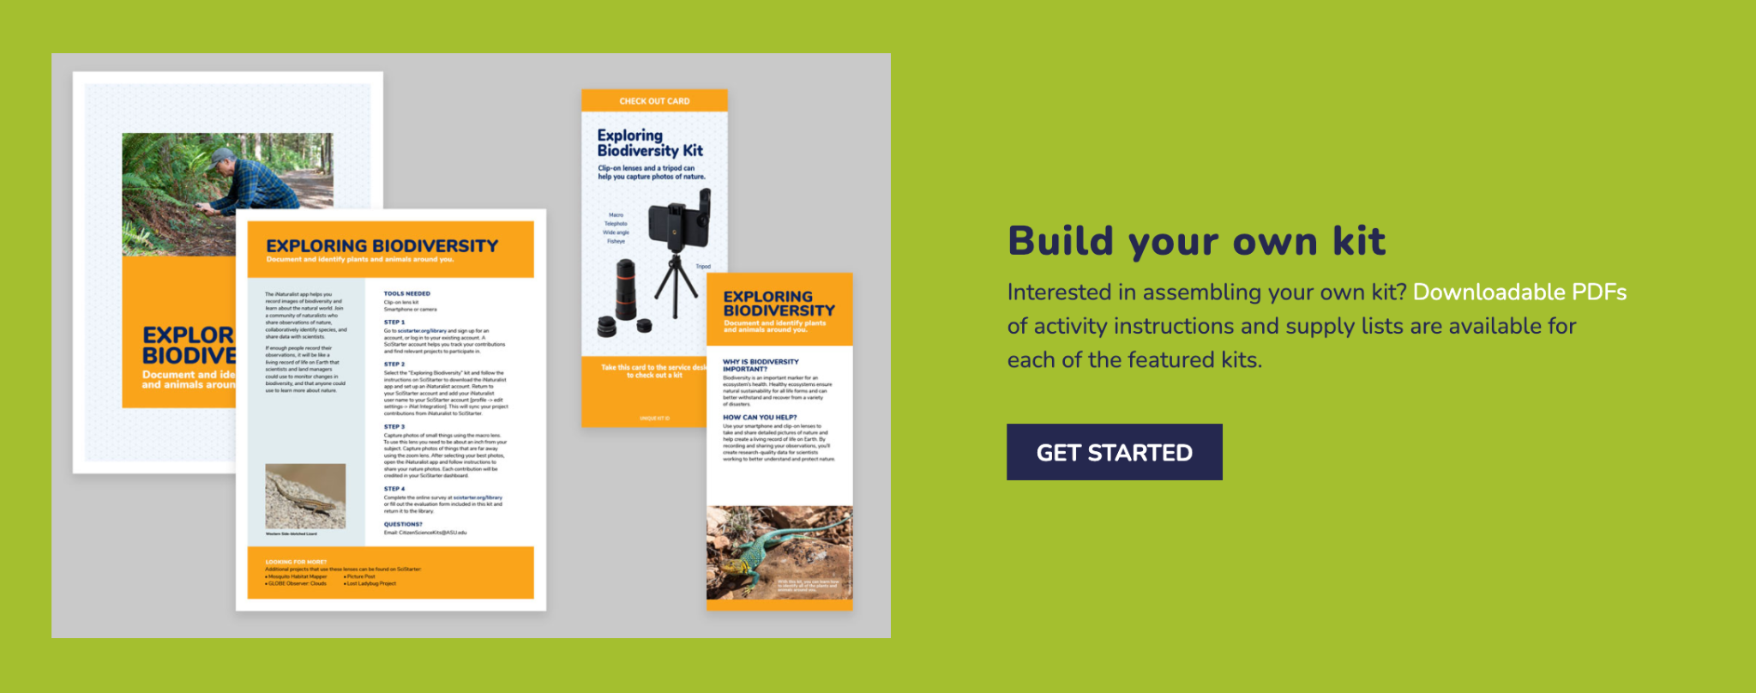
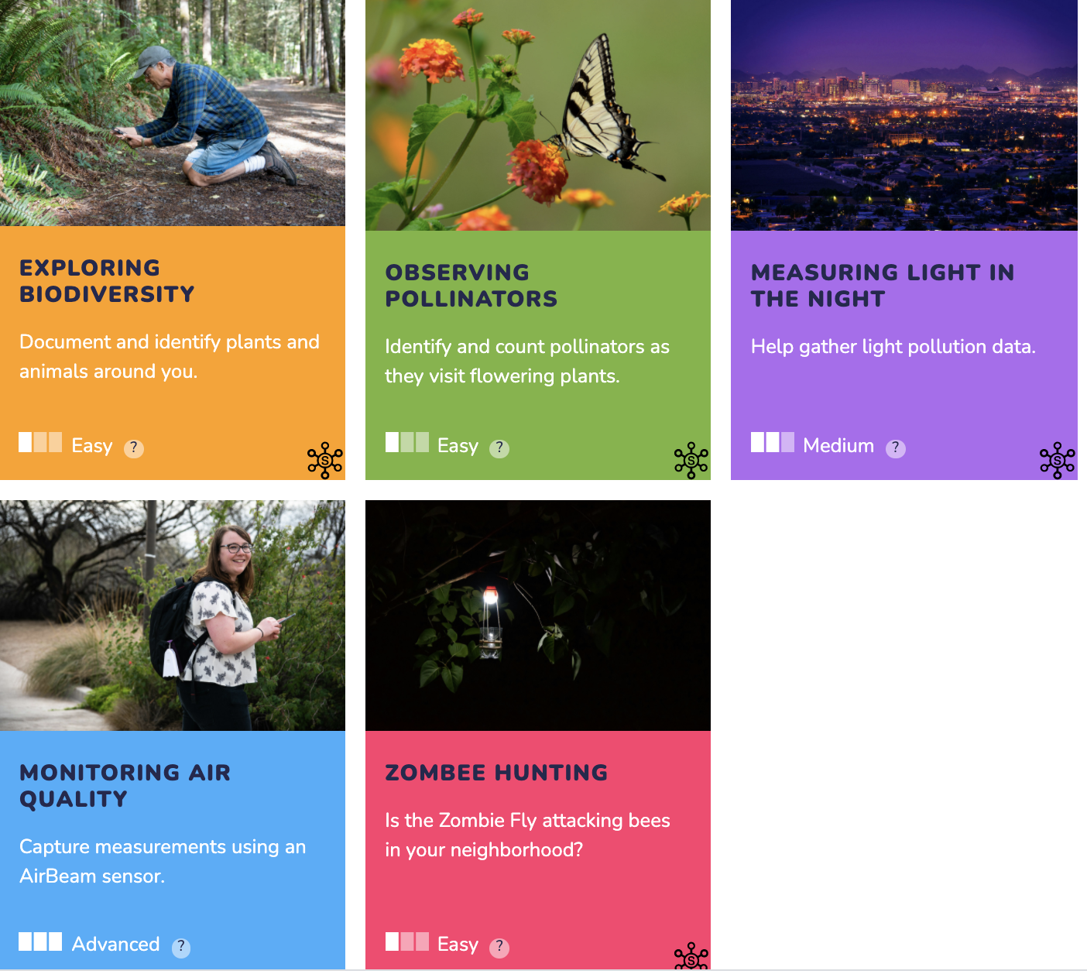
Circulate Field-Tested Citizen Science Kits
SciStarter.org/library-build-a-kit

Slide 27
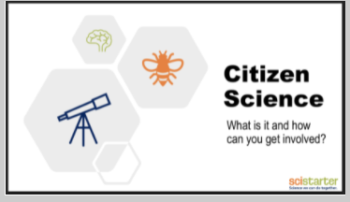
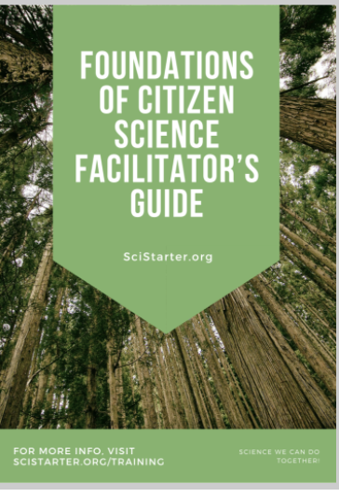
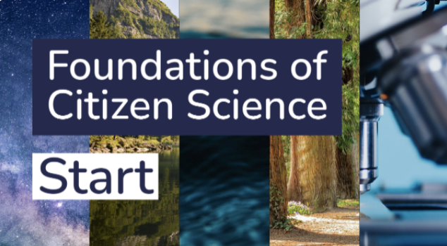
Or Simply Introduce Citizen Science to Library Users!
SciStarter.org/training
Online, interactive module created by instructional designers at Arizona State University.
Slides and speaker’s notes to facilitate an introduction to citizen science using the Foundations of Citizen Science. Cobrand or adapt to fit your needs.

Slide 28
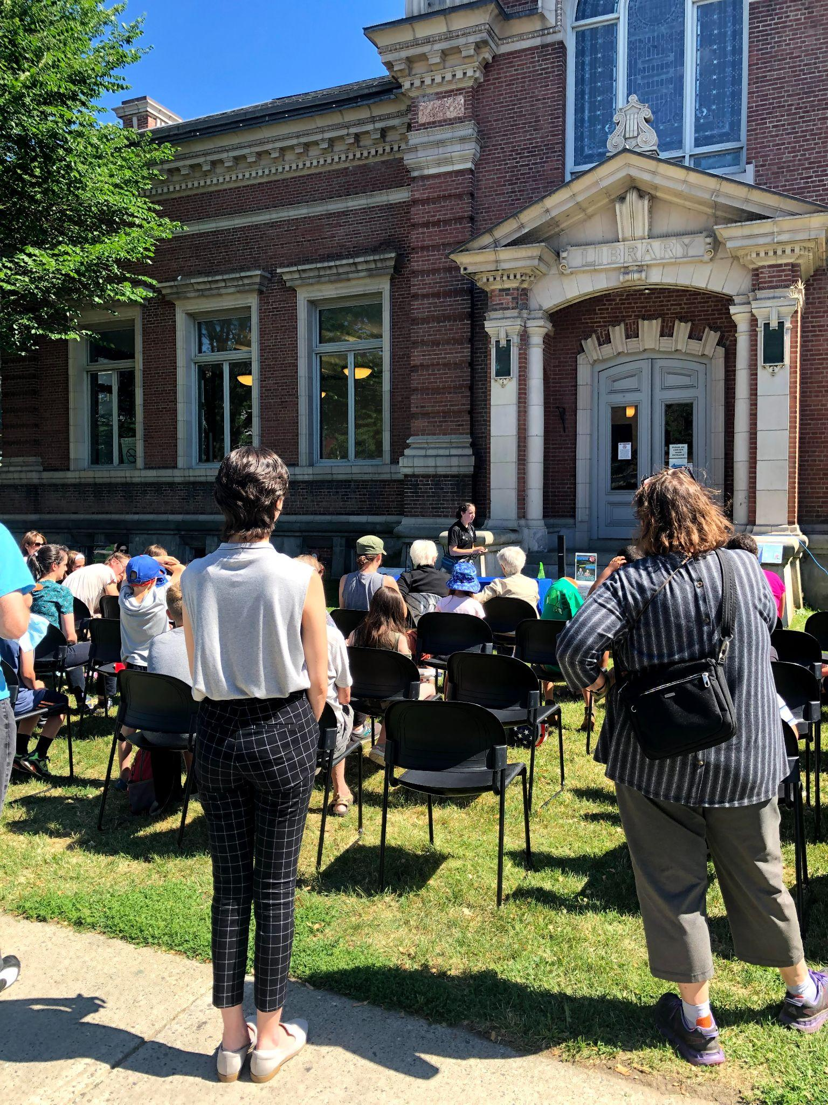
Sample Itineraries
Morning: Organized bird hike with eBird.
Afternoon: Hosted a "get to know Citizen Science" session at a local community park (offered kits, books, SciStarter.org demonstrations)
“It was a fun day of exploration and we are hoping to participate again, this year!”
Amanda Goston
Milbridge Public Library
Milbridge, ME
“We hosted in-person programs on the library lawn with Birds of Vermont. Distributed kits and partnered with local senior centers to expand science education and research.”
Gale Batsimm
Fletcher Free Library
Burlington, VT

Slide 29
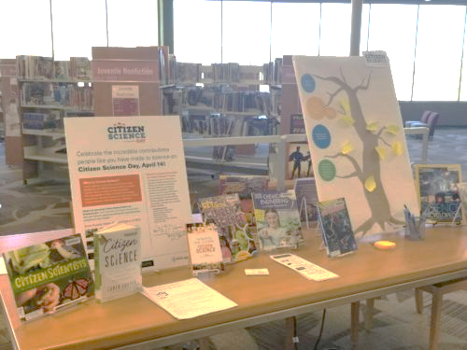
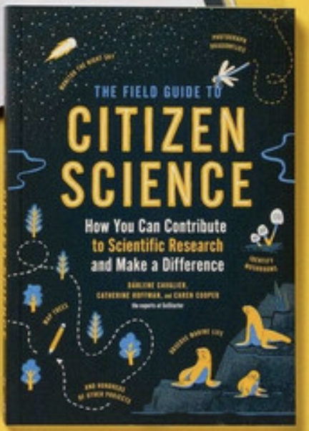
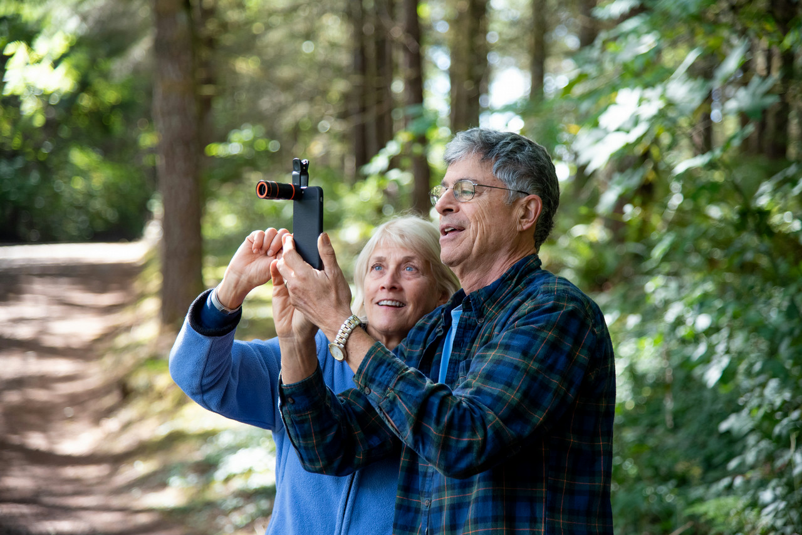
You don’t need to create something new to participate in Citizen Science Month!
Displays
Book Clubs
Affinity Group Additives
Use our customizable bookmarks, fliers, shelf-talkers and citsci book displays to build awareness.
Connect to the existing book clubs that are hosted at your library.
Introduce relevant projects from SciStarter.org to affinity groups.

Slide 30
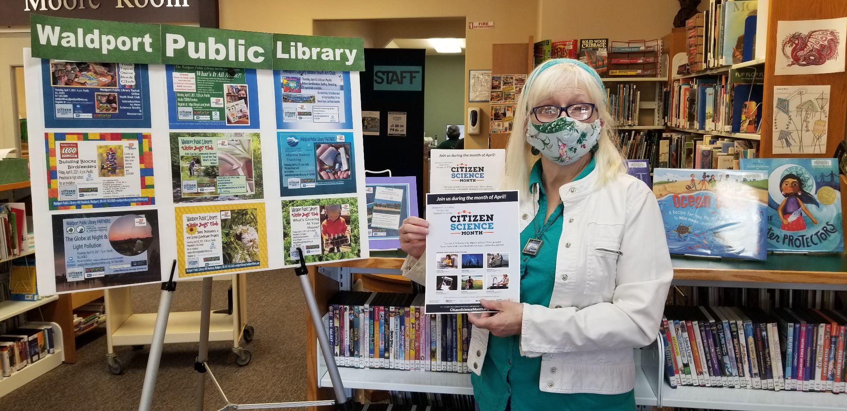
Citizen Science Display: Waldport Public Library
Add example of low moderate

Slide 31
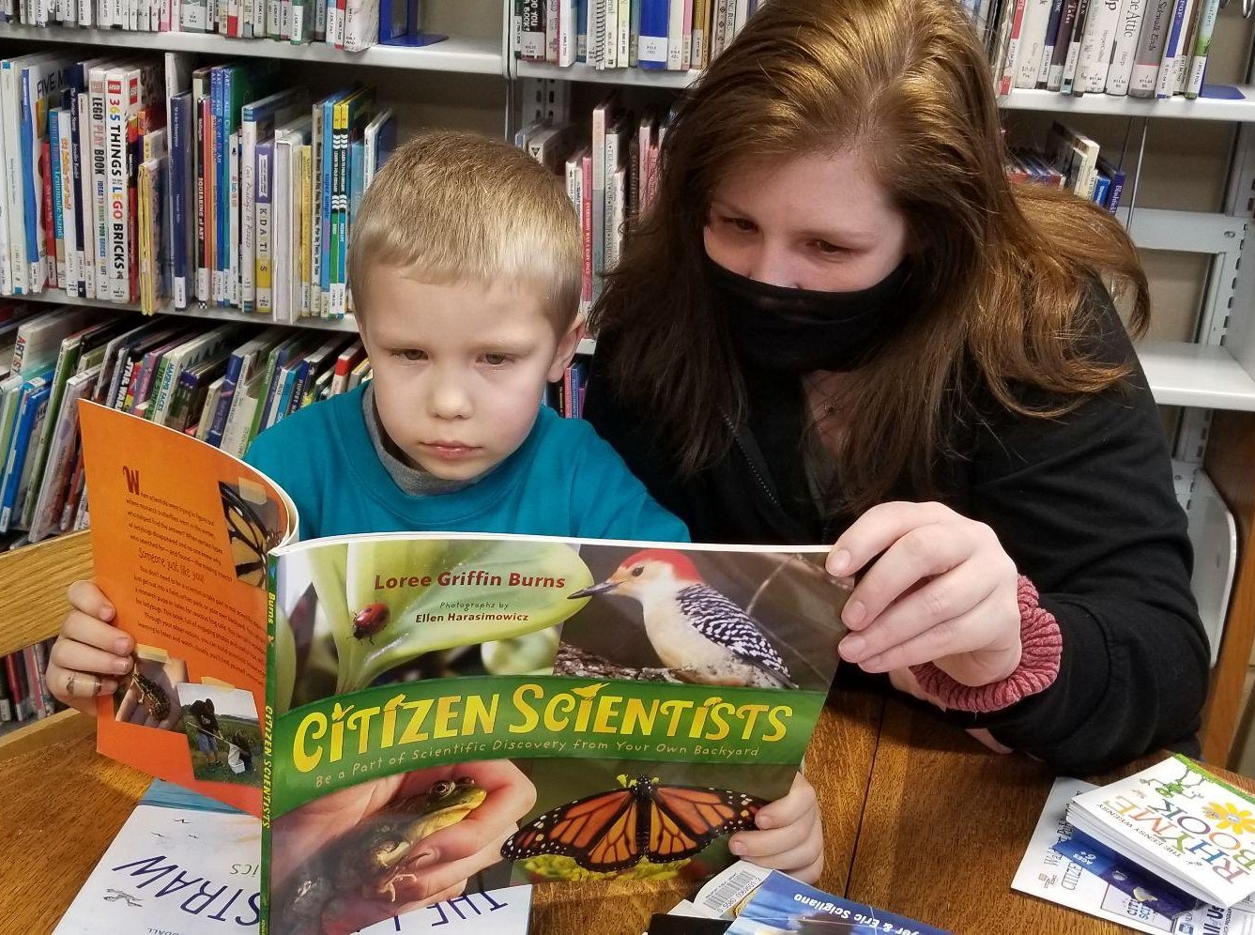
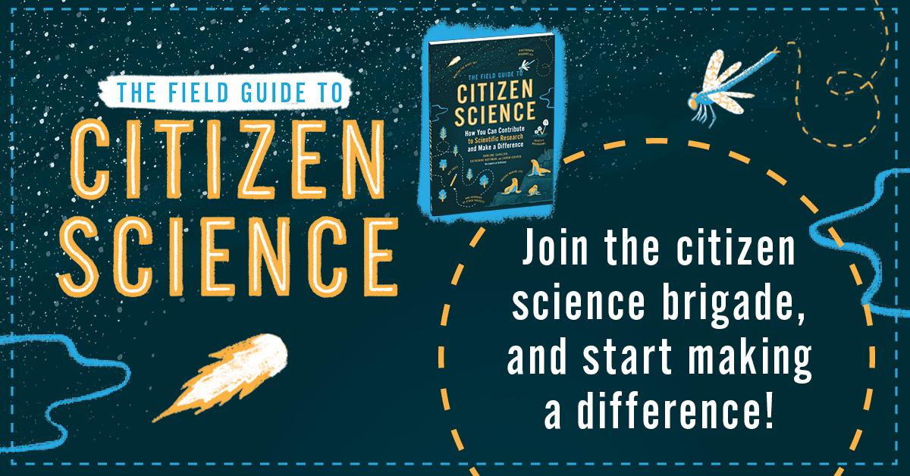
Citizen Science Storytimes and Book Clubs!
Waldport Public Library

Slide 32
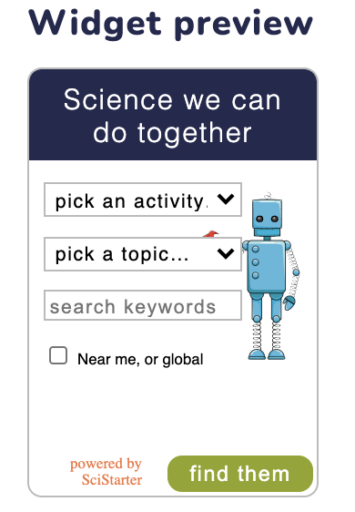
Embed the Project Finder On Your Library’s Website
Make it easy to convert your website viewers to doers!
Simply to go SciStarter.org/widget/new :
select the search filter and styles you want
add the generated widget embed code to your website
and snap! just like that, your community will find up-to-date, awesome citizen science projects from SciStarter.

Slide 33
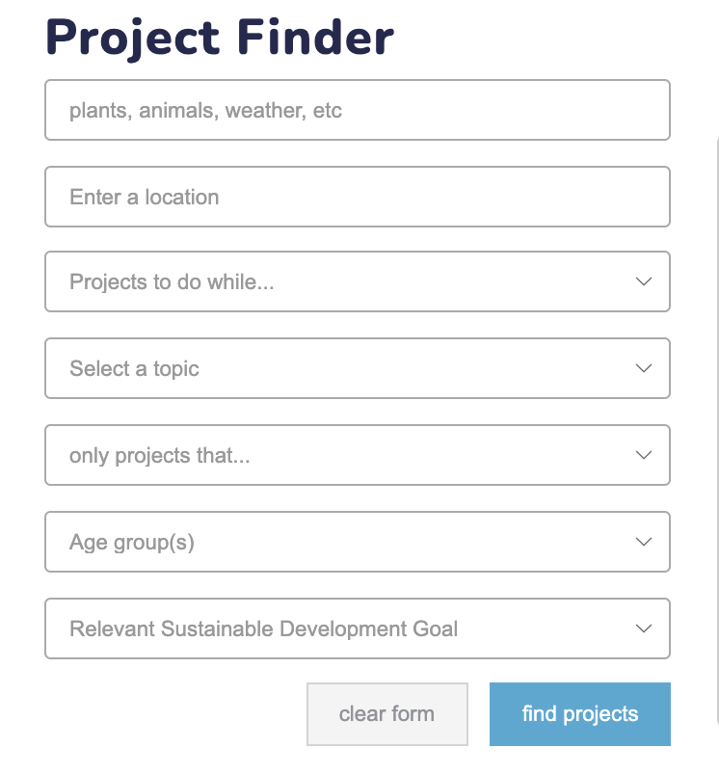
Find a Project on SciStarter.org

Slide 34
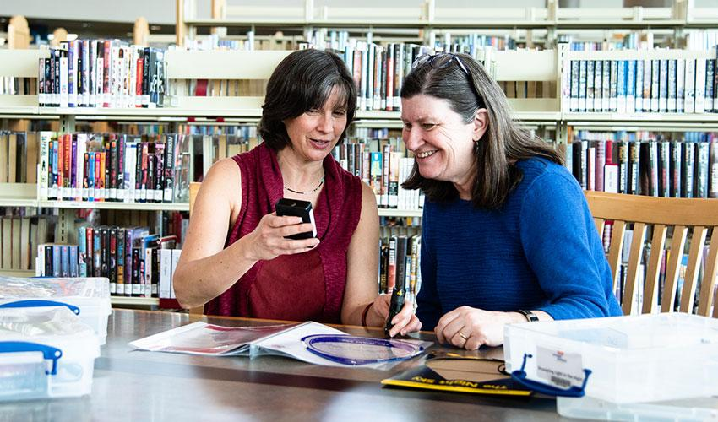
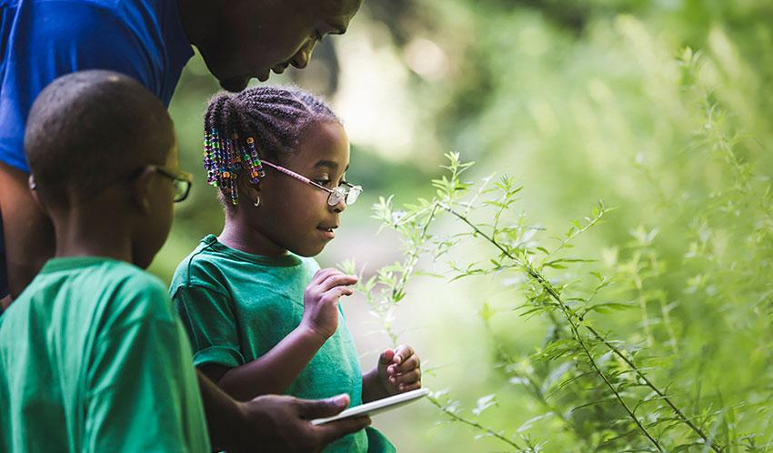
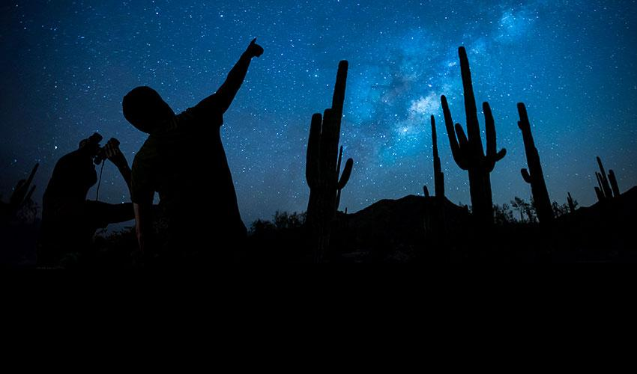
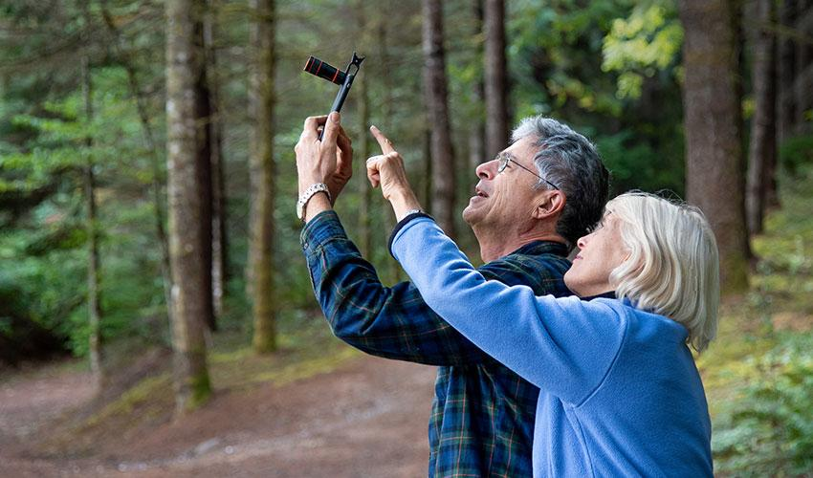
Introduce projects to affinity groups.

Slide 35
Or promote, share, and tune-in to other events!
PBS Ken Burns’ Ben Franklin film release in April will include an online Citizen Science Month event with PBS stations and SciStarter. PBS Books to feature the Field Guide to Citizen Science in April programming especially for libraries.
Discover and Astronomy Magazines cohost a live webinar featuring experts leading projects from SciStarter.org/NLM .
National Library of Medicine hosts a series of online events featuring the All of Us Research Program which invites one million people across the U.S. to help build one of the most diverse health databases in history. They welcome participants from all backgrounds, and researchers will use the data to find ways to treat and prevent disease.
Check out CitizenScienceMonth.org for more.

Slide 36
Poll:
How might you participate in Citizen Science Month?
Feel free to elaborate in the chat!

Slide 37
Promoting Your Events

Slide 38
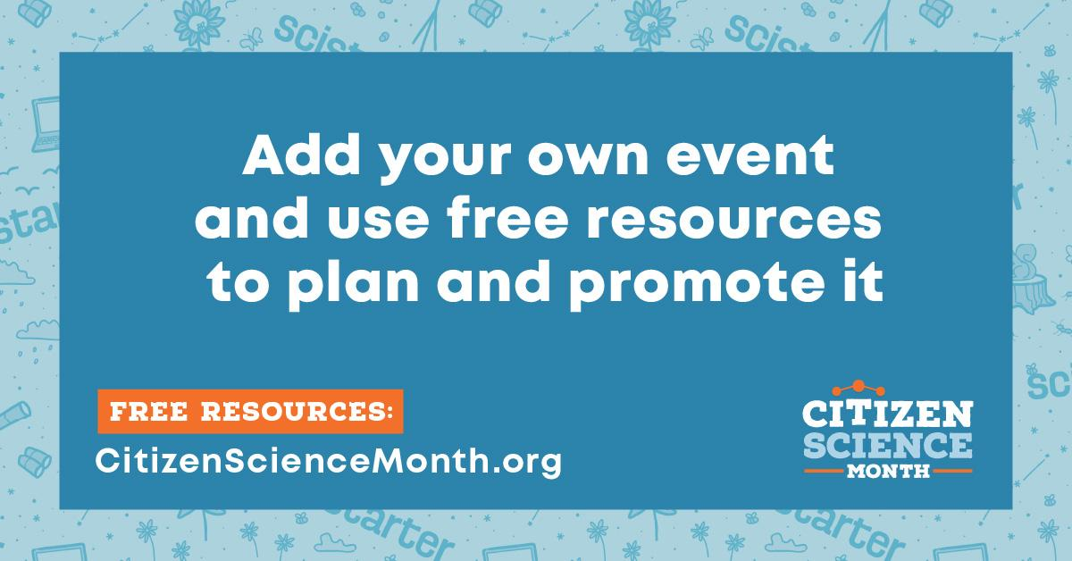

Slide 39
Register your event/program on SciStarter
Help us learn what libraries are doing across the country
Help you promote your event (locally, regionally, nationally, globally) for free
SciStarter.org/add-event

Slide 40
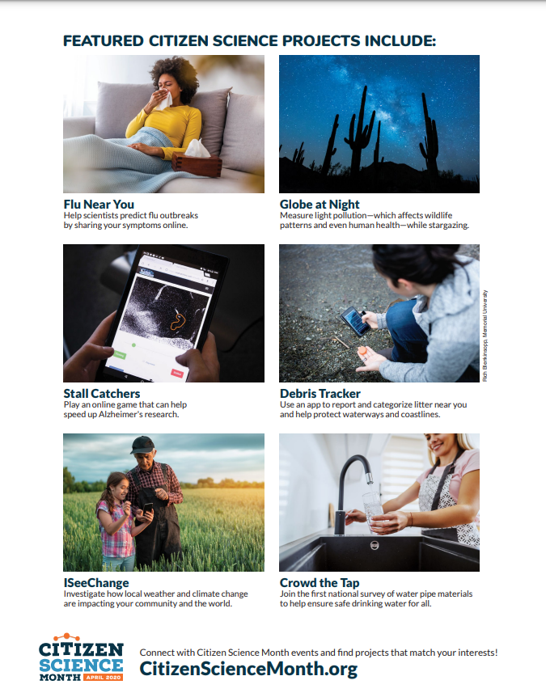
CitizenScienceMonth.org/Resources
Bookmarks, fliers, graphics
Notes:
Caroline

Slide 41
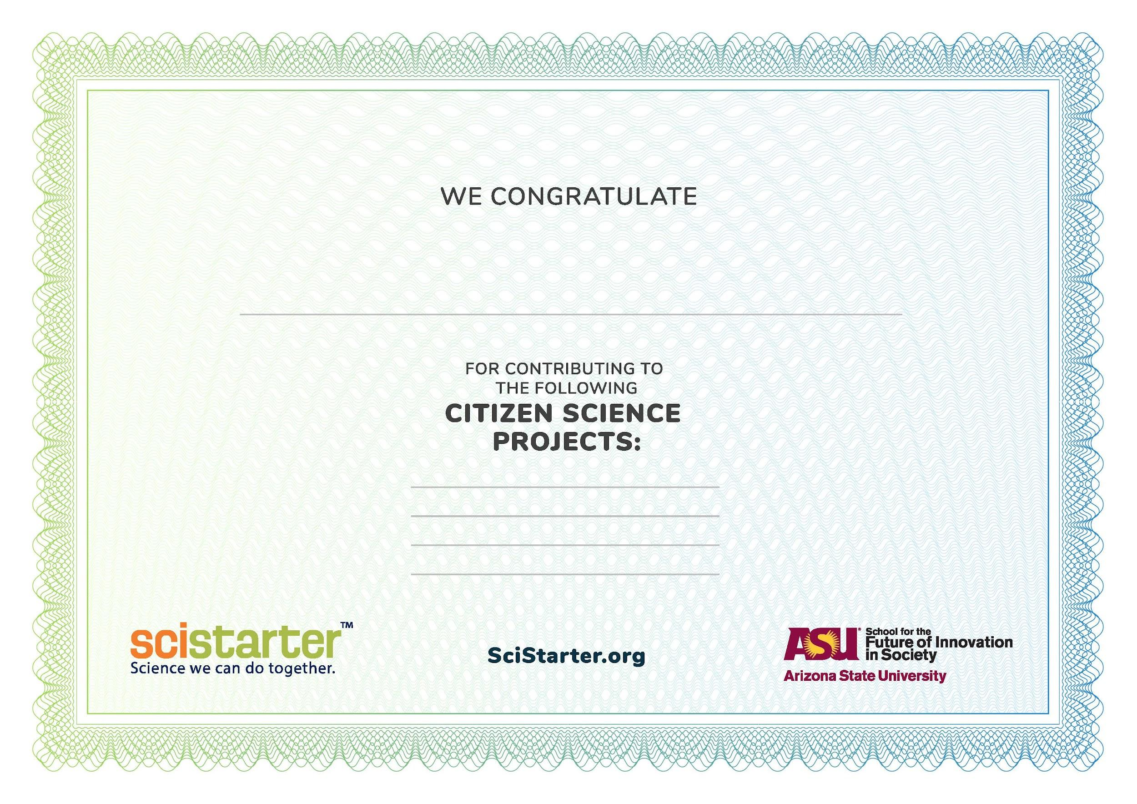
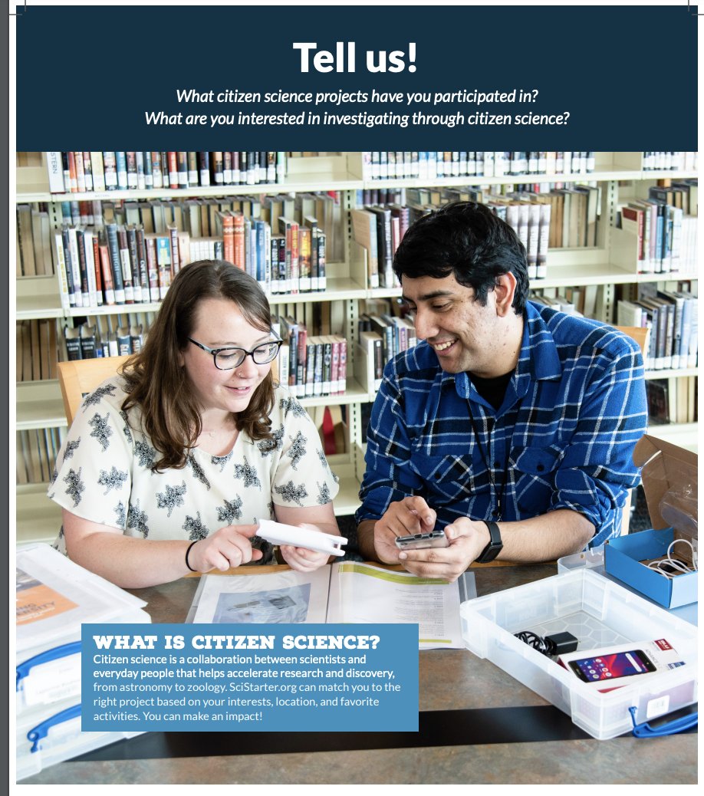
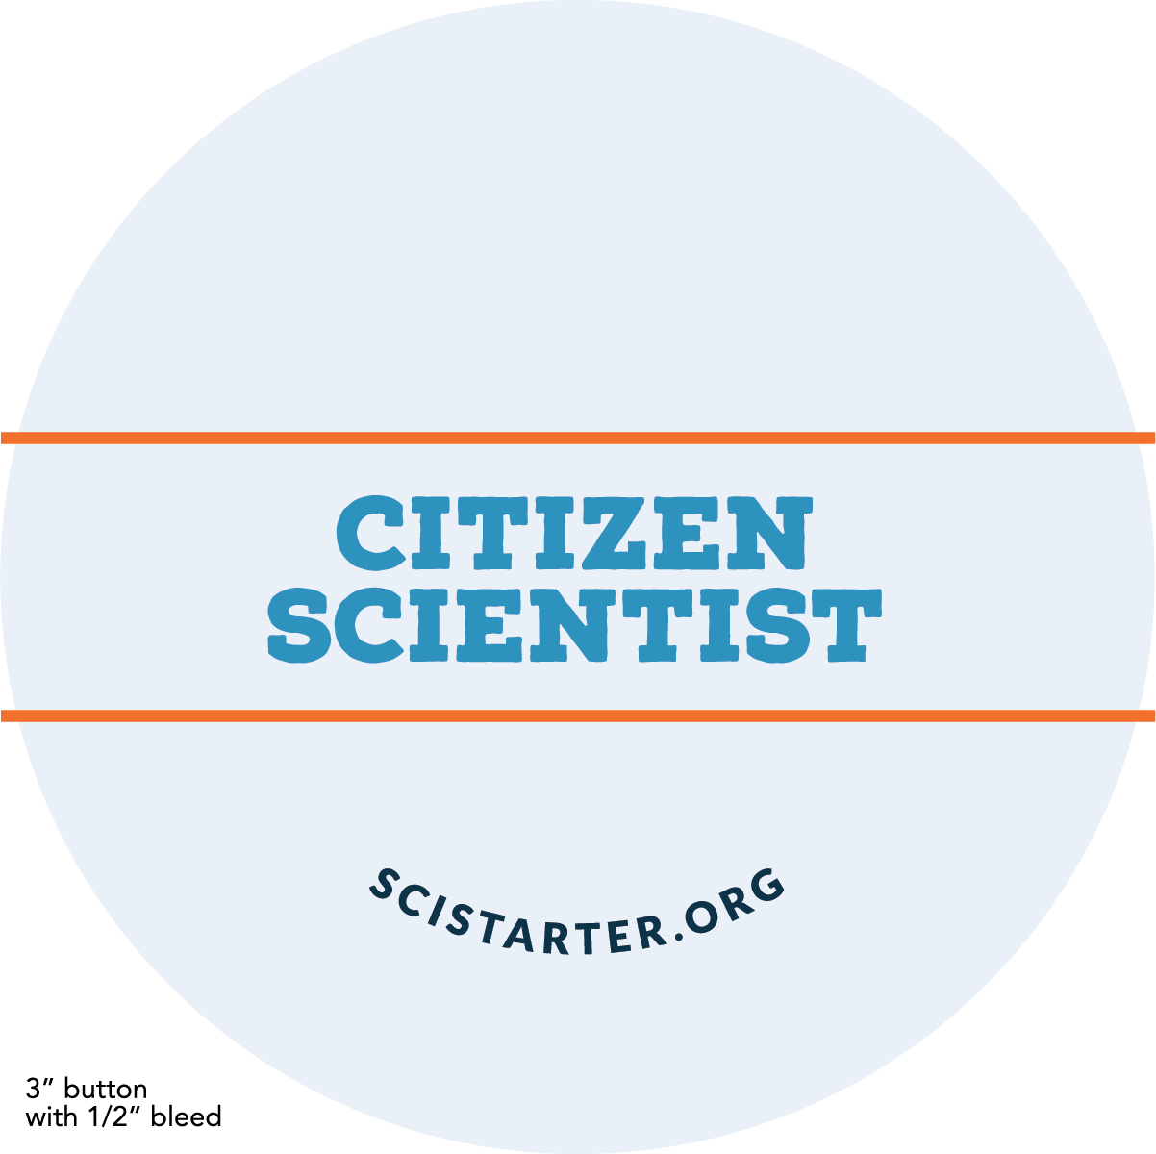
CitizenScienceMonth.org/Resources
Logos, customizable certificates, buttons, interactive posters

Slide 42
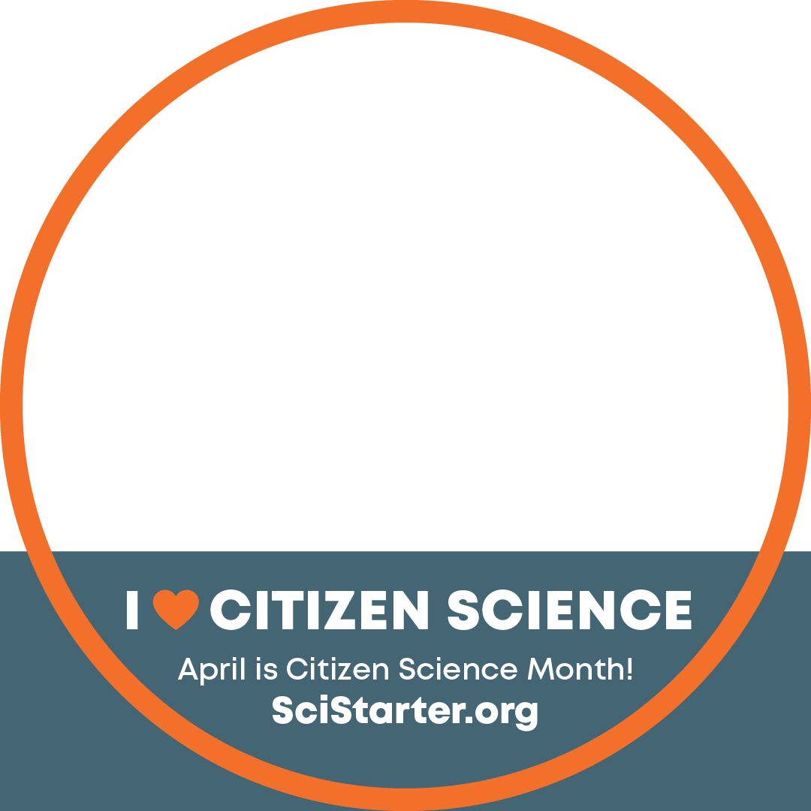
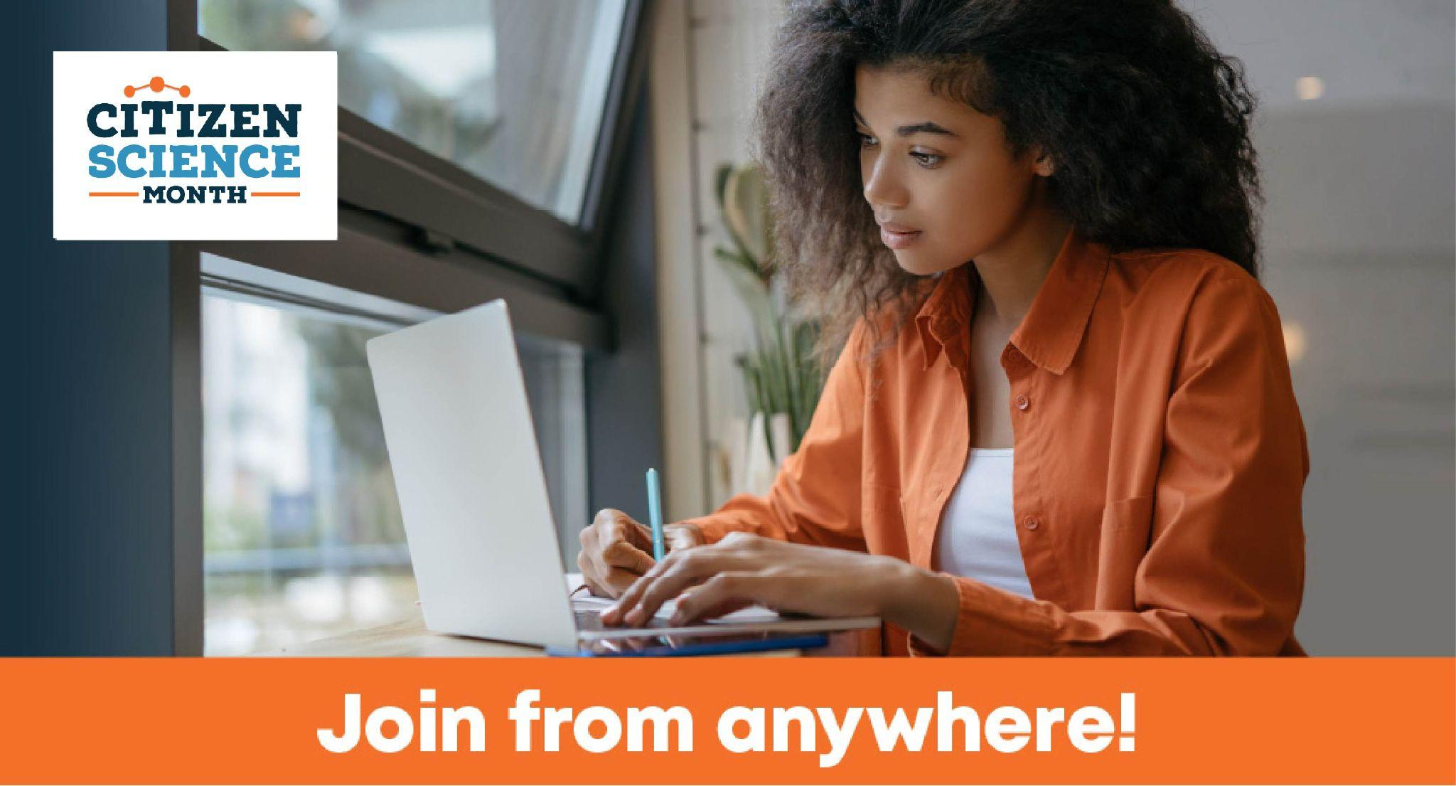
CitizenScienceMonth.org/Resources
Social Media Assets

Slide 43
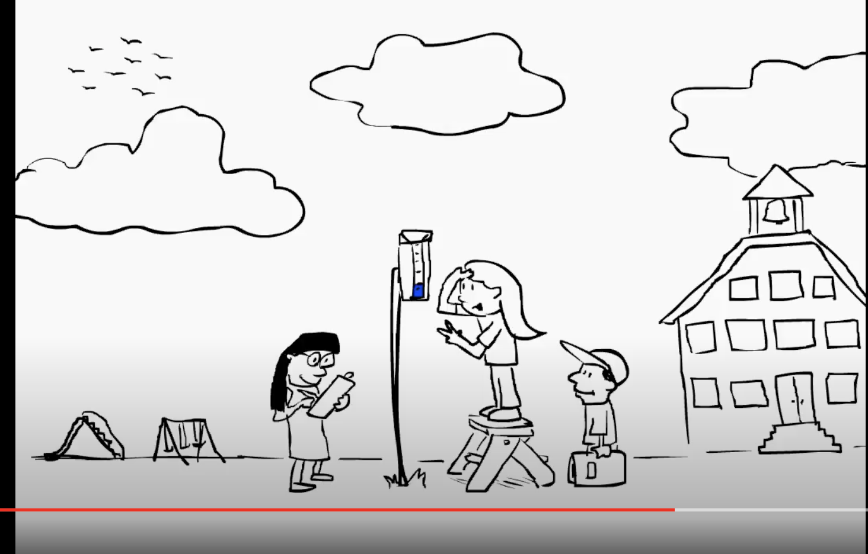
CitizenScienceMonth.org/Resources
Dozens of short “How To” videos with step-by-step instructions on how to participate in citizen science projects.
YouTube Playlist: tinyurl.com/CitSci-HowTo

Slide 44
Next Steps
Notes:
https://scistarter.org/library-network

Slide 45
CitSciMonth: April 2022
Ask us anything on Thursdays at 8am and 11am ET or email info@SciStarter.org
Sign up for facilitator updates: https://CitizenScienceMonth.org/MailingList
Add your program/ event to SciStarter: SciStarter.org/add-event
Notes:
[Caroline]

Slide 46
Questions?
Type your questions in the chat!
Email: librarynetwork@scistarter.org

Slide 47
Thank you!
Join the National Citizen and Community Science Library Network at SciStarter.org/library-network and complete the post-webinar survey:

Slide 48
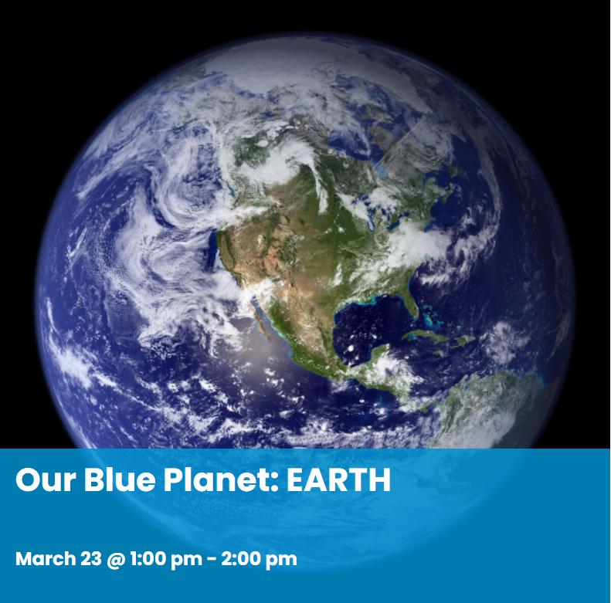
Join STAR Net for our next FREE webinar
https://www.starnetlibraries.org/event/our-blue-planet-earth/

