Slide 1
Celebrate Earth Day with Your Library
Elementary Aged Presentation

Slide 2
Note to Presenter
Feel free to pick and choose the slides you would like to use for your presentation.
There are many great online resources and hands on activities which you can use to enhance your program at http://www.starnetlibraries.org/earth-day/.
Notes:
You can find a wealth of resources here as well: https://observer.globe.gov/training/clouds

Slide 3
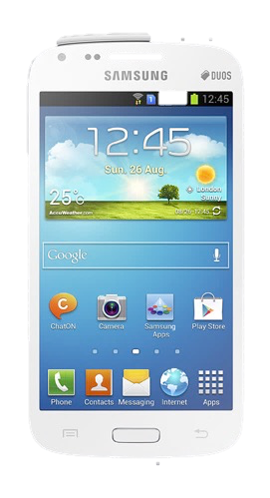
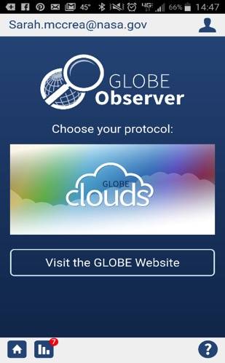
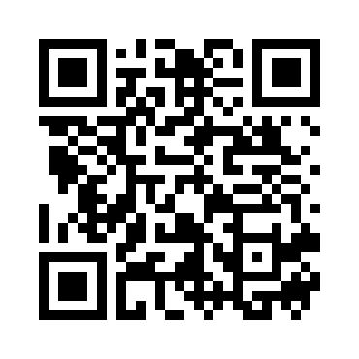
Get the App
GLOBE Observer
Make observations that complement NASA satellite observations to help scientists studying Earth and the global environment.
Take photographs of clouds and record sky observations and compare them with NASA satellite images.
Notes:
You will need to consider how to do this with younger audiences as an email address is required in order to activate an account. You could have parents/adults stay and be included in the program and have them download the app on their phones. You could use tablets and have the app downloaded and ready to go using your email. Another option is to ask the parents to download the app before their children attend.
By using the GLOBE Observer app, you are joining the GLOBE community and contributing important scientific data to NASA and GLOBE, your local community, and students and scientists worldwide.

Slide 4
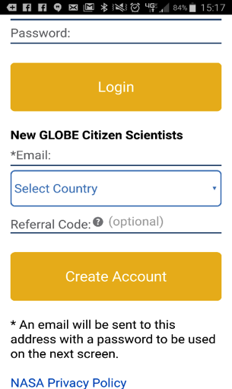
Get the App
Enter your email and Earth Day referral code: earth2017 (case sensitive) to create account.
Note: GLOBE Observer app Team will send an approval email with a password to Login.
Now you are ready to go!
Issues: globeobserverhelp@lists.nasa.gov
Notes:
Case sensitive
App etiquette: if you have issues sign out, sign in, update

Slide 5
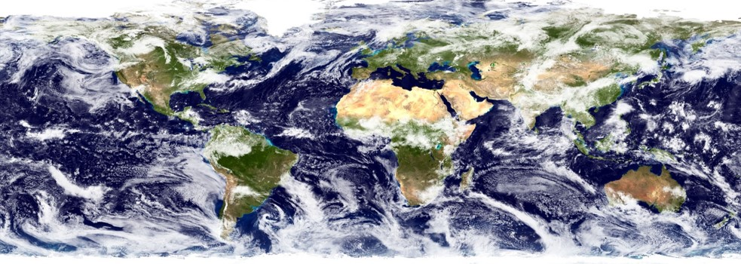
Science Behind Clouds
Share what you already know about clouds.
Notes:
One of the most interesting features of Earth, as seen from space, is the ever-changing distribution of clouds. They are as natural as anything we encounter in our daily lives. As they float above us, we hardly give their presence a second thought. And yet, clouds have an enormous influence on Earth’s energy balance, climate, and weather.
Even small changes in the abundance, location, or cloud type can impact Earth’s climate and weather. This is why collecting data on clouds is important.

Slide 6
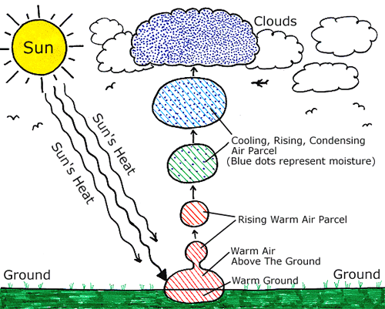
How do clouds form?
Notes:
Clouds form from water in the sky. The water may evaporate from the ground or move from other areas, like plants. Water vapor is always in the sky in some amount but is invisible. Clouds form when an area of air becomes cooler than the air around it and the water vapor there condenses to liquid form. At that point, the air is said to be "saturated" with water vapor. The air where the cloud forms must be cool enough for the water vapor to condense. The water will condense around things like dust, ice or sea salt - all known as cloud condensation nuclei.

Slide 7
Notes:
You can use this “cloud triangle” to help people understand where in the sky clouds form, the names of the clouds, as well as whether or not precipitation is falling. This is an easy way for them to remember this information. There are images on the actual app, so they do not need to memorize this in order to successfully make and report their observations.
You and your participants may notice that sometimes the altitude information changes depending on the slides that you use. This is often true when working with different resources, even among scientists! All of the information on these slides is accurate, but with the GLOBE Program, we cite the the altitudes which you will find on slide 6. When participants notice the different values and units, this can be a good chance to share the importance of making sure that they are using reliable websites to get information, and also to mention that sometimes values may differ slightly even among scientists.

Slide 8
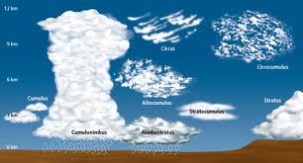
Why are they different shapes?
The temperature, wind and other conditions where a cloud forms determine what type of cloud it will be.

Slide 9
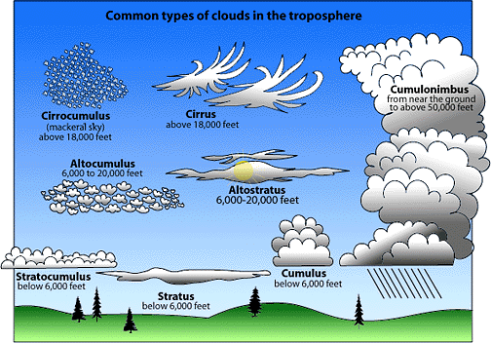
Notes:
You and your participants may notice that sometimes the altitude information changes depending on the slides that you use. This is often true when working with different resources, even among scientists! All of the information on these slides is accurate, but with the GLOBE Program, we cite the the altitudes which you will find on slide 6. When participants notice the different values and units, this can be a good chance to share the importance of making sure that they are using reliable websites to get information, and also to mention that sometimes values may differ slightly even among scientists.

Slide 10
High Altitude Clouds
Cirrus
Cirrostratus
Cirrocumulus
Notes:
Cirrus clouds are ice clouds. They can look like delicate white feathers or streamers. They are always more than three miles up where the temperature is below freezing, even in summer. Wind currents twist and spread the ice crystals into wispy strands.
Cirrocumulous are the same size or smaller than the width of your littlest finger when you hold up your hand at arm's length.
Cirrostratus are transparent, whitish veil clouds with a fibrous (hair-like) or smooth appearance. A sheet of cirrostratus which is very extensive, nearly always ends by covering the whole sky.

Slide 11
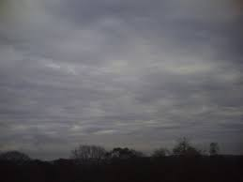
Middle Altitude
altostratus
altocumulus
Notes:
Altostratus clouds usually covers the whole sky and have a gray or blue-gray appearance.
Altocumulus clouds are mid level clouds that are made of water droplets and appear as gray puffy masses. They usually form in groups. If you see altocumulus clouds on a warm, sticky morning, be prepared to see thunderstorms late in the afternoon.

Slide 12
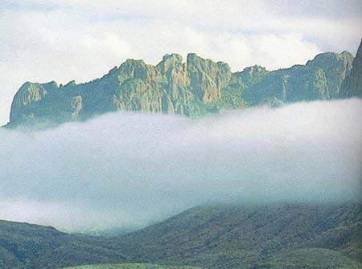
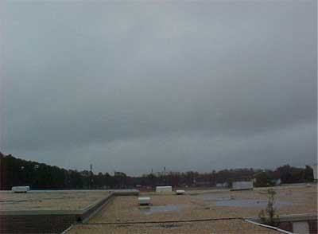
Low Altitude Clouds
Stratus clouds
Notes:
Stratus clouds often look like thin, white sheets covering the whole sky. Since they are so thin, they seldom produce much rain or snow. Sometimes, in the mountains or hills, these clouds appear to be fog.

Slide 13
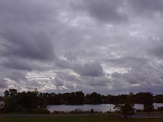
Stratocumulus
.
Notes:
These clouds are low, puffy and gray. Most form in rows with blue sky visible in between them. Rain rarely occurs with stratocumulus clouds, however, they can turn into nimbostratus clouds

Slide 14
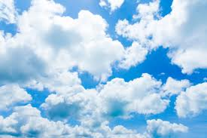
Cumulous clouds
Notes:
are white, puffy clouds that look like pieces of floating cotton. Cumulus clouds are often called "fair-weather clouds". The base of each cloud is flat and the top of each cloud has rounded towers. These clouds grow upward and they can develop into giant cumulonimbus clouds, which are thunderstorm clouds

Slide 15
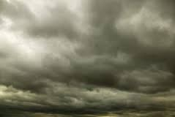
Rain or Snow Clouds
Nimbostratus clouds
Notes:
form a dark gray, wet looking cloudy layer associated with continuously falling rain or snow. They often produce precipitation that is usually light to moderate

Slide 16
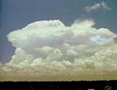
Cumulonimbus
Notes:
Cumulonimbus clouds are a sure sign of bad weather to come--at least bad if you don't like rain and hail! These clouds grow on hot days when warm, wet air rises very high into the sky. Up and down winds within the cloud may push water droplets up to very cold parts of the atmosphere, where they freeze.
When the ice drops come back down, they get another coating of water and are pushed back up to freeze again. Finally, they get too heavy to stay in the cloud and fall to the Earth as hail stones.

Slide 17
Why does NASA look at clouds?
Clouds are important for many reasons.
- We want to know if precipitation is falling.
- At night, clouds reflect heat back to the surface and keep it warmer.
During the day, clouds can shade us from the sun and keep Earth cooler.
Studying clouds helps NASA better understand Earth's weather and climate.

Slide 18
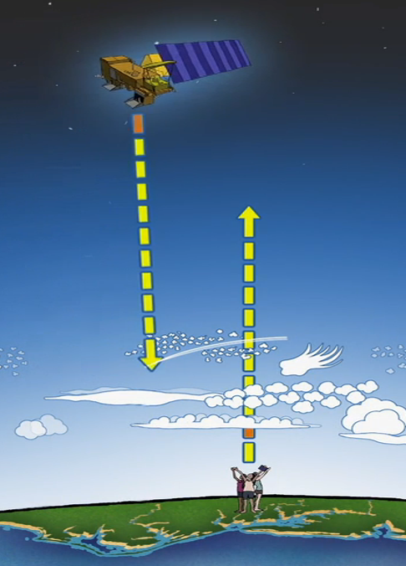
Two Perspectives
Notes:
Help the children understand the two perspectives are different, one seeing the tops of clouds the other seeing the bottom, and having both provides and better picture.

Slide 19
Which picture was taken from a satellite? How do you know?

Slide 20
NASA Satellites
You can see which satellites are passing over you by going to the “Check Satellite Flyovers”.
You can also check and see what the satellite is “seeing” as it passes over where you are.
Your participation helps NASA scientists better understand how clouds effect our Earth system.
Notes:
This would be a good video to show: https://nasaeclips.arc.nasa.gov/playlists/realworld?v=real-world-citizen-science
GLOBE Observer cloud observations are helping NASA scientists understand clouds from below (the ground) and above (from space). Clouds play an important role in transferring energy from the Sun to different parts of the Earth system. Because clouds can change rapidly, scientists need frequent observations from citizen scientists.

Slide 21
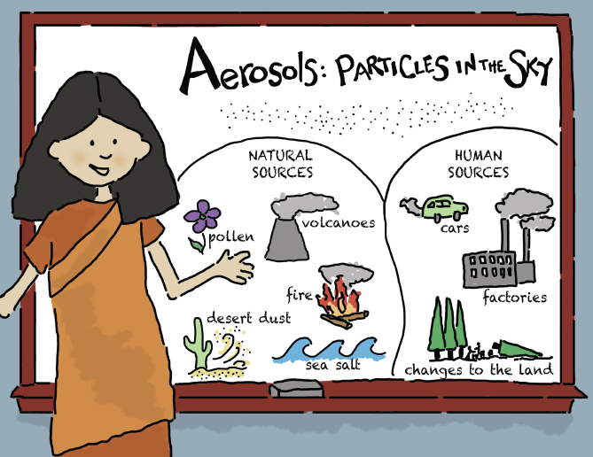
What else might be in the sky?
Notes:
There are tiny particles floating in the sky. These tiny particles are called aerosols, Aerosols are usually very smallm even smaller than spots on a ladybug! Although aerosols occur in nature, aerosols can also be human-made. Pollen iis one example of natural aerosols. Car exhaust is an example of human-made aerosols.

Slide 22
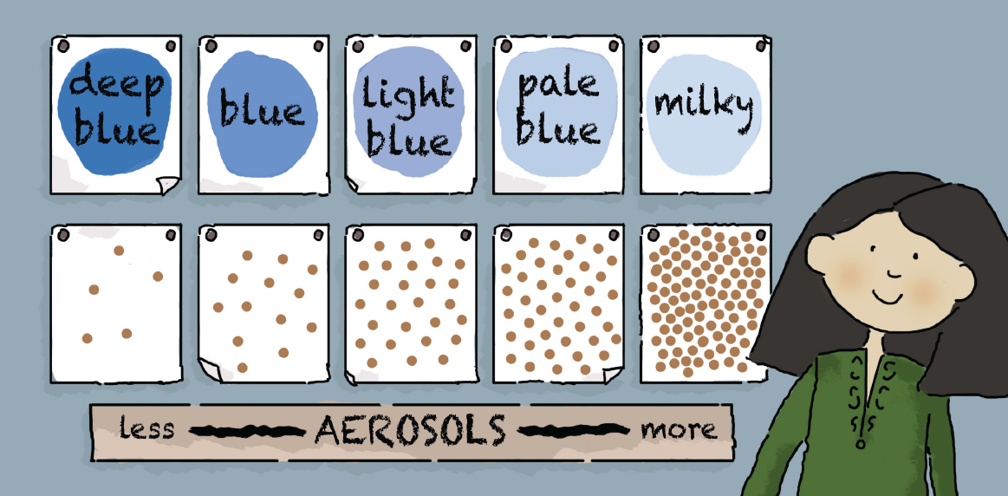
Sky Color

Slide 23
Visibility

Slide 24
What are you waiting for?!
Notes:
A fun way to use this app with kids is to have them use the compass to find the cardinal directions. Have each child face a different cardinal direction, and let them pass the phone/IPad around to take the pictures of the sky. If you have more than four kids helping you, let one take the picture straight up- and you can tell them that we call this the "zenith", and let another take the picture straight down.

