Slide 1
Junior FIRST® LEGO® League (Jr.FLL®)
Junior FIRST® LEGO® League STAR_Net Library Pilot (Jr.FLL®)
Jr.FLL Presentation
LEGO® Education Sales Meeting
August 17, 2011

Slide 2
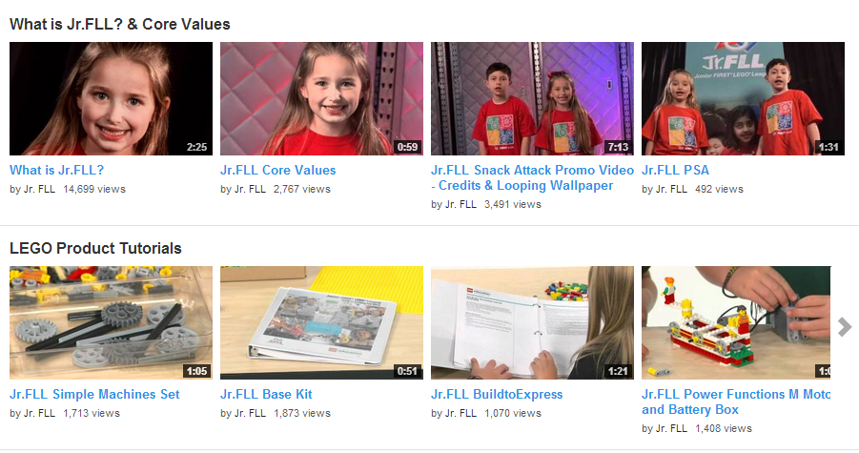
What is Jr.FLL?
Check out our Jr.FLL YouTube Channel for brief videos about the program
http://www.youtube.com/jrfllglobal

Slide 3
What is Jr.FLL????
Children Ages 6-9
Teams of 2-6 children
Season: August – June
Registration: August – April $50
Challenge theme introduced every year – created with topic experts from the field
LEGO model and Show Me poster
Events called Expo’s
Events are 2-4 hours long…That’s it!
Unofficial events organized by community members in US/CAN
Official Expos held by Jr.FLL Partners
Notes:
Play What is Jr.FLL Video
Coaches materials include:
Challenge doc that explains yearly themed challenge
Coach Guide for running a Jr.FLL team
Coach Resources with tips and resources to use on that year’s specific theme
Model & Poster
We want the model to have a simple machine and a motorized part
Posters include info on each team member, research done and model made – New challenge docs will include more specific information on Poster layout – this helps both reviewers and spectators know what they’re looking at as layouts will be similar poster to poster.
Events – will go over this more in-depth in a future slide
Keep them short and simple – remember these are little kids
Anyone can organize an Expo – the more the merrier mentality – do not feel you have to have an expo for every team in your area.

Slide 4
Who?
Team Profile:
Home School Communities, After school Programs, Elementary School PTA’s, Libraries, Science Centers, Children’s Museums, Scouts, Community Centers
Coach Profile:
Parents, teachers, engineers, scientists, librarians, college students and scout leaders
Coach Responsibilities:
Mentoring children
Liaison with parents and community
Set expectations for team
Guide team with Core Values
Notes:
Team Profiles: Teams are made from all kinds of different groups, these are just a few of the most common
Coach Profile: Good coaches come from many walks of life and have included teachers, parents, engineers, scientists, college students, and scout leaders.
Most coaches said that they heard about the Jr.FLL Program from another parent or from a school.
Coach Responsibilities:
mentoring the team through the season’s Jr. FLL Challenge, as well as for planning and scheduling meetings, visits, and trips.
liaison between team members, mentors, parents, and volunteers.
It is important the coach inform kids and parents about what is expected of them in terms of their commitment to the team.
Coach is also responsible for honoring and communicating Jr. FLL core values to team members, team volunteers, and others affiliated with their team.

Slide 5
Jr.FLL Core Values
We are a team.
We do the work. Our coaches and mentors help us learn, but we find the answers ourselves.
We share our experiences and discoveries with others.
We are helpful, kind, and show respect when we work, play, and share. We call this gracious professionalism.
We are all winners.
We have fun.
Notes:
Just like all other FIRST programs – Jr.FLL has their own set of Core Values

Slide 6
The Challenge
Every year the Jr.FLL Program staff works with experts in the field to create a Challenge for teams to research
The Challenge relates to an important real-world topic
Past Challenges have been about: climate, transportation, food, seniors, and etc.
Check out past Challenges
Teams research the Challenge theme and create a LEGO model and a Show Me poster that represents their learning

Slide 7
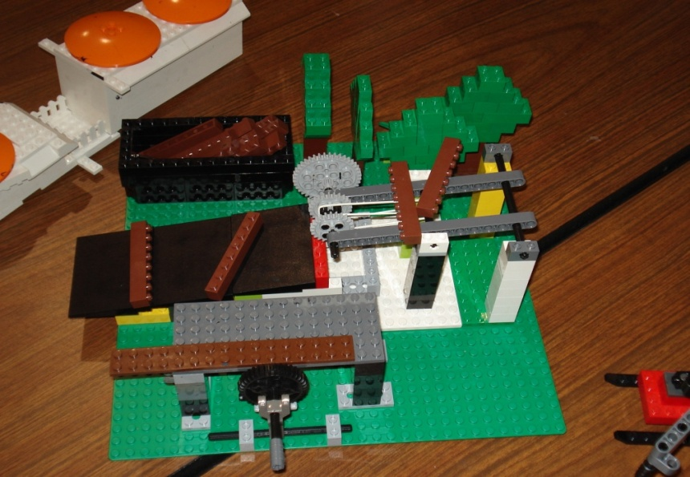
Jr.FLL Challenge Components
Model
Must:
Be constructed of only LEGO elements
Fits within a 15” X 15” footprint (teams usually use a LEGO XL Base Plate)
Have at least one motorized piece
Have at least one simple machine
Based on the Challenge directions provided in the Jr.FLL Challenge Document
Notes:
Guided by adult coaches, teams use LEGO elements to build a model with a motorized part and develop a coordinating Show Me poster to represent their journey.
Model: Can be anything that they learned on that year’s topic. Does NOT have to be an invention. – But it can be! Needs to be 15x15 – teams typically use a 15”x15” baseplate
Show Me Poster: This year we are introducing some new standards so posters will look similar. This helps reviewers as they will have an idea of what they are looking at as layouts will be similar poster to poster. For example we’re going to ask all teams to put their team info on the right side, info about their Senior Partner and their search on the left side and info about the item they researched and their model in the middle.

Slide 8
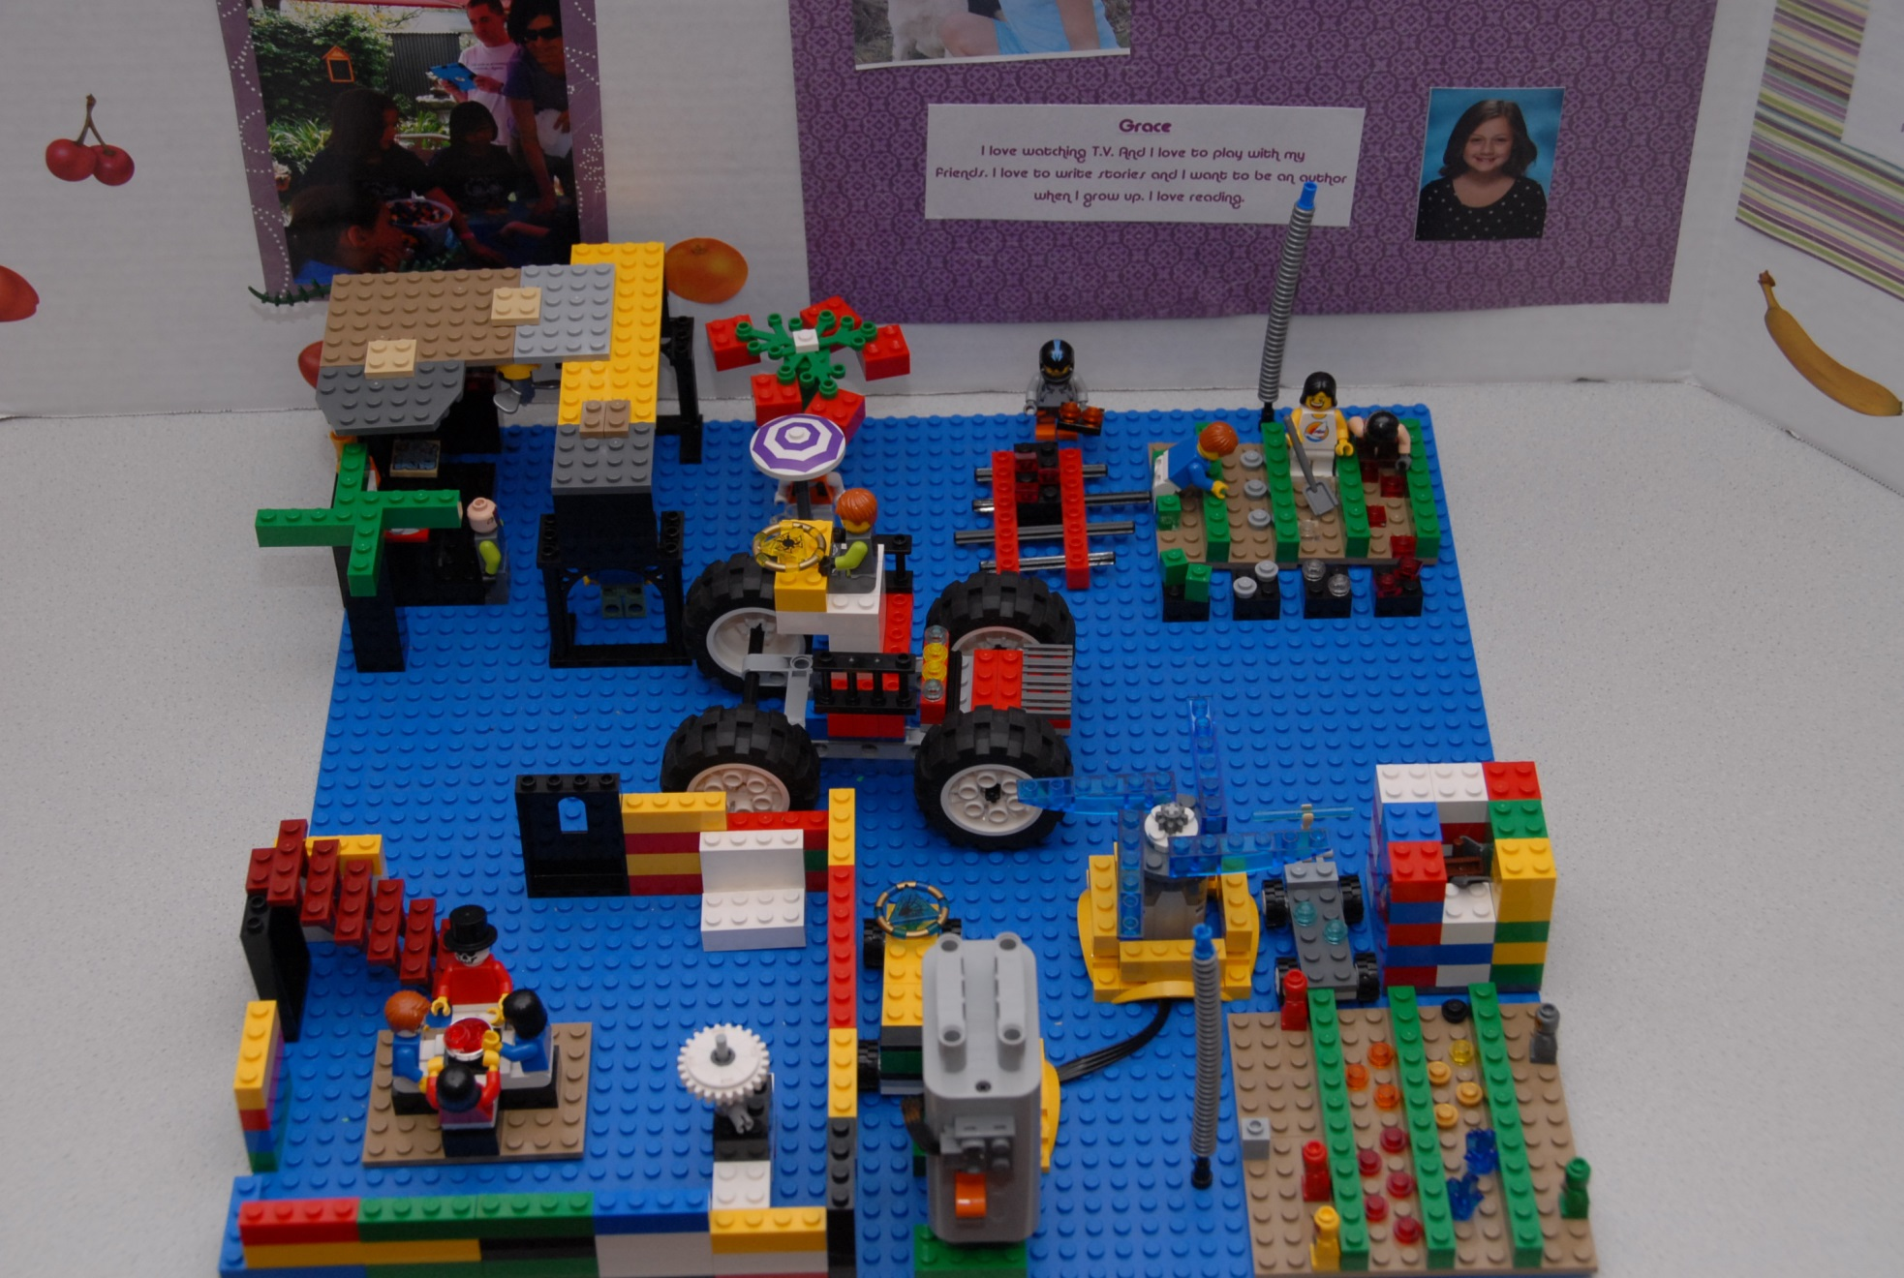
LEGO Model Example

Slide 9
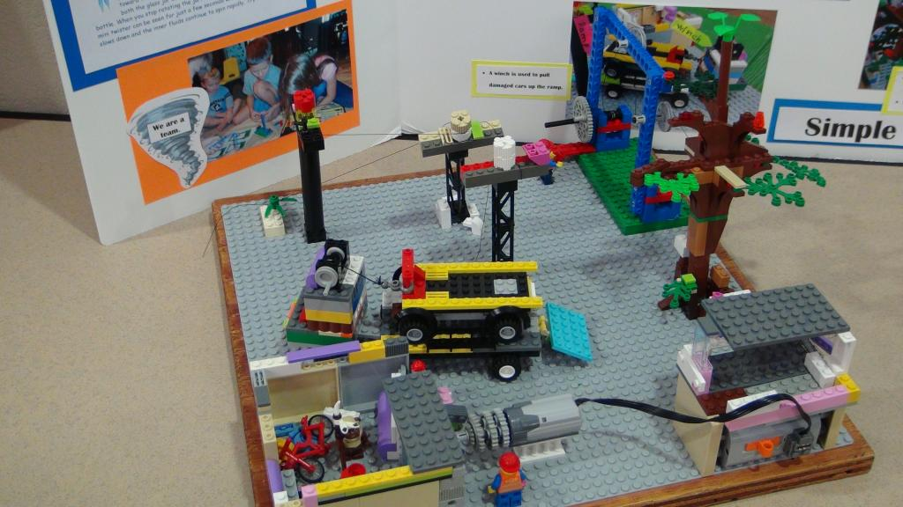
At least one motorized component and one Simple Machine
Simple Machine – wheel and axle
Simple Machine - pulley
Motorized component

Slide 10
Show Me Poster
Includes information about:
the team
topic specific research
the model and the motorized part

Slide 11
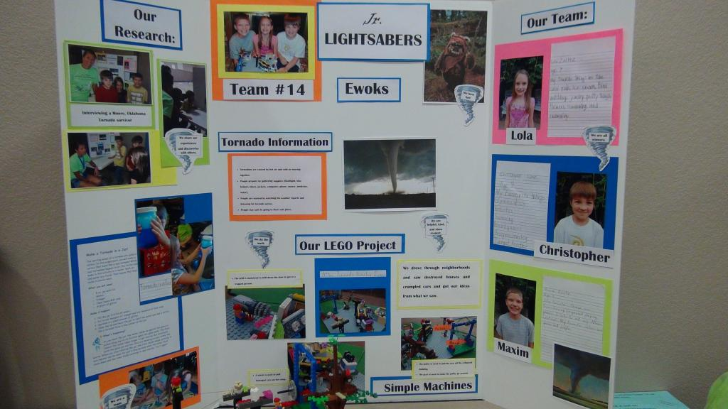
Show Me Poster

Slide 12
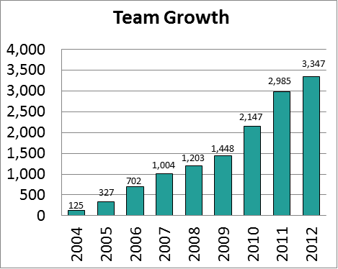
Jr.FLL Seasons

Slide 13
Jr.FLL Program
1. Register Teams
2.Download Challenge Materials
Prepare Team Materials
3. Begin the Season
4. Attend an Expo
February
March
March
May

Slide 14
Let’s take a closer look at each step…..

Slide 15
1. Register Teams
Registration is open August - April
Visit www.usfirst.org/jrfll
Click on Registration tab
Click on Register for the 2013 DISASTER BLASTER℠ season
Create a profile
You will receive a temporary team number. The permanent team number will be issued once finance has approved the registration
Keep your username and password handy, you will visit TIMS several times

Slide 16
2. Download Challenge Materials
Team Summary Page
Log in to your TIMS account
Click blue Edit/View button next to team name
Brings you to the Team Summary page
Scroll down to Challenge Materials and click View
Documents are ready to download
Preview all documents before beginning the season
Download Materials

Slide 17
Challenge Materials
1. Start by reading the Coaches’ Manual
Suggestions on organizing the team, role as a Coach, season schedule, helpful links
2. Preview the Challenge Pack
A guide that can be used for every season. It contains 12 main sessions and 4 drop-in sessions if your team has extra time. Bring your team through 4 phases: Think About It, Learn About It, Build It, Share It. Aligned with Challenge Document
3. Read through the DISASTER BLASTER℠ Challenge Document
with the team
Explains Challenge theme, aligned to Challenge Pack, contains questions to start your thinking for your research, suggestions on areas to focus your building and presentation
4. Browse the Coaches’ Resources
Contains websites, books, and vocabulary words to begin your research

Slide 18
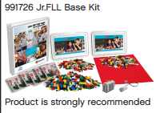
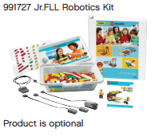
Prepare Team Materials
Jr.FLL Base Kit
Jr.FLL Robotics Kit
Jr.FLL Guide to Building and More
2 Simple Machines sets
884 LEGO bricks
LEGO Power Battery Box
LEGO Power Functions Motor
6 BuildToExpress mini-kits
XL Base Plate
WeDo Software Activity Pack
WeDo Construction set (150+ pieces)
WeDo Software v.1.2

Slide 19
3. Begin the Season
Be sure to arrange a space for your team to meet (library, classroom, team member’s house)
Decide your meeting time and how often – communicate this to parents
Usual Schedule – 6-8 weeks, once or twice a week, meetings 1 – 2 hours
Keep meetings fun and kids busy
Find safe storage for unfinished LEGO models
Coach is there to guide children through the process, children do the work
Follow the Core Values throughout the season
Most important – Have Fun!

Slide 20
4. Attend an Expo
Season is complete – now what?
An Expo is an opportunity for teams to showcase what they learned with other teams and Reviewers
Children will explain their model and Show Me poster, their research, and anything else they want to share about their experience
Follow the steps in the Share It section of the Challenge Pack
Session 2 – Prepare and Practice a Presentation for a Jr.FLL Expo
Volunteer Reviewers will ask questions about the team’s display and Model
Meant to be a fun community event
All team members receive a participation award

Slide 21
Optional: Online Showcase
Upload team research, photos, LEGO Model, and Show Me poster to the Online Showcase
http://jrfllshowcase.usfirst.org/
This is a virtual Expo experience for others to view from around the world
We encourage you to take a look at other teams’ profile pages, trade virtual stickers and share what your library teams have accomplished

Slide 22
Resources
FIRST Documents
LEGO Resources
Coaches’ Manual
organizing the team, season schedule, additional resources
Challenge Pack
guide with lessons for team meetings
Challenge Document
specific Challenge topic
Coaches’ Resources
websites, books, vocabulary words
Jr.FLL Base Kit
Jr.FLL Guide to Building and More – three-ring binder with building practice models, Simple Machines information and BuildToExpress lessons
Jr.FLL Robotics Kit
WeDo Software – user-friendly programming capabilities, practice examples with motorized component
WeDo Activity Pack – building instructions and programming examples

Slide 23
Websites
www.usfirst.org/jrfll
US website, registration link, coaches’ resources, Jr.FLL information
https://my.usfirst.org/jr.fll/tims/test/site.lasso (Team Information Management System – TIMS) – register, download challenge materials, links
http://www.juniorfirstlegoleague.org/
Global website with Jr.FLL program information
http://jrfllshowcase.usfirst.org/
Online Showcase – virtual Expo
http://www.legoeducation.us/
Kit information, building instructions, product videos
http://www.youtube.com/jrfllglobal
Jr.FLL YouTube Channel, videos about the program and LEGO products

Slide 24
Support
Need more help?
Email Lindsay Frazier at lfrazier@usfirst.org with additional questions

Slide 25
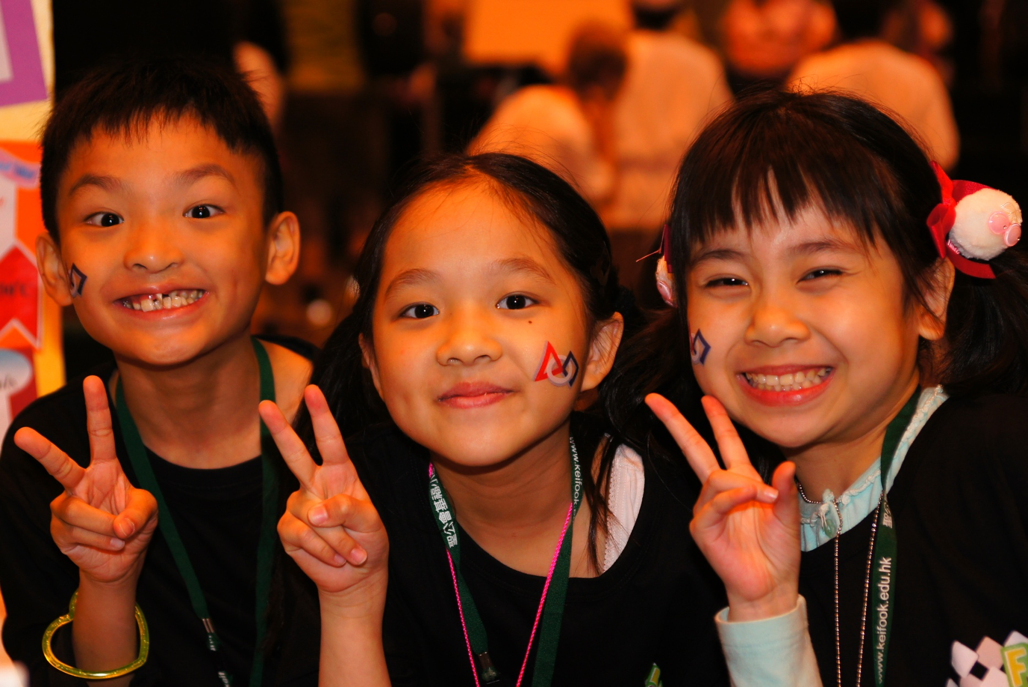
THANK YOU for supporting Jr.FLL!!!!

